Slide 1
Costs, Benefits and Alternatives
Getting the most out of the new RMA Section 32 requirements

Slide 2
The old way
Consider options
Decide
Justify
Propose
Defend

Slide 3
A better way
Develop options
Evaluate
Decide
Collaborate
Implement

Slide 4
32 1 (a)
Examine the extent to which the objectives of the proposal being evaluated are the most appropriate way to achieve the purpose of this Act
I.E. is this sustainable management in terms of the 4 well-beings?

Slide 5
32 1 (b) – alternatives
examine whether the provisions in the proposal are the most appropriate way to achieve the objectives by—
(i) identifying other reasonably practicable options for achieving the objectives; and
(ii) assessing the efficiency and effectiveness of the provisions in achieving the objectives; and
(iii) summarising the reasons for deciding on the provisions

Slide 6
32 2 – benefits and costs
(a) identify and assess the benefits and costs of the environmental, economic, social, and cultural effects that are anticipated from the implementation of the provisions, including the opportunities for—
(i) economic growth that are anticipated to be provided or reduced; and
(ii) employment that are anticipated to be provided or reduced; and
(b) if practicable, quantify the benefits and costs referred to in paragraph (a);

Slide 7
Theoretically, this can still be done after the fact – but why would you?

Slide 8
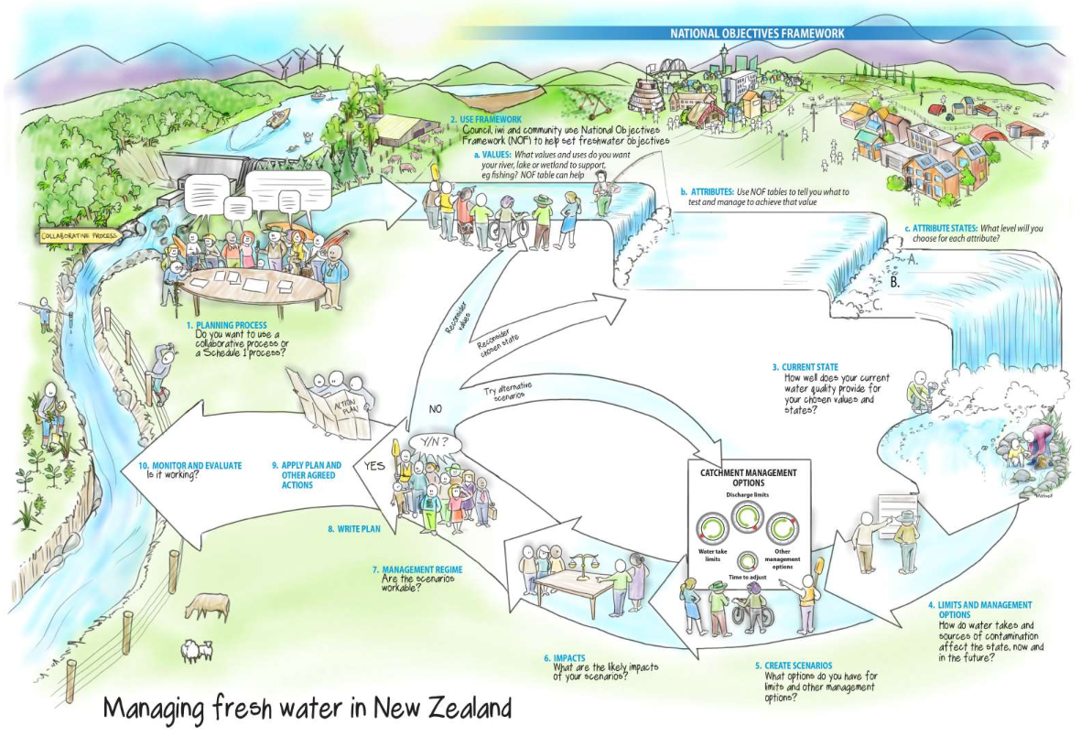
S32 is about understanding impacts BEFORE making decisions

Slide 9
Understanding impacts
Section 32 can be
A pointless compliance exercise to justify what has already been decided
A powerful process that gives decision-makers confidence that they are taking the right path

Slide 10
A bad example
Proposed NPS on biodiversity…
…an assumption isn’t really analysis, especially when you ignore long-term impacts of policy change!

Slide 11
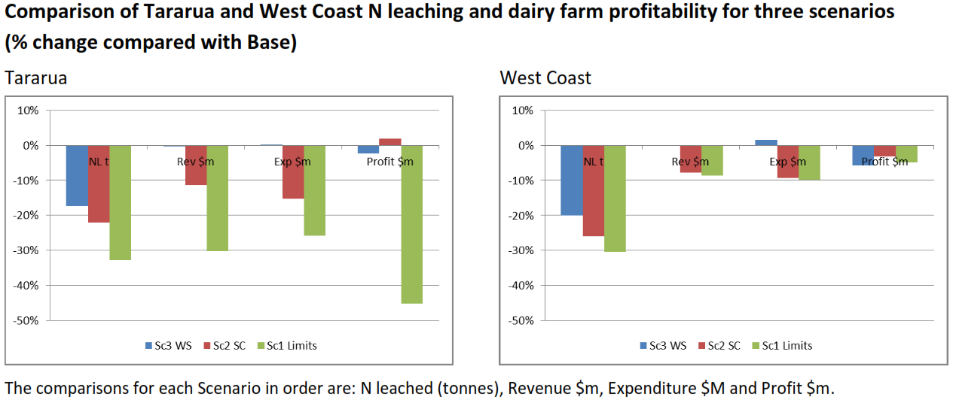
A better example
Profit is more easily maintained than revenue/GDP/employment
Farm heterogeneity impacts are BIG.

Slide 12
Impact of the One Plan report
There are three possible ways the One Plan could have been implemented
If we tested only some farms, we would have missed the impact of heterogeneity (use the LUC limits and hope for the best)
If we only looked at farm profit, we would have missed the regional impacts of reduced production and revenue (farm system change)
The more complete analysis means achieving 17% N reductions with negligible community impact (within-system change)

Slide 13
No one solution
There is no single method for a section 32 analysis – it’s about committing to a robust process for transparent decision-making
STAG have identified principles, options and objectives
The next step is to understand the relative impacts of the options before making final recommendations

Slide 14
What questions does STAG need answered to feel confident about its recommendations?

