Slide 1

Presentation to
Stag
10 April 2014

Slide 2
Background to Grow Rotorua, CCO model
Projects of Interest
  Land Use Change Options
  Geothermal Direct Heat
  Activated Carbon
  Freshwater CoE
  Tuhono Matauranga
Discussion

Slide 3
Background to Grow Rotorua

Slide 4
Funded by RDC
Three year mandate, operational Jan 2013
CCO governed by an independent board
2 staff, 7 board members (John Green Chair, Jane Nees, Warren Parker, Gina Rangi, Hemi Rolleston, Tony Marks, Michael Barnett)
Support wider Bay of Connections program
Four key sectors
  Forestry
  Tourism
  Geothermal
  Land Use Change

Slide 5
Year one to June 2013
  Establishment, wide screening
  Project focus
Year two to June 2014
  Delivered investment cases (incl. demonstration sites)
  Investment and business attraction
Year three to June 2015
  Investments facilitated
  On-going structures and processes

Slide 6
Six key deliverables:
Develop logically robust investment value propositions
Communicate and promote new propositions to the investment community
Facilitate private sector investment
Identify and propose solutions for the barriers to creating investment wealth
Understand and promote to the local education sector the capability and skills required
To identify ways to assist Te Arawa investment in the region

Slide 7
Current “Top 10” Projects:
1. Spa/wellness 6. Geothermal Direct Heat
2. Biking 7. EWP/Prefab^{n}/Panelisation
3. Golf course 8. Freshwater CoE
4. Activated Carbon 9. Business Attraction
5. Land Use Change 10. International Education

Slide 8
Projects of Interest:
Land Use Change Options

Slide 9
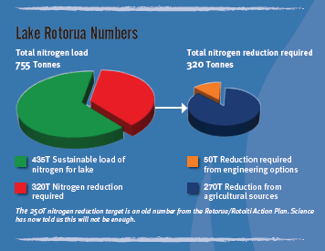
Need to remove 270T of N from Lake Rotorua by 2032
Grow Rotorua encouraging land use change options

Slide 10
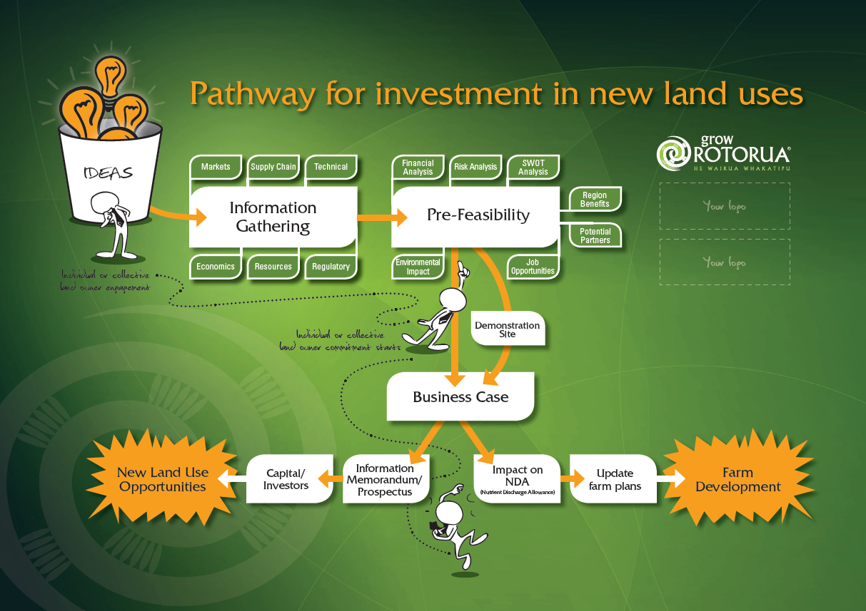

Slide 11
Manuka
  Return to landowners dependent on:
    Yield per hive (kg)
    Hives per hectare
    Quality => Price
  Range from $230 to $1500 / ha
  Need to establish demonstration sites in the District

Slide 12
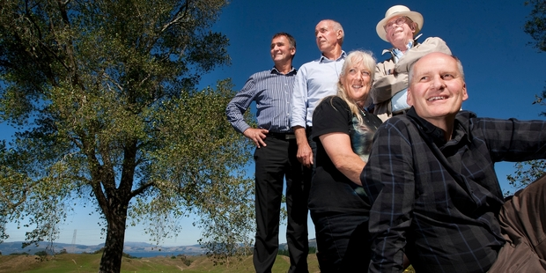
Trialling manuka plantations are, from left, Francis Pauwels (Grow Rotorua), John Burke (Comvita), Judy Pudney (landowner) Hugh Riddiford (eLandnz Ltd) and Mark Smith (Grow Rotorua). Photo/Ben Fraser
A ground-breaking trial could give landowners in the Lake Rotorua catchment a new and profitable way to meet proposed nutrient limits.
Grow Rotorua has helped broker a deal between Rotorua farmers Mark and Judy Pudney and global natural health products company Comvita for them to be part of a nationwide trial for manuka plantations.

Slide 13
Closed-loop Dairy
  Economics look compelling:
    Milk solids /cow typically 450 kgs/annum
    Closed-loop dairy from 650 min to >1000 kgs/annum
  But…
    Cut and carry operation
      Dry matter production on farm - critical
    Requires further capital
  Need to establish a demonstration site in the District

Slide 14
Other Ag/Hort
  Twenty-one potential crops and land use options were reviewed based on soil, climate etc.
  Very cursory analysis
  Those warranting further investigation:
    Kiwifruit – intensive closed system
    Blueberries
    Hops
    Ginseng (understorey crop)
    Dairy goats
    Milking sheep

Slide 15
Next Steps
Grow Rotorua looking at funding options for business case development
MPI may have case studies of alternate ag/hort options worth investigating
NZTE may be required to assist in finding overseas market partners if no local supply chain partner e.g. Comvita for Manuka

Slide 16
Projects of Interest:
Geothermal Direct Heat

Slide 17
Recently held very successful Geothermal Direct Heat Workshop in Rotorua (120 pax, 60% iwi)
BoC sponsored along with MBIE and EECA
  Presentations on BoC website
Electricity demand predicted flat for 5 - 10 years
  No geothermal power stations in medium term
Strong interest by landowners in lower T, shallower resources
Need to develop business cases for land owners, users and investors

Slide 20
Next Steps
Grow Rotorua looking at funding options for business case development with MBIE / EECA
MPI may have case studies for hort/floriculture options under glasshouse worth investigating
NZTE may be required to assist in finding overseas market partners if no local supply chain partner e.g. Comvita for Manuka

Slide 21
Projects of Interest:
Activated Carbon

Slide 22
Eco Technology has developed a low-cost process to produce activated carbon from woody material
RACE JV investment group established to carry out due diligence (DD) on the business opportunity
  Includes three local iwi groups
  Grow Rotorua managing the DD process
Sample testing in the US has supported the claims that product surface area is exceptionally high for this type of technology
Economics now being validated

Slide 23
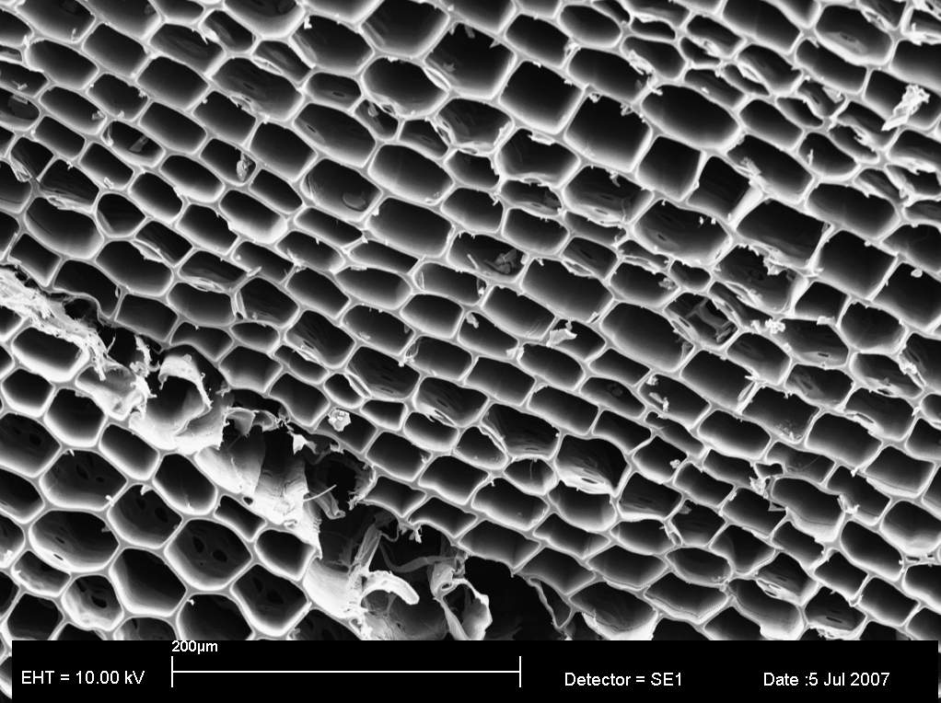
Electron Microscope picture of pore structure seen in Activated Carbon

Slide 24
Next Steps
Opportunity to use AC as a soil remediation agent to “lock up” N and P discharges
MPI has been approached by Eco Technology to further investigate this opportunity
NZTE may be required to assist in finding overseas market partners and potential investors for a manufacturing plant in Rotorua

Slide 25
Projects of Interest:
Freshwater CoE

Slide 26
Leverage learnings from 10+ years of work on lakes restoration in Rotorua District ($235m total)
Multiple parties involved:
  Grow Rotorua
  RDC
  University of Waikato
  Waiariki Institute of Technology
  Te Arawa Lakes Trust
  Bay of Plenty Regional Council
  Scion

Slide 27
Envisage 3 business units / models
  Research, post graduate, education
  Technical, engineering development (BoPRC, RDC)
  IP and Consultancy commercialisation
Options for ownership, investment and governance
Opportunity to leverage location (Lakefront, CBD, Scion, Waiariki ?)

Slide 28
Projects of Interest:
Tuhono Matauranga

Slide 29
Tuhono Matauranga (Joining the dots)
Several agencies working in the same space with the same objectives:
  Sustainable, viable alternative land uses
  Nutrient reduction
  Maintain / grow economic contribution
  Maintain / grow underlying asset value
  Underutilised / underperforming lands
  Job creation
TAPS, TTP, TPK, GRL, Scion, Tarit, TAGH, Comvita, Poutama, TMoTuhoe, several Trusts.

Slide 30
Thank You
francispauwels@growrotorua.com
027 544 9054

