Slide 1


University of Waikato
3rd Year Research Projects 2013
CHEM361
Jasmine Robinson, Jamie Peryer-Fursdon, Jordan Grant, Hamish Hodgson, Holly Bredin-Grey, Wade Norton, Adam Hartland, David Hamilton
Resolving vertical gradients in redox zonation in seasonally-stratified, eutrophic lakes: implications for water quality

Slide 2
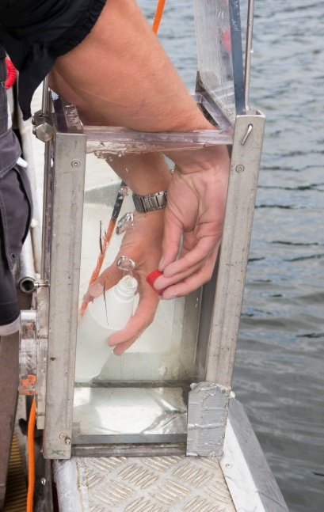
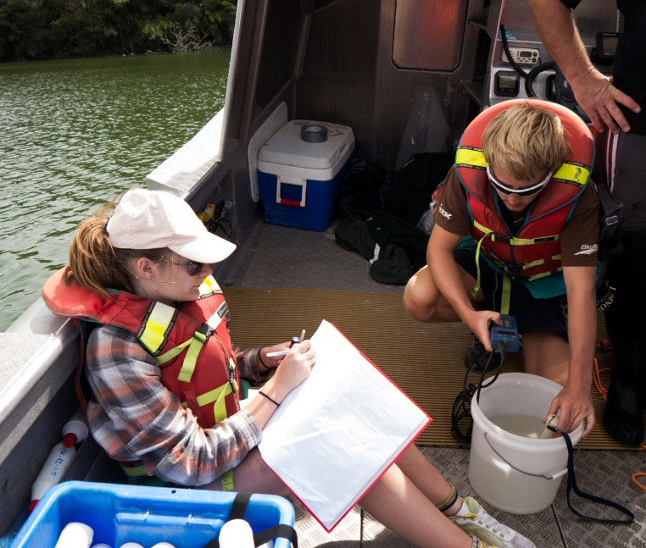

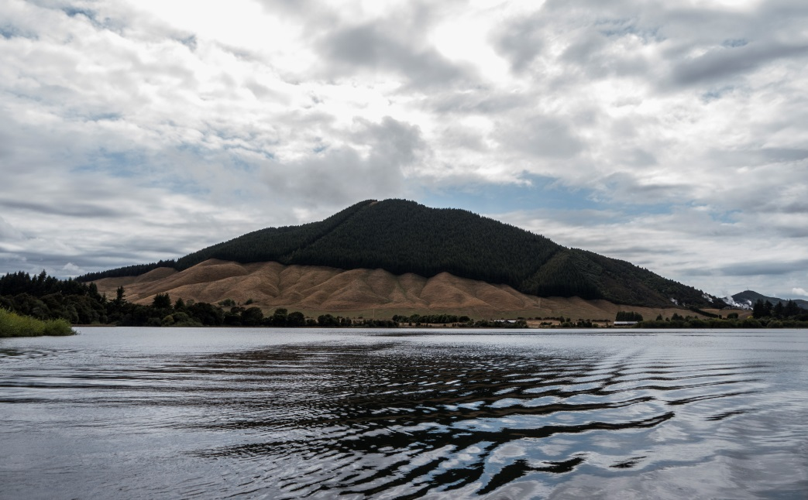
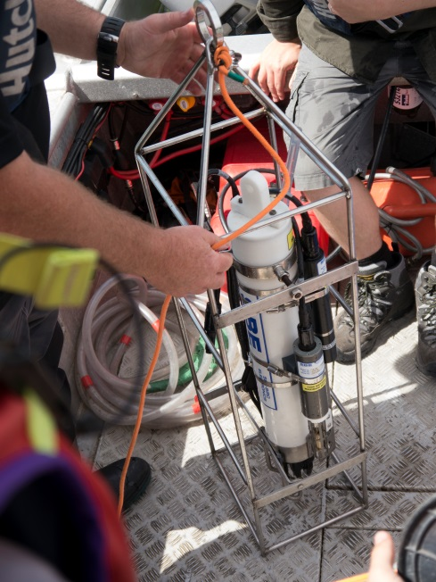

Fieldwork – Lakes Okaro and Ngapouri
(4-6th March 2013)
Photos courtesy of Pierre Oesterle

Slide 3
Following fieldwork the students analysed the chemical composition of their samples:
pH
Bicarbonate alkalinity
Major ions
Trace elements
The students addressed three research questions in pairs:
What are the implications of seasonal stratification for trace element toxicity? (Jasmine and Holly)
Can we account for changes in water chemistry through inverse geochemical modelling? (Wade and Jordan)
How effective is Alum dosing in Lake Okaro? (Hamish and Jamie)

Slide 4
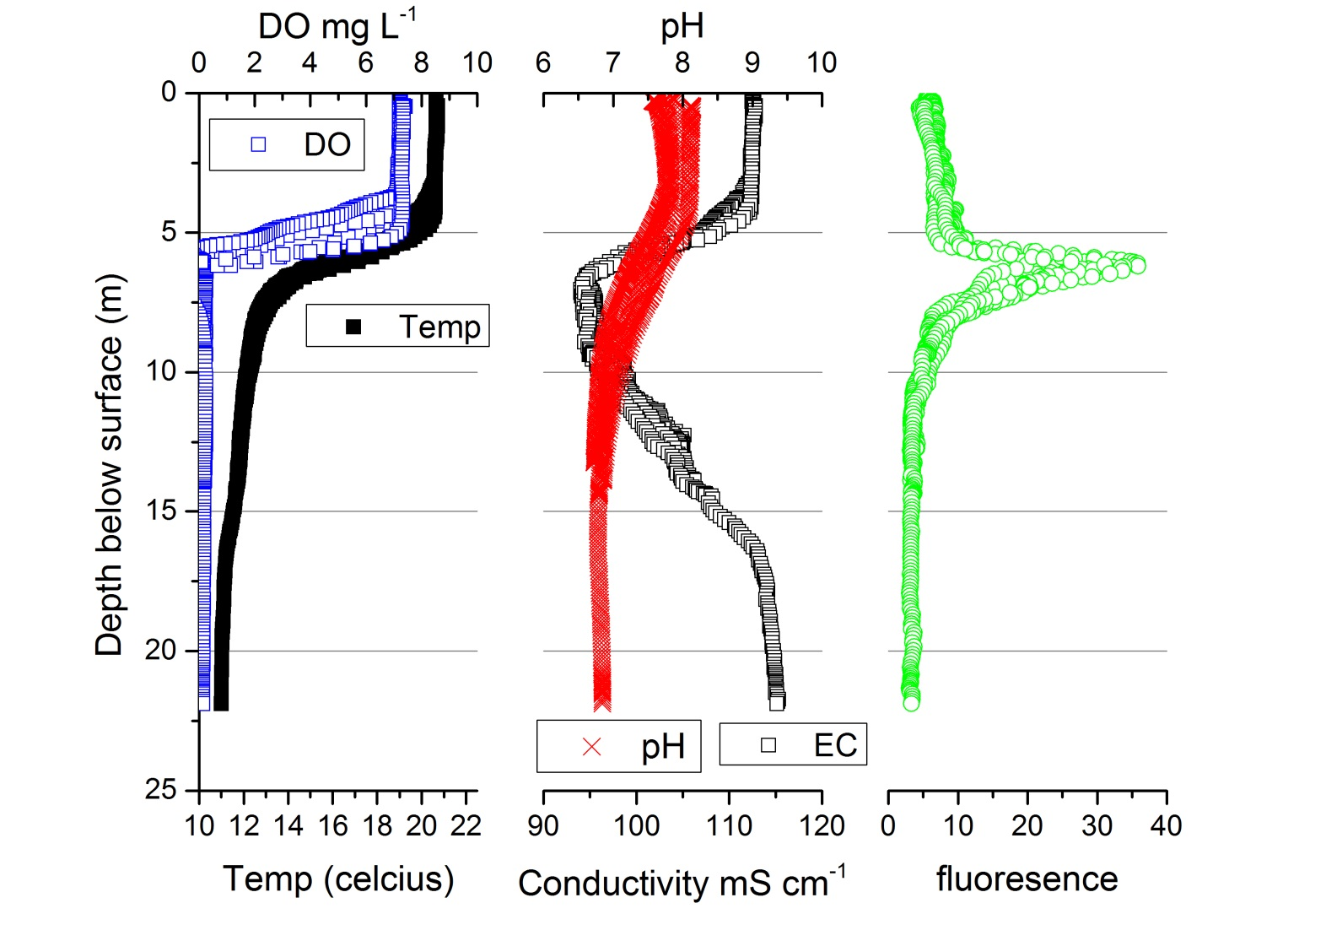
What are the implications of seasonal stratification for trace element toxicity?
Jasmine and Holly focused on Lake Ngapouri because this lake was most strongly stratified.

Slide 5
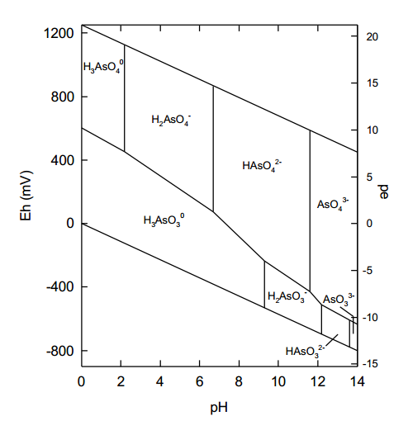
Redox coupling between Fe, Mn and As drives changes in the distribution of toxic species within the lake
Increase in toxic As(3) in bottom waters

Slide 6
Solubility of mineral phases (as colloidal/particulate oxides) has huge bearing on the speciation of PO₄-P and AsO₄-As.
This is driven by changes in redox potential
However, the pH is absolutely central to the ability of oxides (including Alum) to scavenge and bind these oxyanions
Lake Okaro surface pH of 9.7!

Slide 7
pH in surface waters of Lake Okaro
pH

Slide 8
Jamie and Hamish investigated the effect of pH and oxides on the speciation and bioavailability of PO₄-P and AsO₄-As in Okaro surface waters
This is the result of modelling of P and As binding to gibbsite (Al oxide) using the concentrations of As and P at 6 m depth in Okaro.
The actual masses of As and P adsorbed to the oxide are very similar.
This is the result of modelling of P and As binding to gibbsite (Al oxide) plus Fe and Mn oxides using the concentrations of Fe, Mn, As and P at 6 m depth in Okaro.
This implies that nearly all the P is scavenged by Fe and Mn oxides.

Slide 9
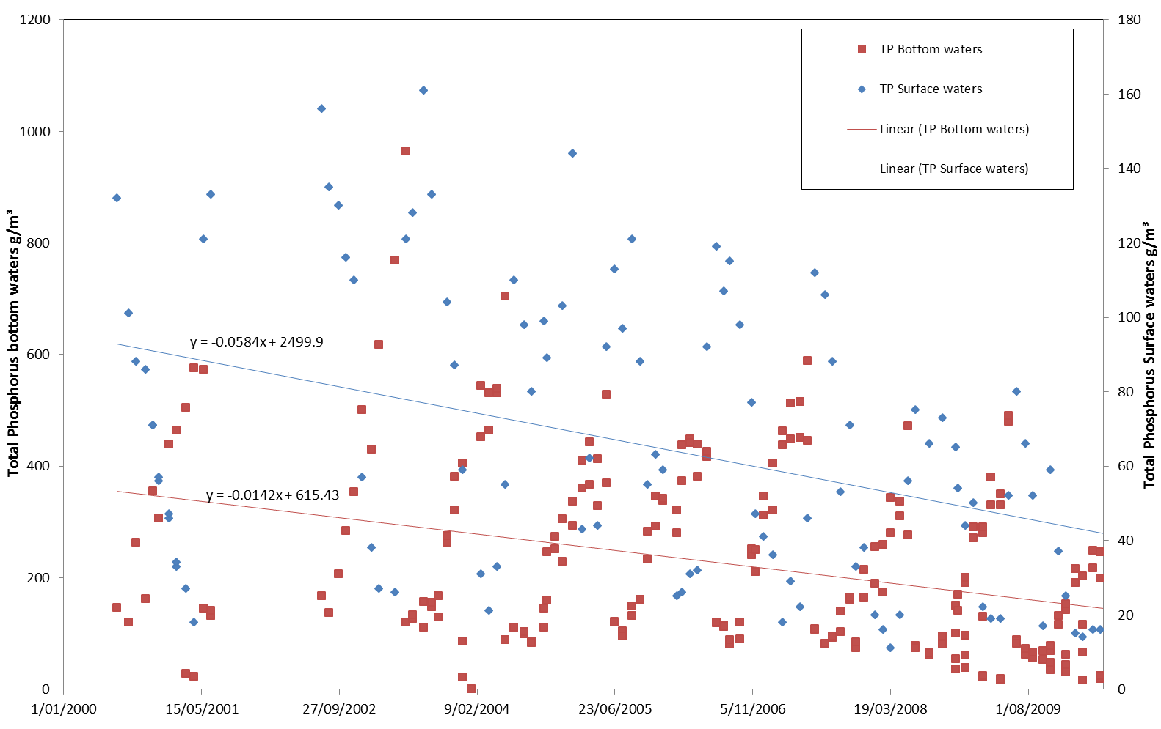
These results imply that amendments of Lake Okaro with Aluminium-based surfactants won’t be particularly effective at adsorbing PO₄ directly, but may induce coagulation of P already adsorbed to other oxide surfaces.
But, overall the combined management practices at Okaro are having a positive long-term effect on the availability of P

