Slide 1
Phosphorus transport to Lake Rotorua
Jonathan Abell
University of Waikato
Rotorua Te Arawa Lakes Research Presentations
24th June 2013

Slide 2
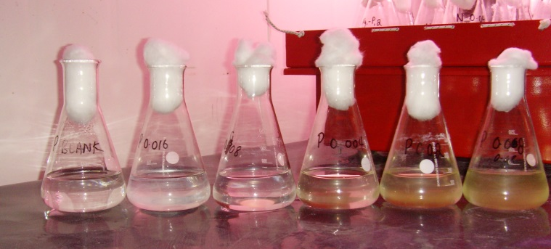
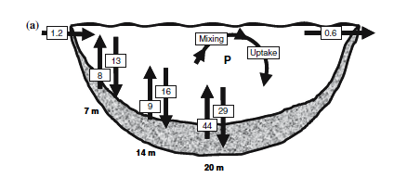
Phosphorus and Lake Rotorua
Both phosphorus and nitrogen are limiting nutrients in Lake Rotorua
Phosphorus is recycled internally
“only a severe reduction in the external load may ‘break’ the depositional cycle”
Burger et al. 2007
In–lake phosphorus concentrations are lower compared to a decade ago

Slide 3
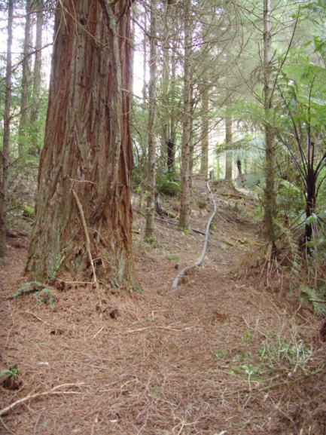
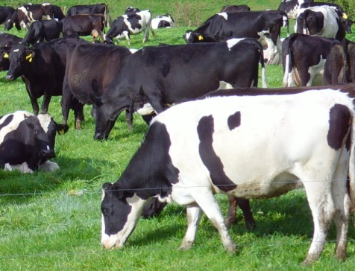
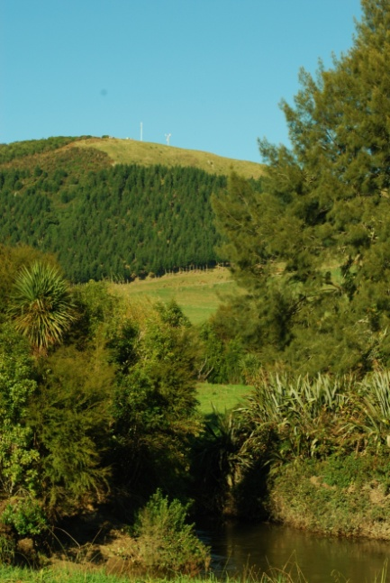
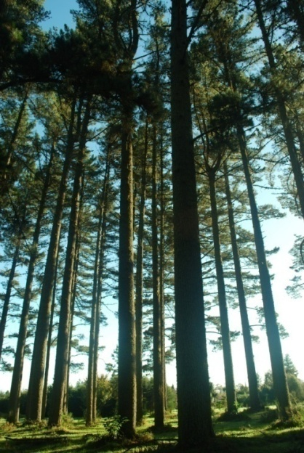
Quantifying storm loads

Slide 4
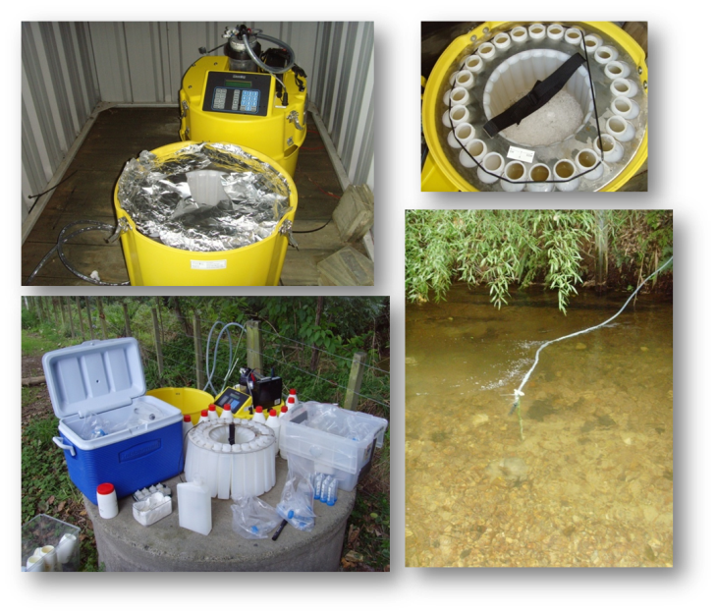
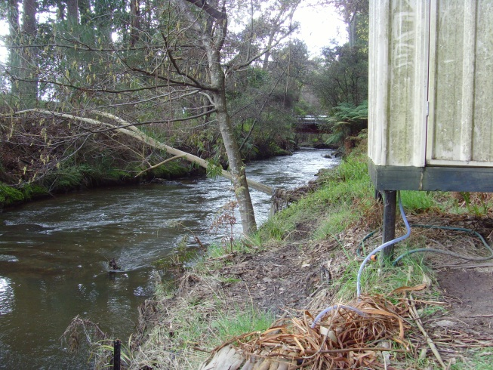
Quantifying storm loads

Slide 5
Quantifying storm loads
Rainstorms deliver big pulses of sediment–bound phosphorus to the lake

Slide 6
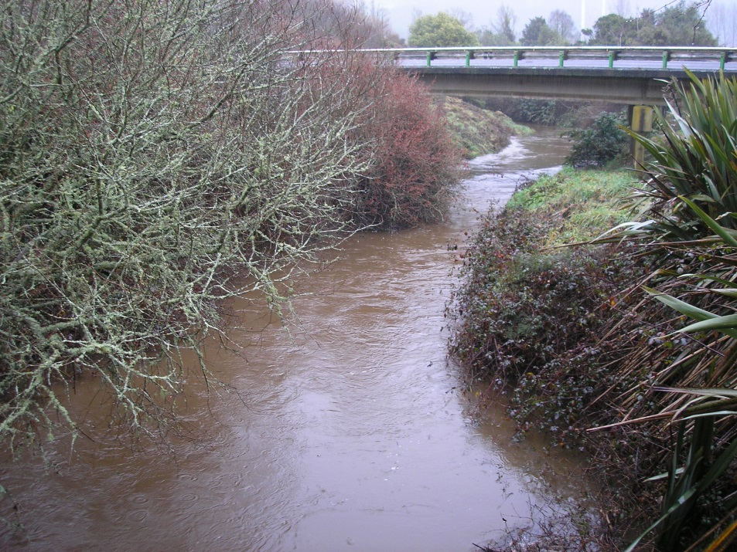
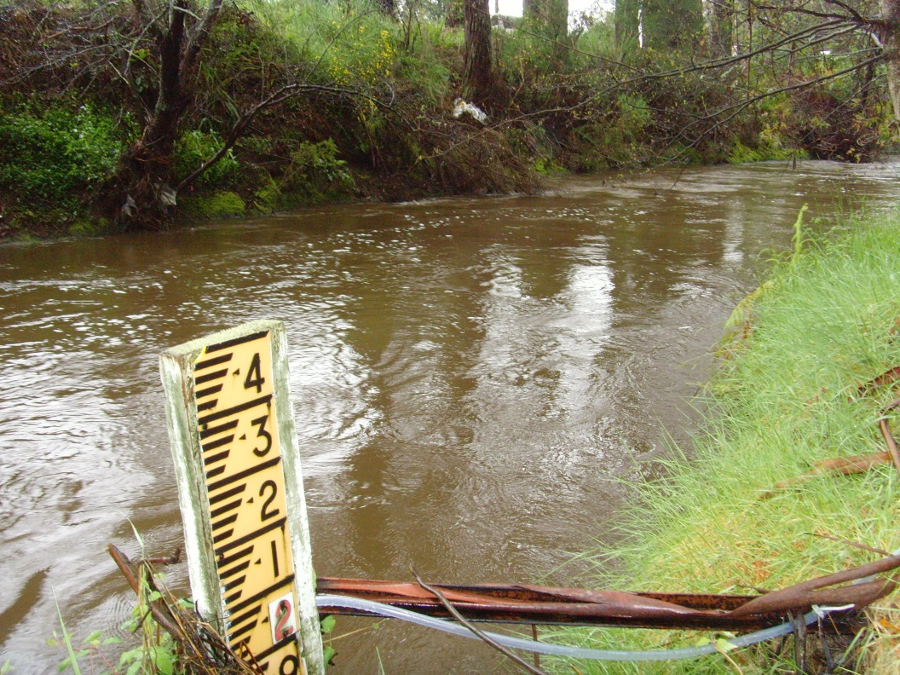
Quantifying storm loads
Proportion of cumulative load | Cumulative time (%)
 | Ngongotahā Stream |  | Puarenga Stream
 | Nitrogen | Phosphorus | Nitrogen | Phosphorus
50% | 28% | 10% | 28% | 17%

Slide 7
How can reduce phosphorus loss from the land and ‘future proof’ our landscapes?

Slide 8
Studying in–lake processes during rain events

Slide 9
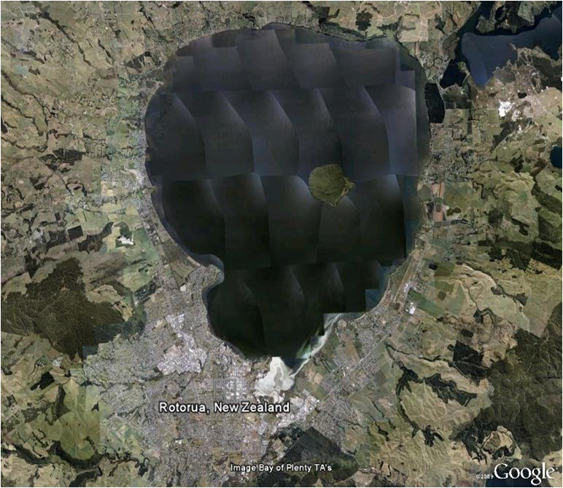
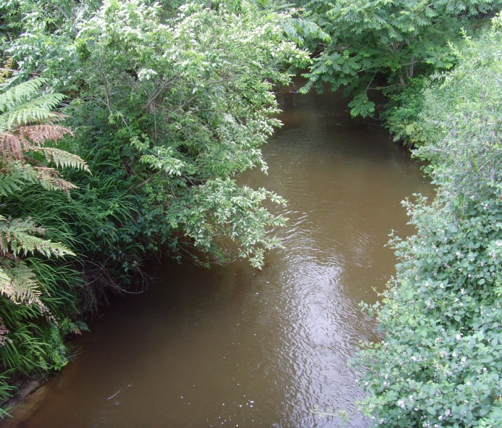
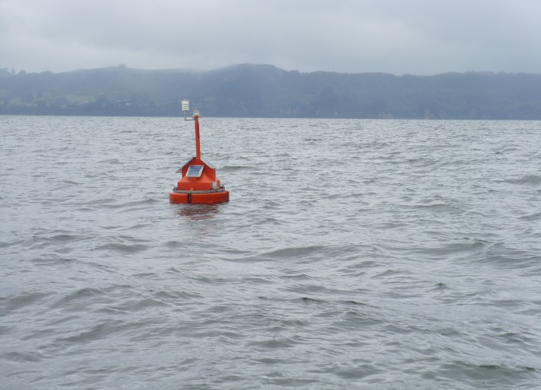
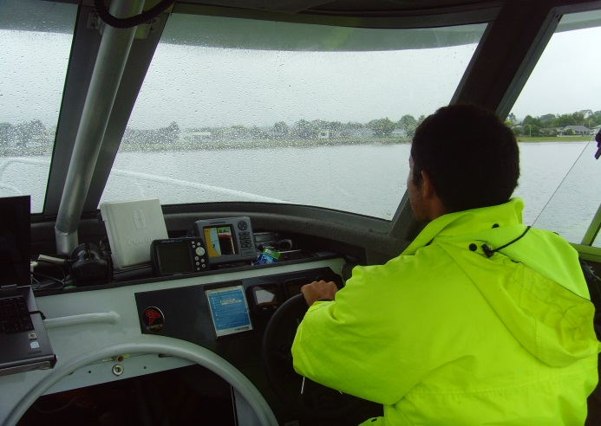
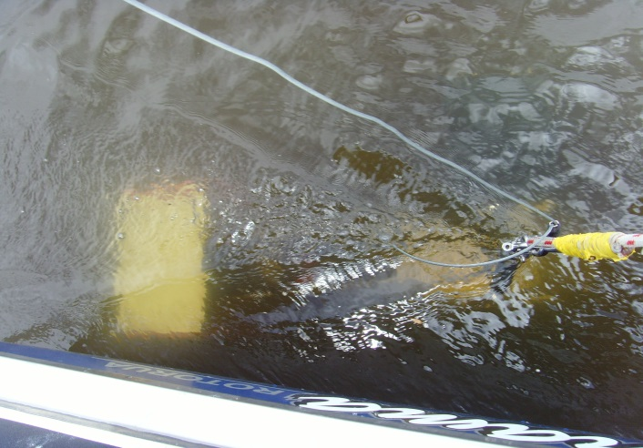
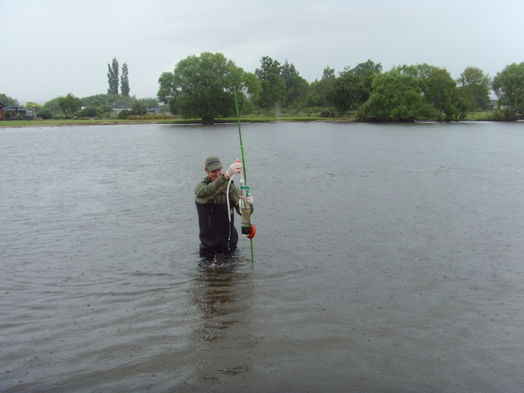
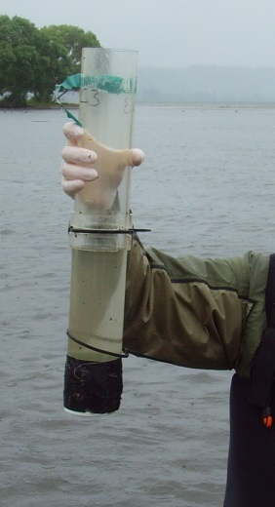
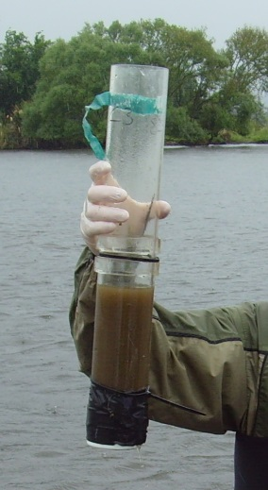
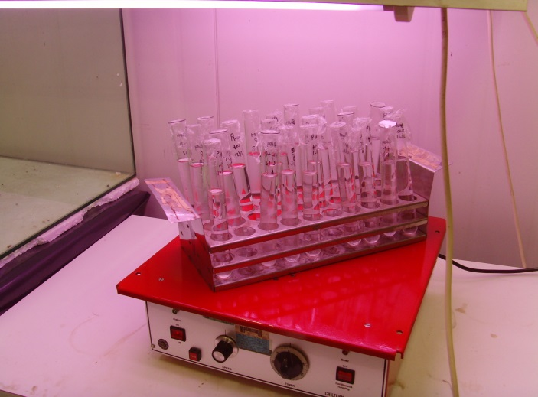
A combined field and modelling study to examine in–lake processes around the Ngongotahā Stream inflow during a summer rainstorm

Slide 10
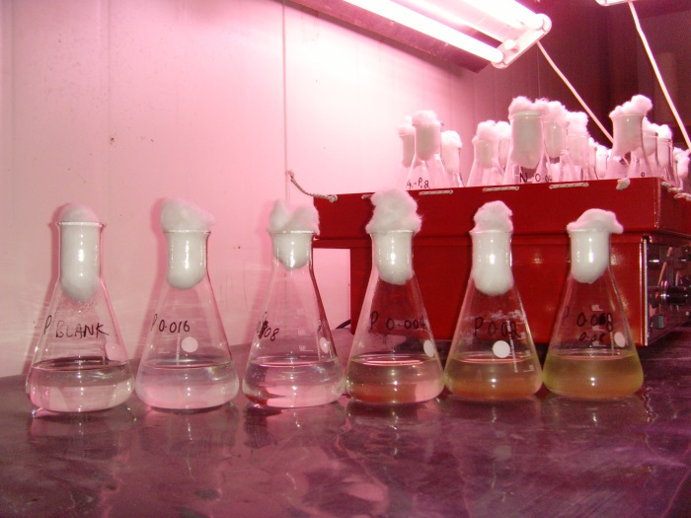
Some results...
Phytoplankton nutrient limitation status varied in time and space
Wind caused the lake to mix
The path of the stream was deflected southwards by in–lake currents
There was very pronounced localised patchiness in phytoplankton biomass after heavy rain

Slide 11
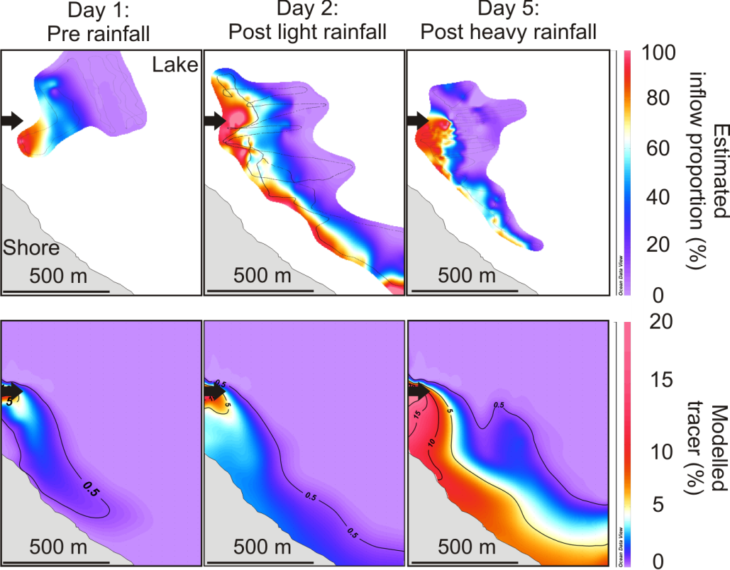
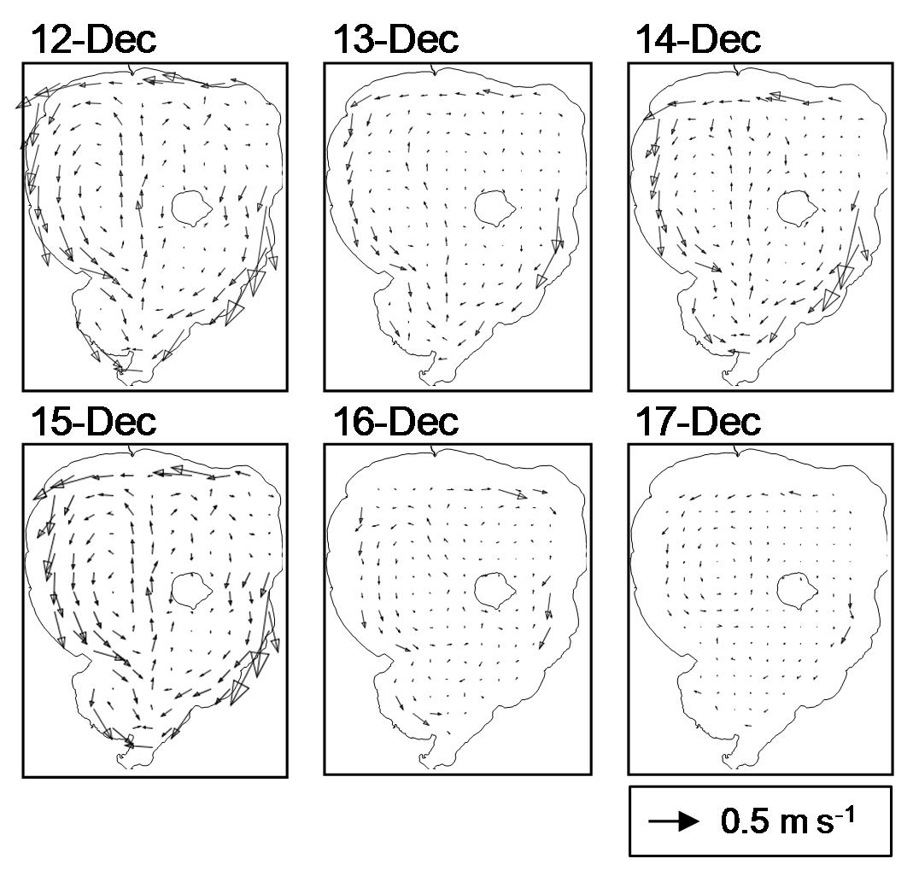
3-D modelling provided a tool which helped to interpret field data and gain broader understanding
z
x
y

Slide 12
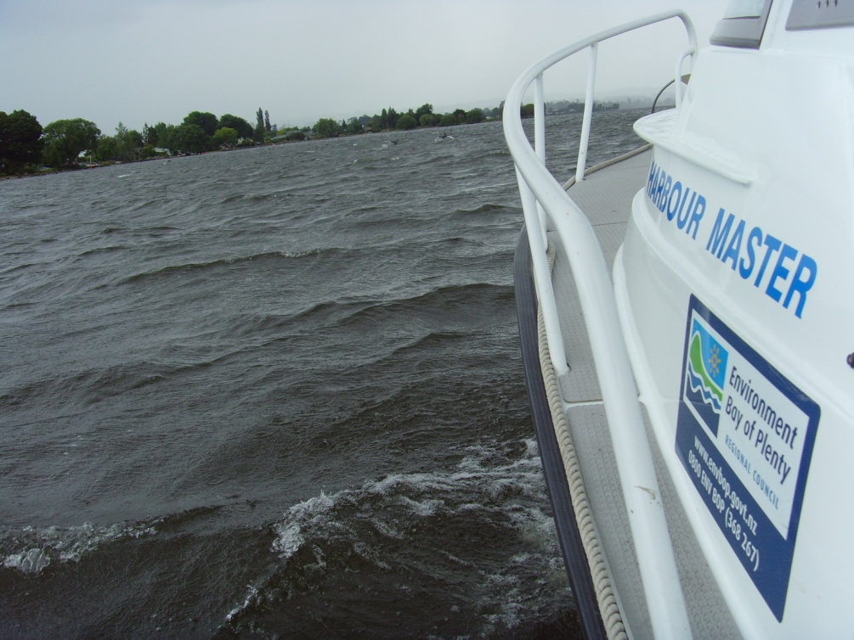
Acknowledgements
Supervisors: David Hamilton & Kit Rutherford
Technical support: Joe Butterworth and Chris McBride
Monitoring data: Craig Putt (BoPRC), Stan Lodge (NIWA), Paul Scholes (BoPRC) and Alison Lowe (RDC)
Modelling: Deniz Özkundakci, Mat Allan, Liancong Luo, Hannah Jones and Kohji Muraoka
Samplers: Craig Hosking, Rebecca Eivers, Dean Sandwell
Site access: Agrodome NZ

