Slide 1
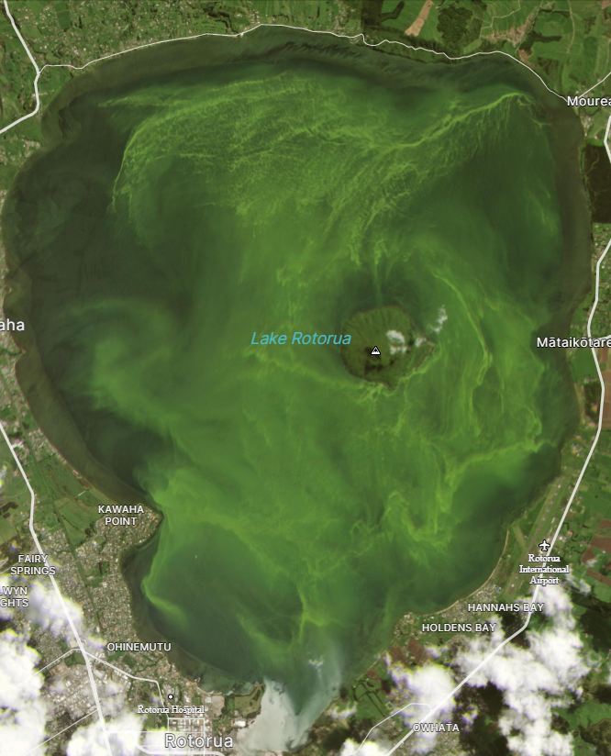
Phytoplankton Nutrient Limitation in Lake Rotorua
Satellite image of Lake Rotorua during Dolichospermum circinalis bloom, 21 October 2020.

Slide 2
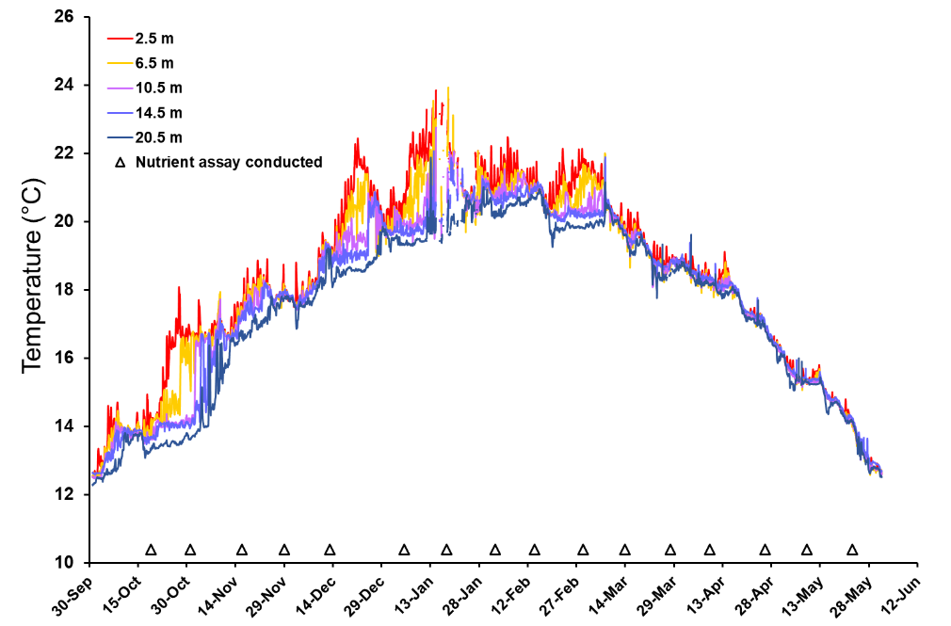
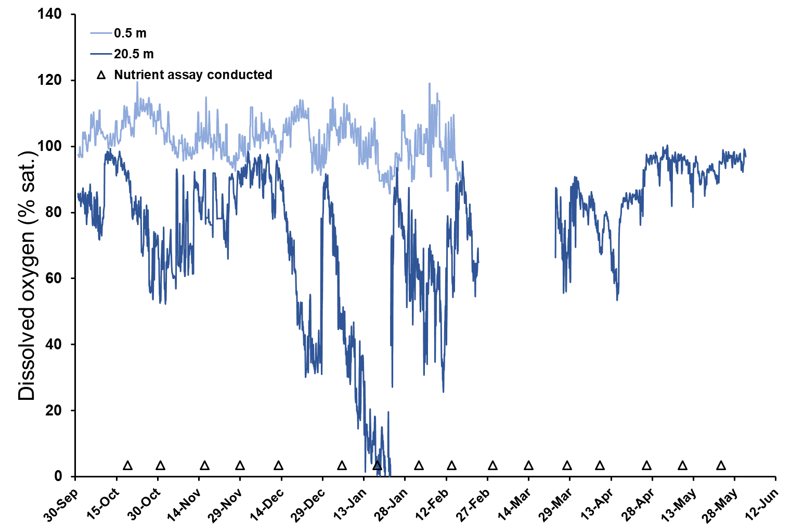
water temperature and dissolved oxygen concentrations from 1 October 2020 to 31 may 2021. Sampling dates for nutrient limitation assays are indicated by open triangles
Resumption of Puarenga alum dosing 23 November

Slide 3
Lake Rotorua nutrient concentrations, sampled from the epilimnion (2 m) and hypolimnion (15 m) from 19 October 2020 to 23 May 2021. Red dashed line indicates analytical detection limit.

Slide 4
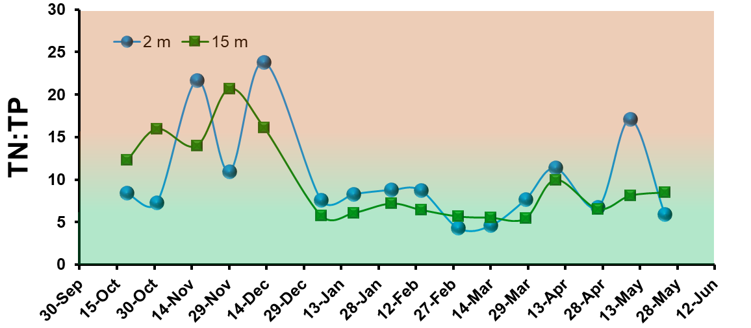
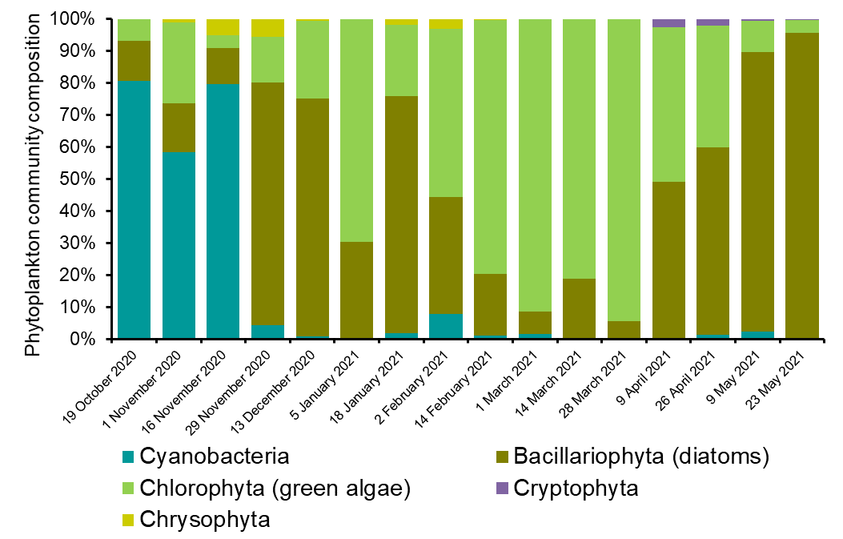
Assay date | Surface mass TN:TP | Chlorophyll a | Phytoplankton biovolume | Net biomass growth
19 October 2020 | Co-limitation | Co-limitation | P limitation | P limitation*
1 November 2020 | Co-limitation | Co-limitation | Co-limitation* | Inconclusive
16 November 2020 | P limitation | Co-limitation | Inconclusive | Inconclusive
29 November 2020 | Co-limitation | N limitation | Co-limitation | No limitation
13 December 2020 | P limitation | N limitation | N limitation* | No limitation
5 January 2021 | Co-limitation | N limitation | N limitation | N limitation
18 January 2021 | Co-limitation | N limitation | Co-limitation | N limitation
2 February 2021 | Co-limitation | N limitation | N limitation | N limitation
14 February 2021 | Co-limitation | N limitation | N limitation | N limitation
1 March 2021 | N limitation | N limitation | N limitation | N limitation
14 March 2021 | N limitation | N limitation | N limitation | Inconclusive
28 March 2021 | Co-limitation | N limitation | N limitation | N limitation
9 April 2021 | Co-limitation | P limitation | P limitation | P limitation*
26 April 2021 | N limitation | N limitation | Co-limitation | Co-limitation*
9 May 2021 | P limitation | Co-limitation* | Co-limitation | Co-limitation*
23 May 2021 | N limitation | Inconclusive | Inconclusive | P limitation*
Resumption of Puarenga alum dosing 23 November
Increase in Al from 55 kg/day to 155 kg Al/day
*Indicates nutrient limitation was indicated but the difference was not statistically significant
Lake Rotorua is primarily N limited/colimited
Little evidence for sustained P limitation during late spring → autumn
Increase in alum dosing was coincidental to collapse of the Dolichospermum bloom.
Stochastic events can have a significant influence on lake ecology.
Factors other than nutrient limitation play a significant roll in determining phytoplankton community composition.

Slide 5
Rotorua daily rainfall (mm day⁻¹) from 1 October 2020 to 31 May 2021. Sampling dates for nutrient limitation assays are indicated by open triangles.

Slide 6
Conclusions
Lake Rotorua is primarily N limited/colimited
Little evidence for sustained P limitation during late spring → autumn
Increase in alum dosing was coincidental to collapse of the Dolichospermum bloom.
Stochastic events can influence lake ecology.
Factors other than nutrient limitation play a significant roll in determining phytoplankton community composition.

Slide 7
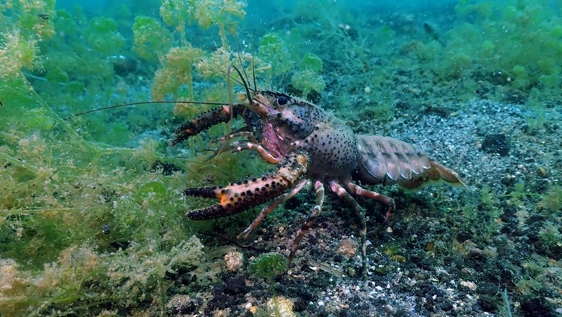
Toxicological effects of aluminium in relation to diel pH changes on fish and kōura
Emily Fensham, Nick Ling and Grant Tempero

Slide 8
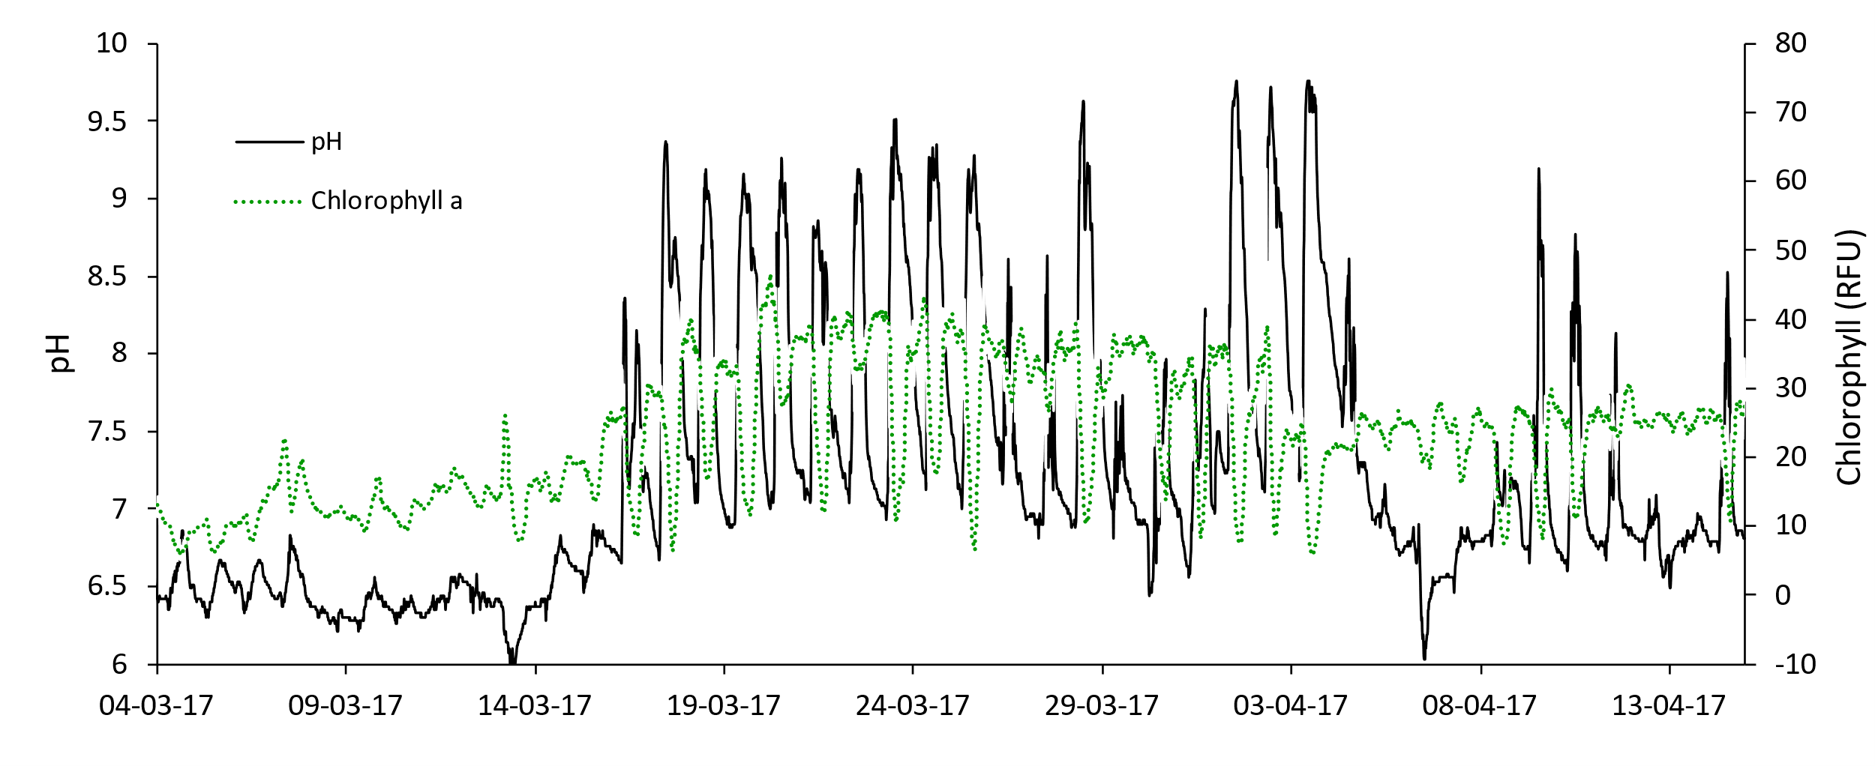
Diel pH cycling in Lake Rotorua during algal blooms
Changes in surface water pH correlating with fluctuations in chlorophyll-a in Lake Rotorua over a 3-week period in March 2017

Slide 9
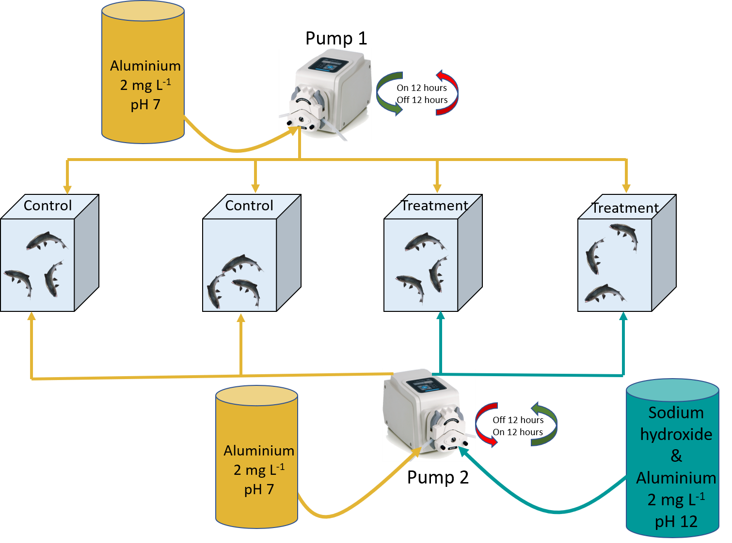
Osmolarity impacts on rainbow trout and kōura
24 rainbow trout (12 control, 12 treatment. Repeated with kōura.
Two experimental runs with each species
2 days acclimation at 2 mg Al/L.
10 days exposure to 2 mg Al/L + 24 hour pH cycling 7-10-7.
Constant temperature 18°C
Stylised experimental design for determining potential osmotic and haematological disruption from alum derived aluminium at 2 mg Al L⁻¹ under diel pH cycling.

Slide 10
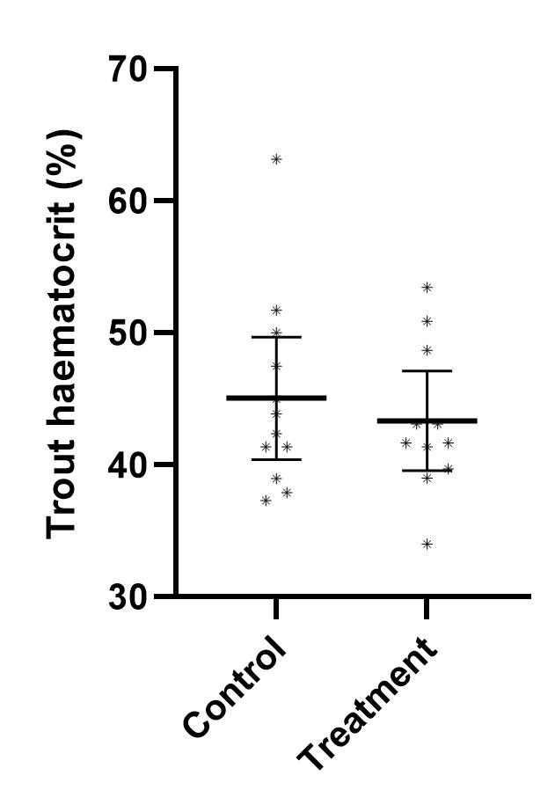
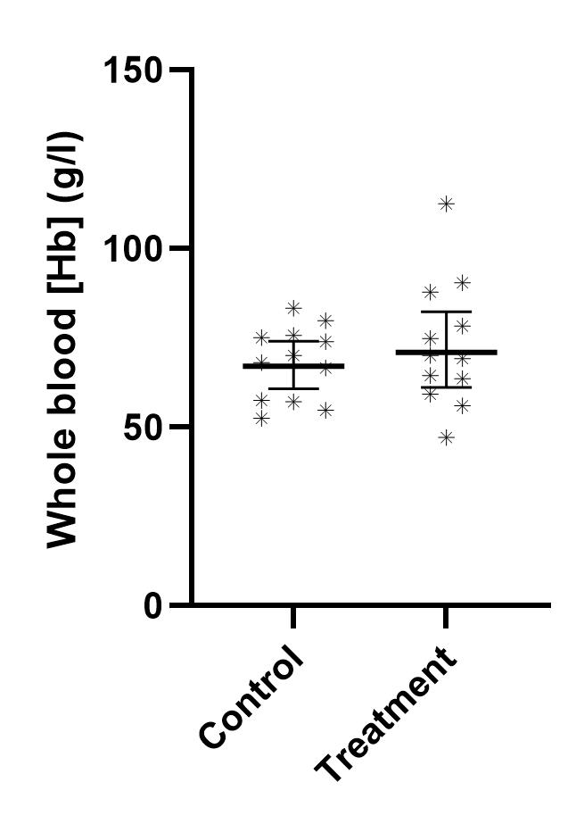
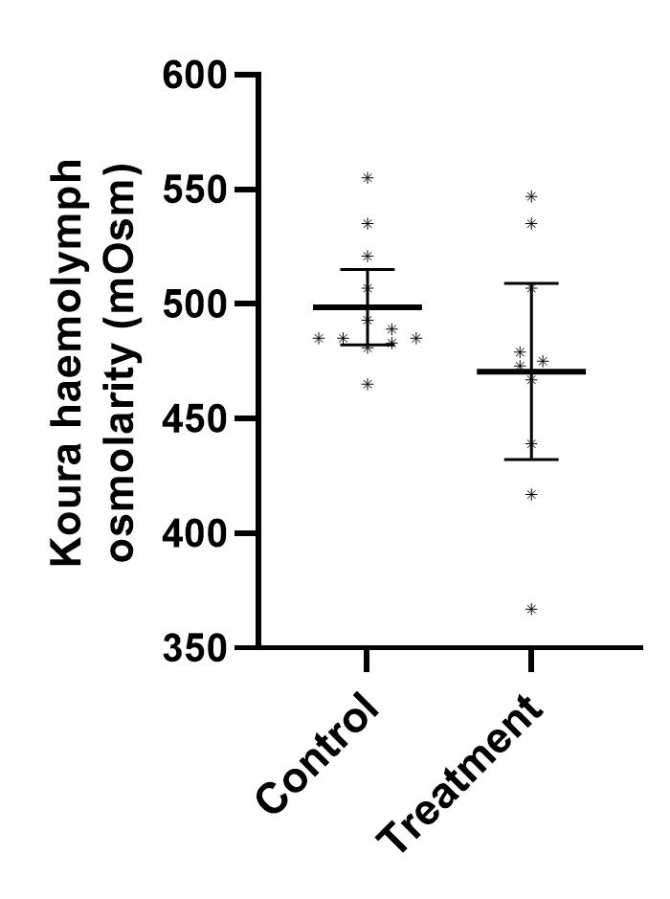
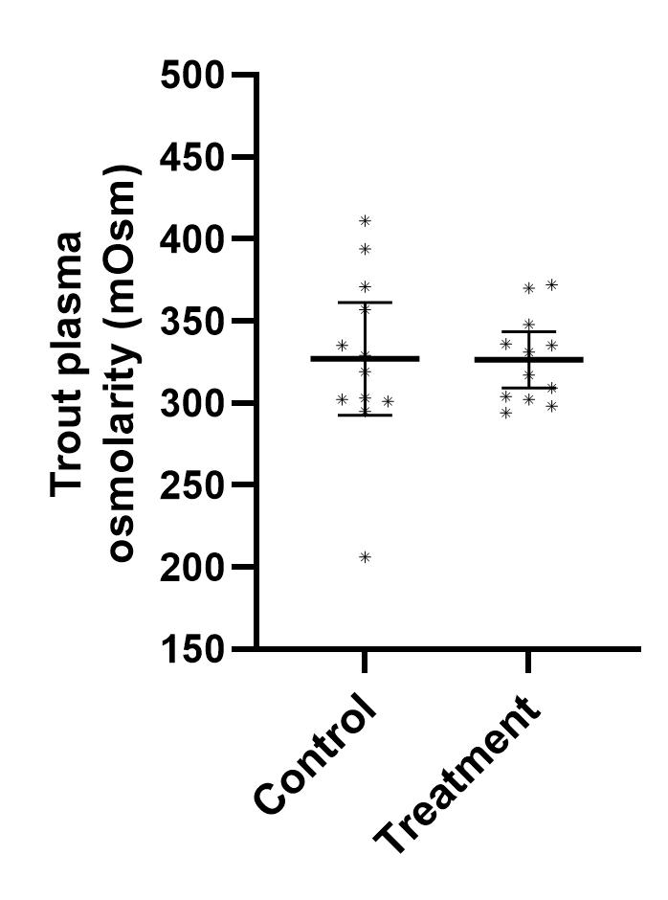
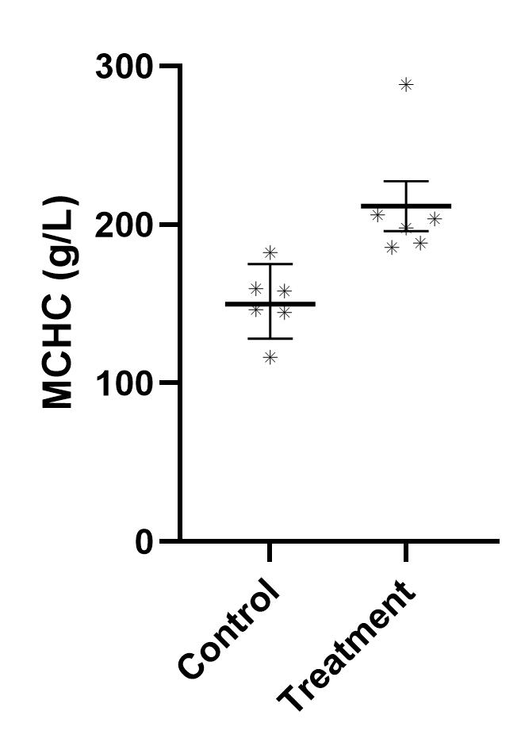
No effect on osmoregulation in trout and kōura
No difference in trout plasma osmolarity
No difference in trout haematocrit (Percentage of blood cells to plasma)
No difference in trout total haemoglobin concentration
Significant difference in trout Mean Cell Haemoglobin Content (likely due to a generalised stress response)
No difference in kōura haemolymph osmolarity

Slide 11
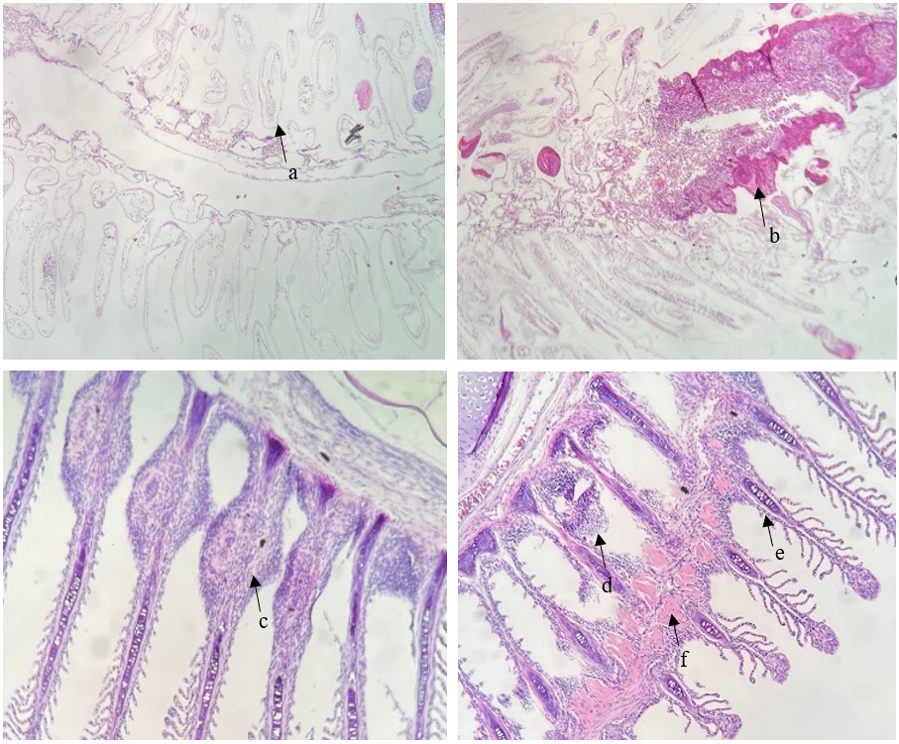
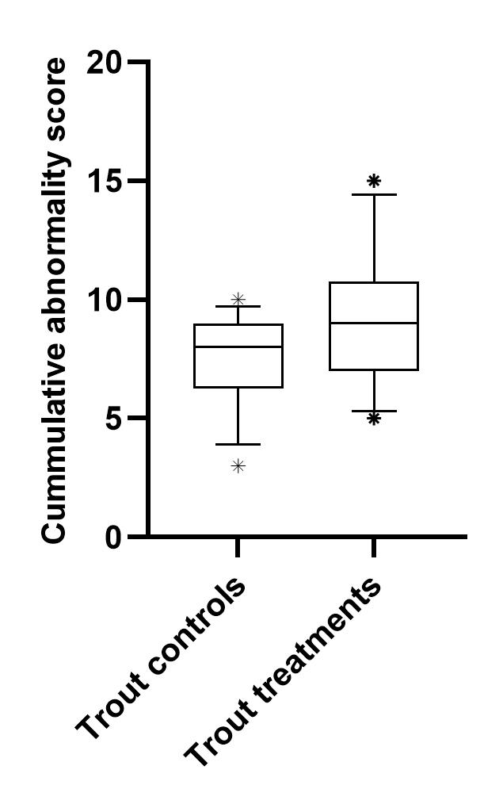
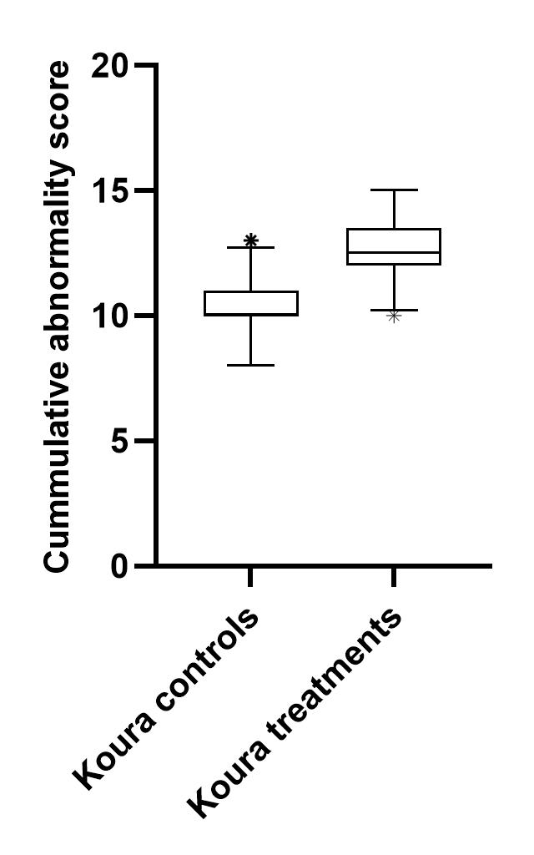
Gill histology results
No difference between trout groups
Significant difference between kōura groups
Histological gill sections of treatment kōura (top) and rainbow trout (bottom) individuals showing epithelial lifting from the cuticle, lamellae swelling, lamellae disorganisation (a), and a cellular anomaly (b) in kōura gills and hyperplasia (c), RBC proliferation (d), epithelial lifting (e), and a cellular anomaly (f) in rainbow trout gills.

Slide 12
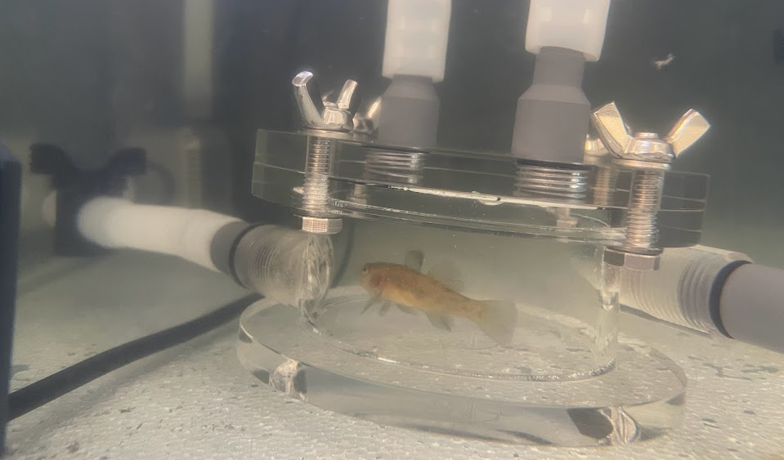
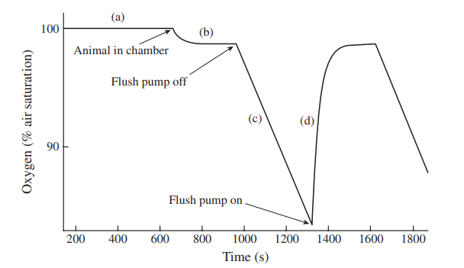
Respiratory impacts on rainbow trout, common bully and kōura
12 hours acclimation at 2 mg Al/L.
48 hours exposure to 2 mg Al/L + 24 hour pH cycling 7-10-7
A graphical depiction of a typical intermittent flow respirometry chart, modelling the rate of fish oxygen consumption from 100% air saturation over time (s). Oxygen levels should be similar to air saturation before animal is placed into the chamber (a) and will reach a new equilibrium after the animal is introduced (b). The period where the flush pump is turned off will see a linear decline in oxygen (c) and the slope of this line is used to calculate mass specific oxygen consumption (mg O₂ g⁻¹ h⁻¹). Before the onset of hypoxia (<80%) the flush pump is switched on and clean water increases oxygen levels back up to equilibrium in a linear fashion (d) (Claireaux & Chabot, 2016).

Slide 13
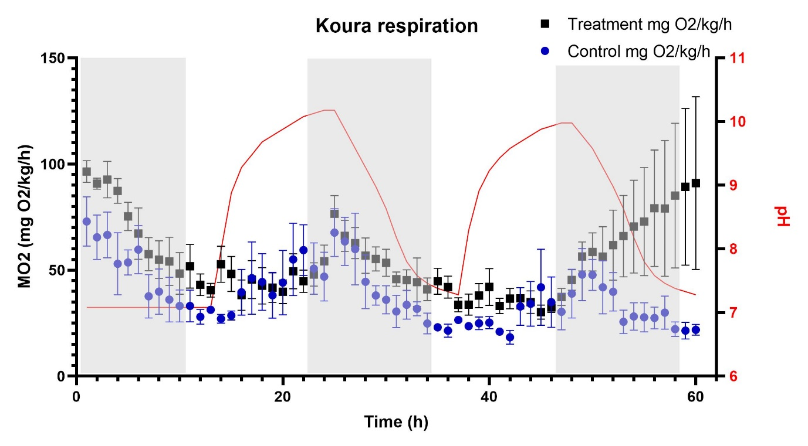
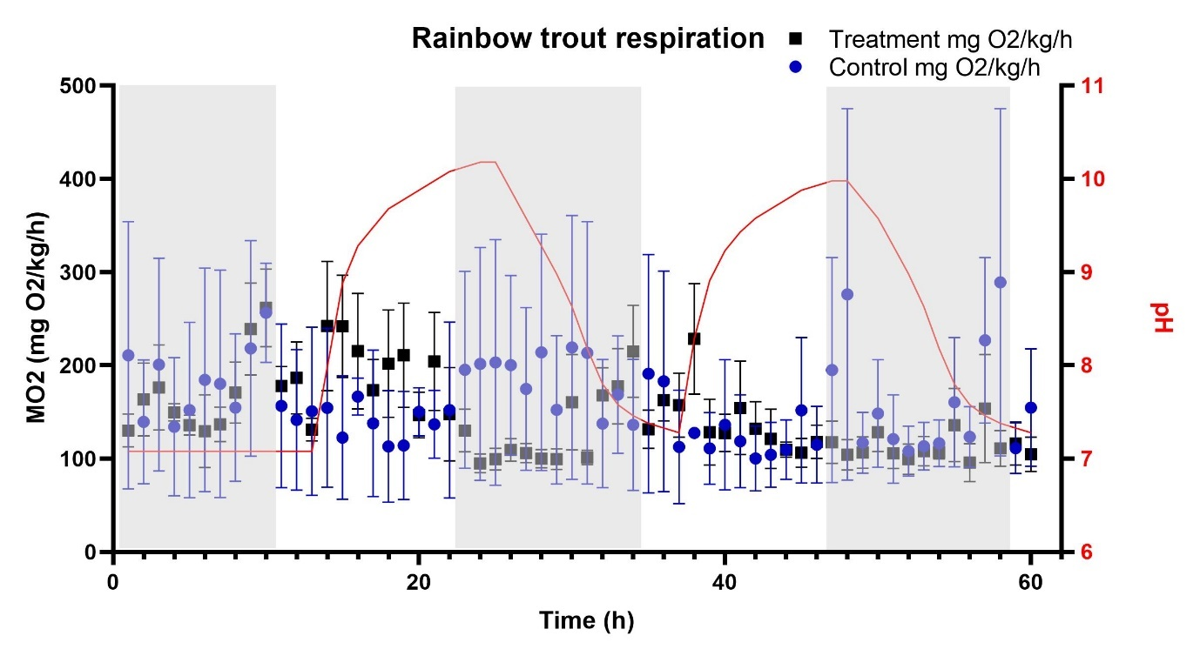
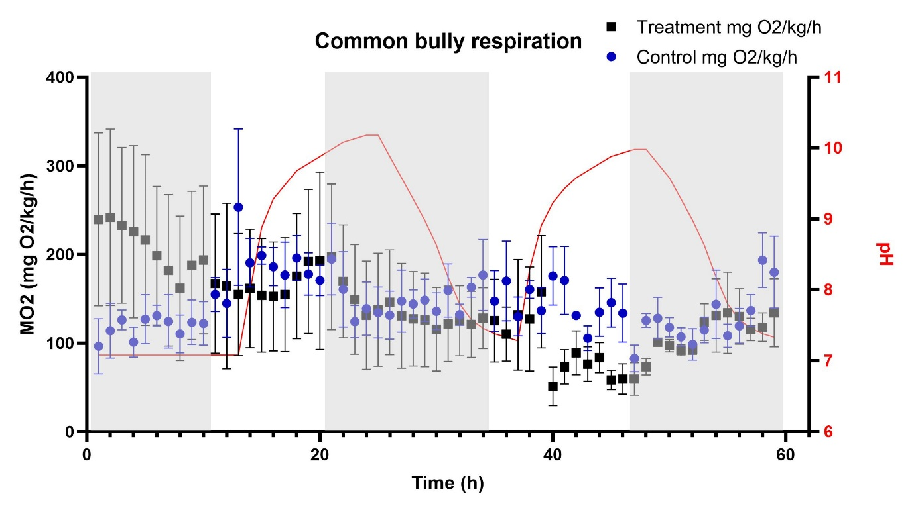
No effect on respiration in trout, kōura and common bully

Slide 14
Comparative total aluminium 5% hazardous concentrations (HC5) for Lake Rotorua under differing pH values based on mean dissolved organic matter concentration of 2 mg L⁻¹ and mean water hardness of 14 mg L⁻¹ (as CaCO₃). Values were calculated using DeFrost et al. (2018) and updated by Defrost et al. (2020) multiple linear regression models.
Conclusions
Diel pH cycling is highly unlikely to have toxicological effects on fish and koura in Lake Rotorua given the dilution factor.
Further investigation into the susceptibility of koura to particulate aluminium is recommended.
Recently updated toxicological research from the USEPA suggests that effects from aluminium at alkaline pH are lower than previously estimated.

