Slide 1
Evolution of geology and groundwater-geothermal systems in the Ōkataina caldera groundwater catchment*
White, P. A.
Leonard, G.S.
GNS Science
* Submitted to the Journal of Volcanology and Geothermal Research, May 2022.

Slide 2
Study area

Slide 3
Okataina groundwater catchment

Slide 4
Okataina groundwater catchment: cold and hot features

Slide 5
Models developed in eight periods
Phase | Period | Major surficial geological units, and main lithology, at the ground surface in the study area | Quaternary Oxygen Isotope Stage | Age at end of Quaternary Oxygen Isotope Stage (ka) | Sea level, relative to current sea level (approximate, m)
Infill | 8 | Haroharo Subgroup rhyolites (Q1o) and Mount Tarawera Subgroup rhyolites (Q1w); Holocene sediments (Q1a) | Q1 | 0 | 0
 | 7 | Haroharo Subgroup rhyolites (Q2o, Q3o) and Mount Tarawera Subgroup rhyolites (Q2w); | Q2, Q3 | 12 | -120
Penultimate | 6 | Mangaone Subgroup pyroclastic fan and fall deposits (Q3z) | Q3 | 24 | -90
 | 5 | Rotoiti caldera with Rotoiti Formation ignimbrite (Q4zR), Earthquake Flat Formation ignimbrite (Q4zE) and lake sediments (mQk) | Q4 | 59 | -80
Matahina | 4 | Kaingaroa Formation (Q7k)* and Mamaku Plateau Formation (Q7u) ignimbrites*, dacite lava domes (mQz) including Puhipuhi Formation, and Ohakuri Formation ignimbrite (Q7o) | Q7 | 186 | -80
 | 3 | Matahina Formation ignimbrite (Q9z) | Q9 | 303 | -50
Proto-KWG | 2 | Whakamaru Group ignimbrites (Q9w) | Q9 | 303 | -50
 | 1 | Ōkataina Group rhyolite lava (pQ9) and Manawahe Formation dacite lava (Qvd) | pre-Q9 | 339 | -
 | 1 | Basement greywacke (Cretaceous and Jurassic) and Pliocene andesite (Pva; e.g., Moutoki Island)* | - | - | -

Slide 6
Greater Tarawera catchment – groundwater and surface water flows*
* GNS work for BOPRC:
White, P.A., Mourot, F., Toews, M.W., Davids, B., 2020. Catchment boundaries of lakes in the greater Lake Tarawera area. GNS Science consultancy report 2018/188 for BOPRC. 39 p.
White, P.A., Toews, M.W., Tschritter, C., Lovett, A.P., 2016a. Nitrogen discharge from the groundwater system to lakes and streams in the greater Lake Tarawera catchment. GNS Science consultancy report 2015/108 for BOPRC. 81 p.

Slide 7
Age of geothermal systems – a palaeo-chronometer?
Geothermal field | Phase | Period | Spring chloride (mg/L) |  |  | P_{m} (%) |  | Source (geology association)
 |  |  | Median | Standard deviation | n | Median | Standard deviation
Tikorangi | Infill | 7 | no data |  |  | no data |  | within Rotoiti caldera; Period 7 geological unit (Nairn, 2002)
Pink Terraces^{1,2} |  | 5-6 | 687 | 162 | 21 | 21 | 5 | within Ōkataina caldera complex
Waimangu^{1,2} | Penultimate | 5-6 | 662 | 190 | 80 | 21 | 6 | within Ōkataina caldera complex
Waiotapu³ |  | 5-6 | 559 | 369 | 55 | 17 | 11 | Lake Reporoa
Rotoiti (Centre Basin) |  | 5-6 | 500⁶ | na | na | 16 | na | Post-24k Rotoiti caldera
Tarawera (Te Rata)^{1,2} |  | 5-6 | 421 | 96 | 17 | 13 | 3 | within Ōkataina caldera complex
Waitangi^{1,4,5} |  | 5-6 | 356 | 7 | 8 | 11 | 0 | within Rotoiti caldera
Patiti² | Matahina | 3 | 230 | 23 | 3 | 7 | 1 | Matahina caldera
Haumi² |  | 3 | 156 | 22 | 2 | 5 | 1 | Matahina caldera
Waikite |  | 3 | 154 | 44 | 18 | 5 | 1 | KWG bounding fault (south; Kapenga depression)
Tarawera/Ōkataina |  | 3 | no data |  |  | no data |  | Matahina caldera
Tarawera (Te Puha) |  | 3 | no data |  |  | no data |  | Matahina caldera
Mangakotukutuku⁴ | Proto-KWG | 1-2 | 120 | 48 | 3 | 4 | 1 | KWG bounding fault (north)
Waiaute⁴ |  | 1-2 | 33 | 22 | 6 | 1 | 1 | KWG bounding fault (south)
Rotoma |  | 1 | no data |  |  | no data |  | Period 1 geological units
Tarawera River (unnamed) |  | 1 | no data |  |  | no data |  | Proto-Tarawera River

Slide 8
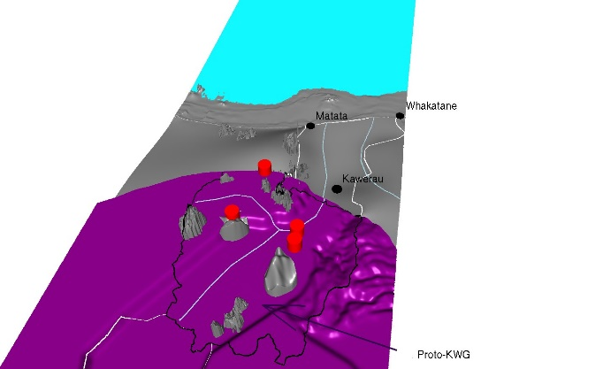
3D models: period 1 and period 2: Kapenga-Whakatane Graben

Slide 9
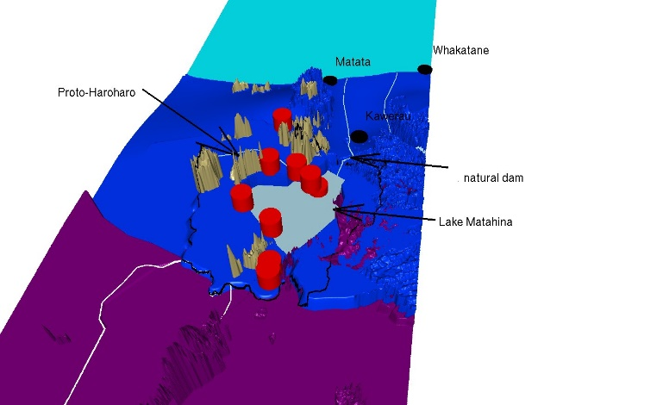
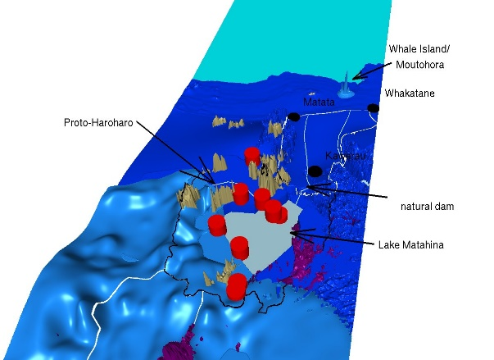
3D models: period 3 and period 4: Lake Matahina

Slide 10
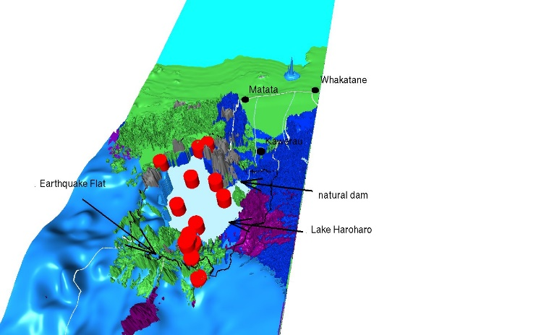
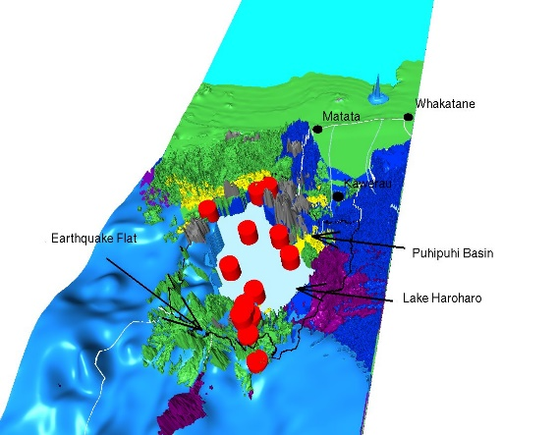
3D models: period 5 and period 6: Lake Haroharo

Slide 11
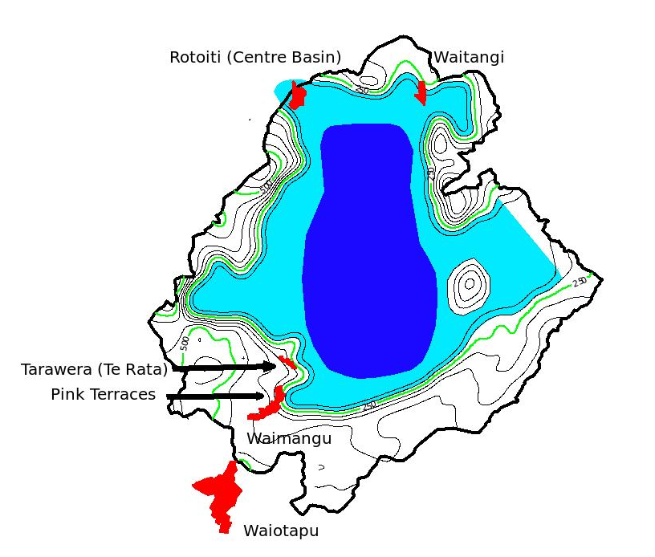
Period 5 – Lake Haroharo, groundwater and geothermal systems: most probably associated with lake shores

Slide 12
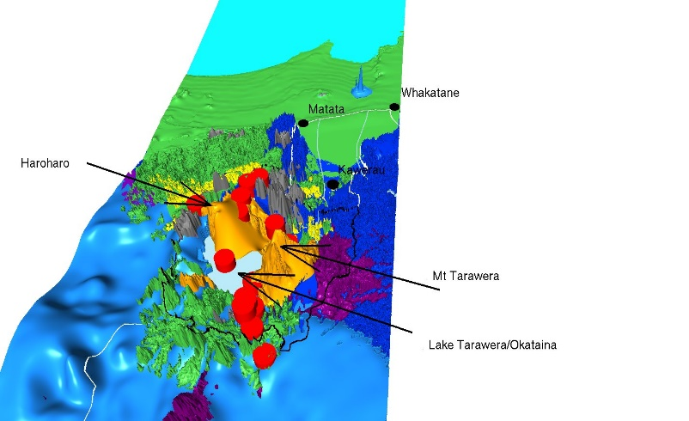
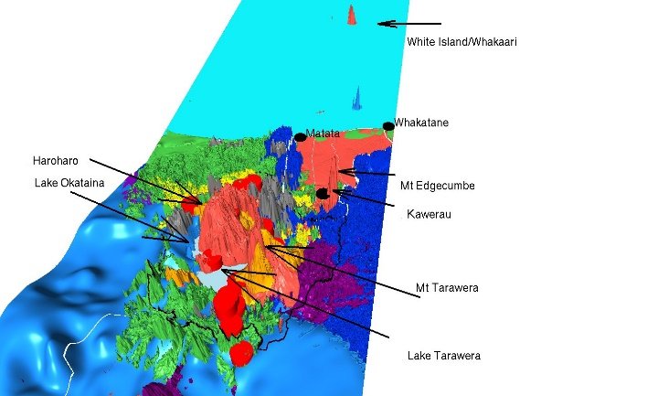
3D models: period 7 and period 8: Haroharo and Tarawera infill

Slide 13
Thanks

