Slide 1

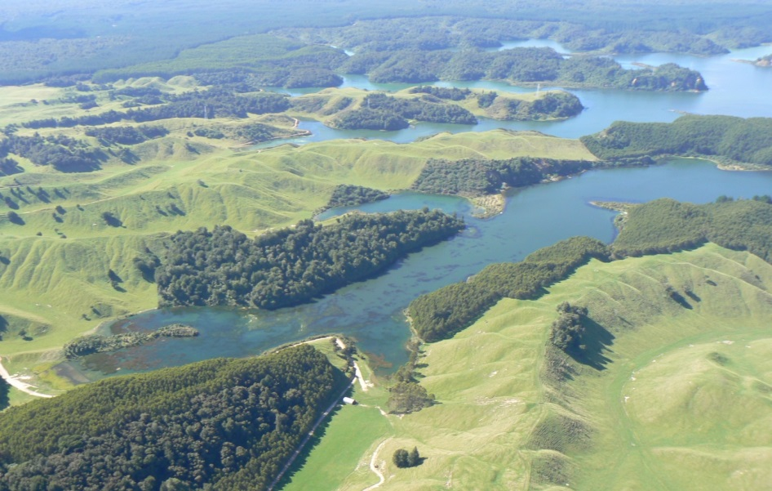
Lake Rotoehu
Water Quality Summary

Slide 2
Lake Rotoehu
Characteristics
Lake size: | 790 ha
Catchment area: | 4940 ha
Elevation: | 295 m
Average depth: | 8 m
Deepest point: | 13 m
Volume: | 61,001,000 m³
Formed: | 8500 years ago
No surface outlet but drains via northwards groundwater flow to springs

Slide 3
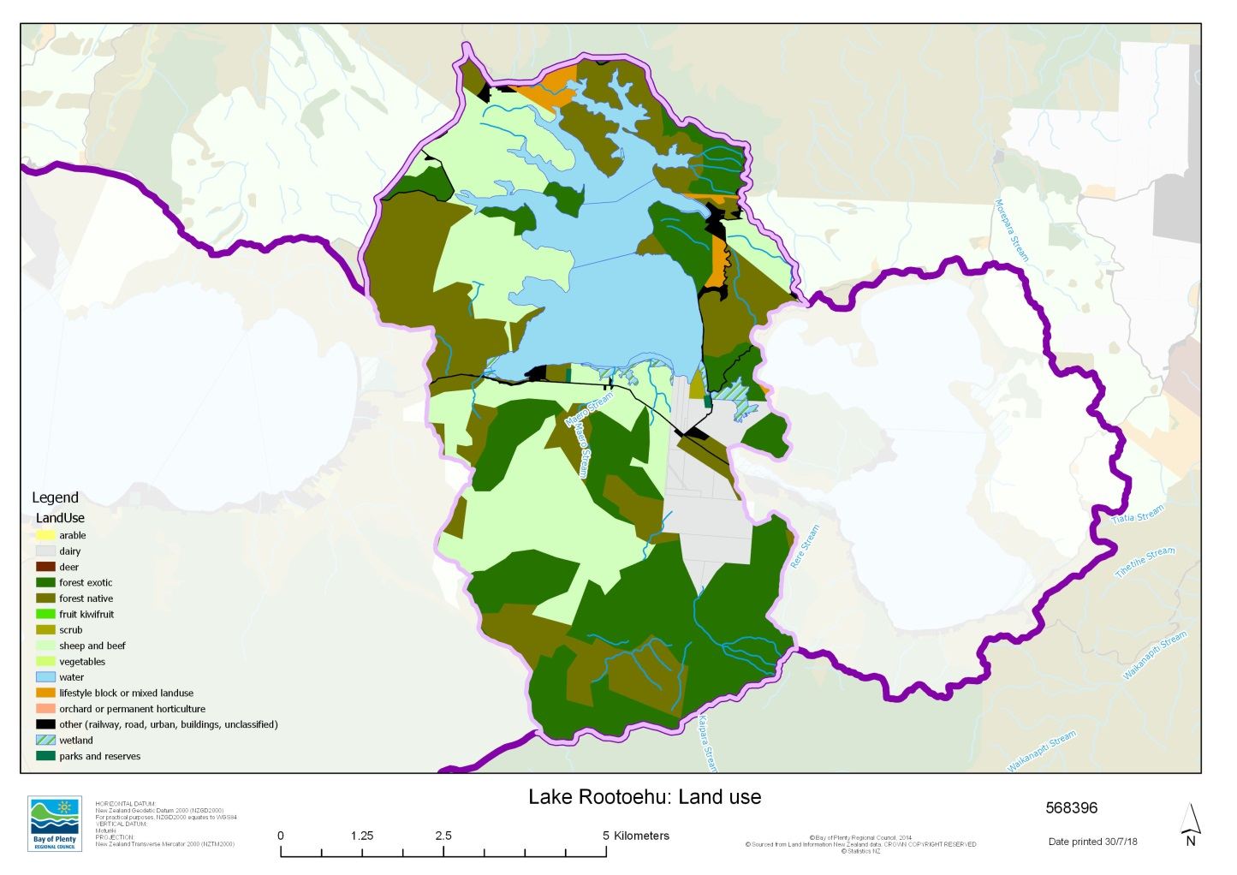
Lake Catchment - land use

Slide 4
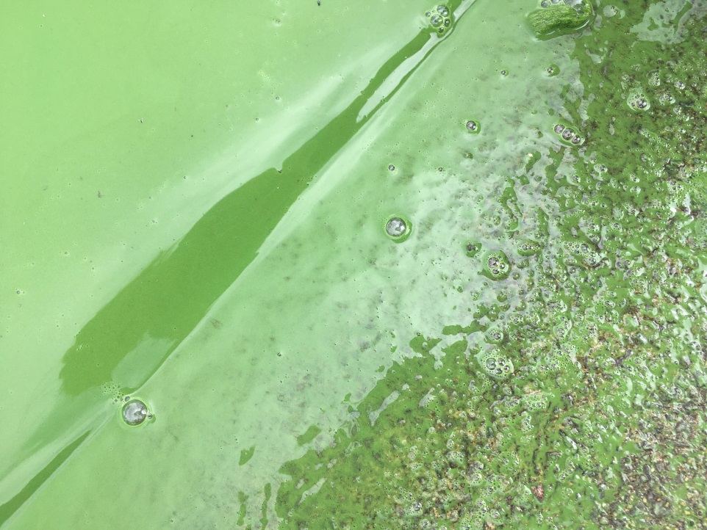
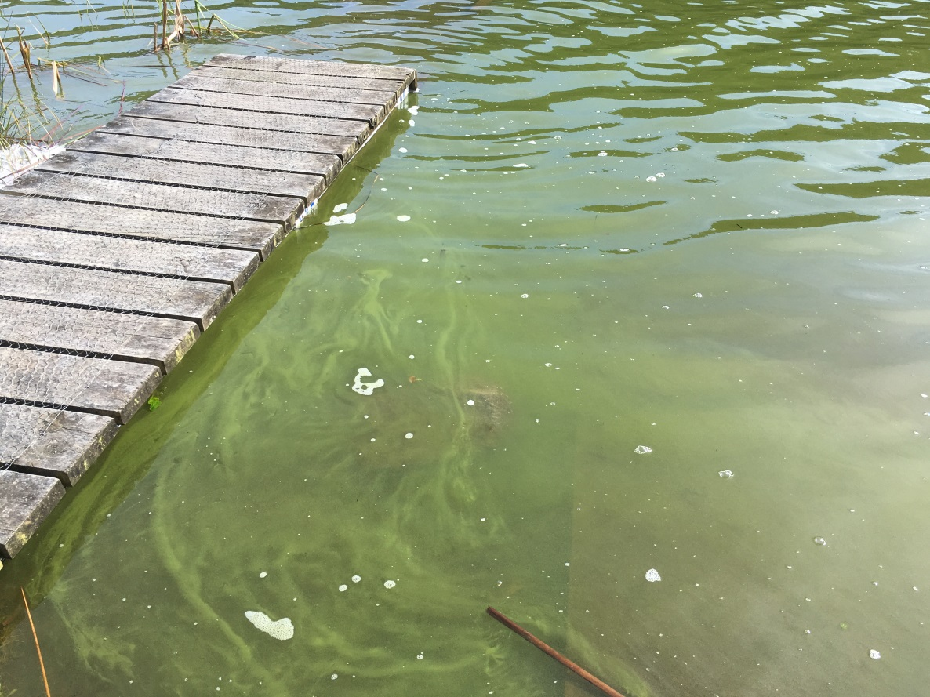
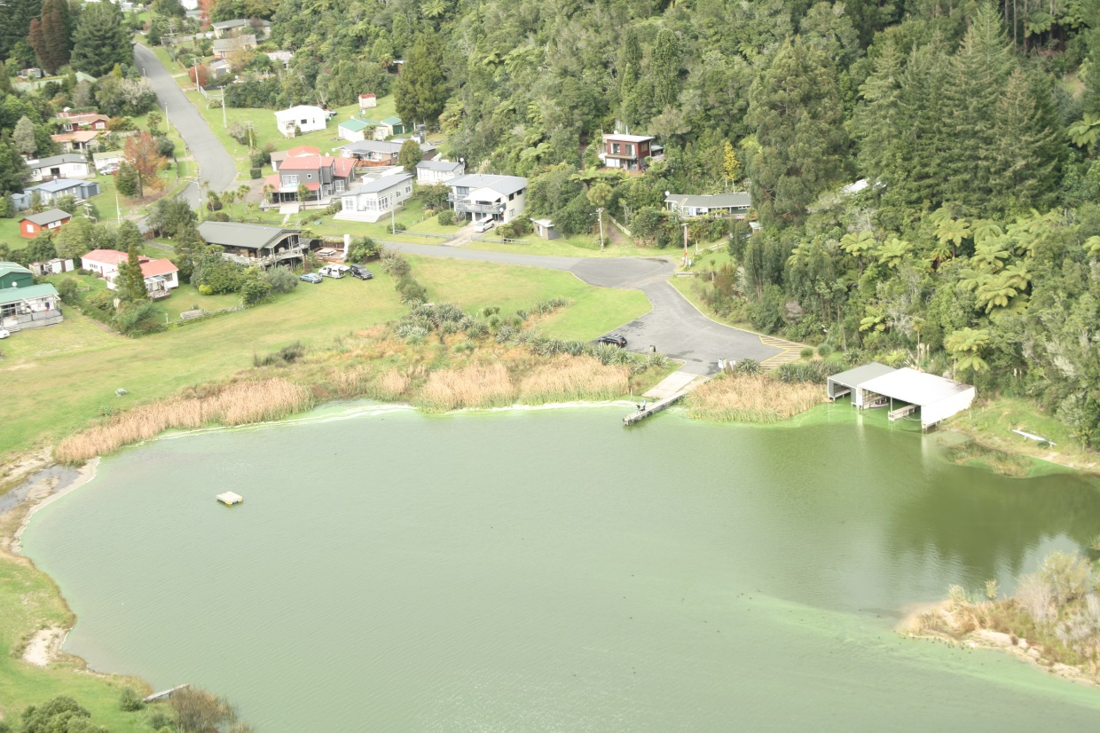
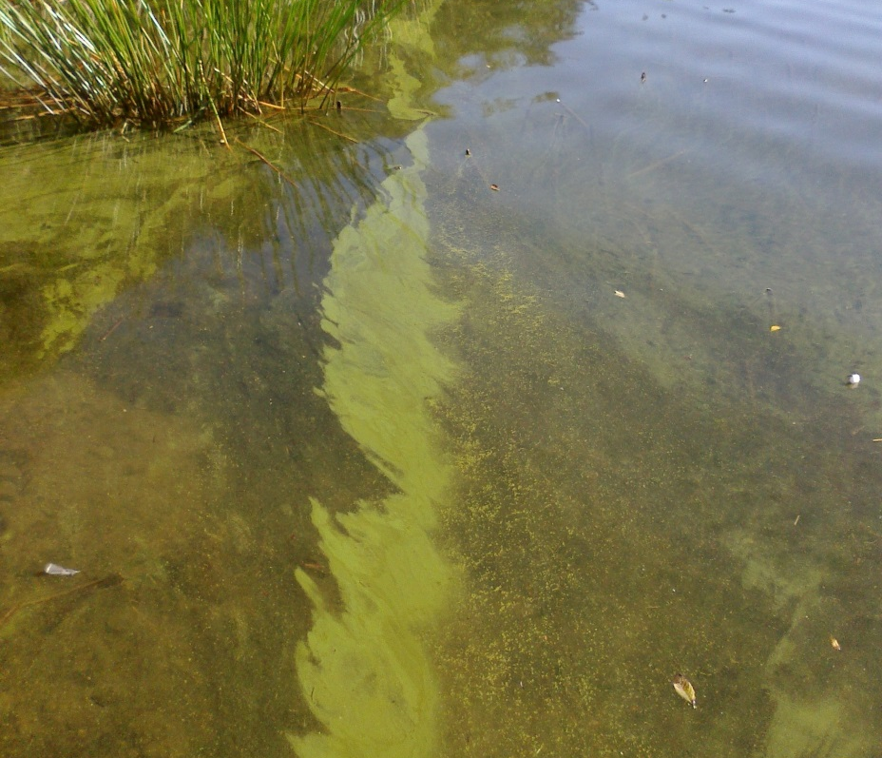
The issue
March 2018
Oct 2017
2016
May 2013
Notes:
Donald noted severe algal blooms (Anabaena spiroides) since 1993

Slide 5
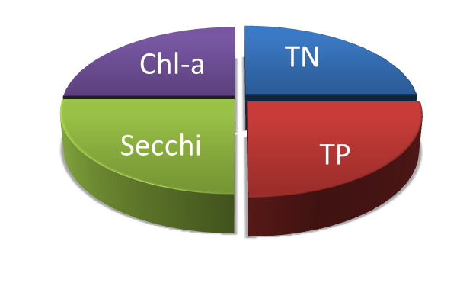
Trophic Level Index (TLI)
Objective TLI = 3.9
Notes:
Eutrophic classification
objective Trophic Level Index (TLI) based on past water quality (RL O1 (Objective 11) of the RNRP). The TLI is a numerical index that represents the water quality aspirations of the regional community.
Action Plan trigger exceeded.

Slide 6
TLI Components

Slide 7
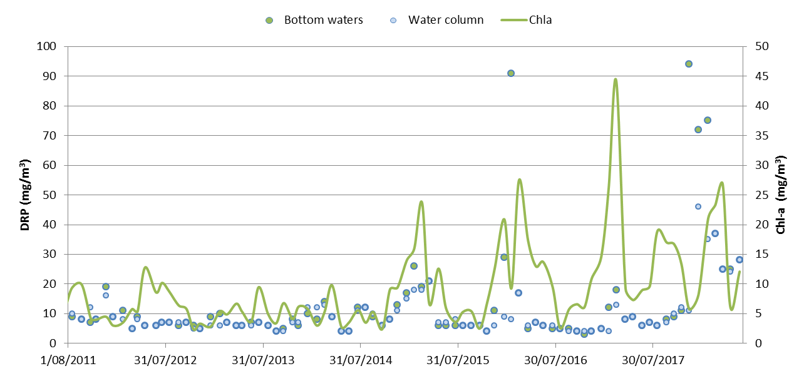
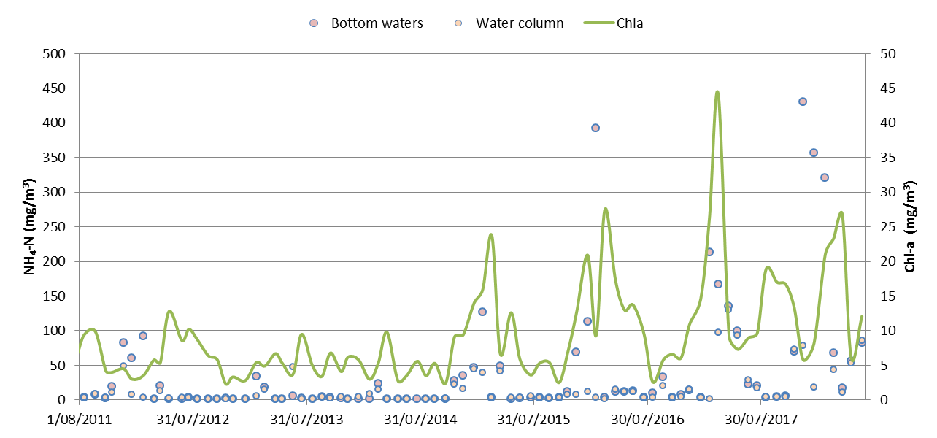
Release events
DRP & NH₄-N

Slide 8
Cyanobacteria
Red alert guideline

Slide 9
NPSFW Attributes
 | TP (mg/m3) | TN (mg/m3) | Chla (mg/m3) |  | Cyanobacteria biovolume (mm3/L)
 |  |  | Med | Max | 3 yrly 80%ile
2011/12 | C | A | C | B
2012/13 | C | A | C | B | A
2013/14 | C | A | C | A | A
2014/15 | C | B | C | B | C
2015/16 | C | B | C | C | C
2016/17 | C | B | C | C | C
2017/18 | C | B | D | C | C
A
B
C
D
Good
Bottom line
Poor
Notes:
Good - Lake ecological communities are healthy and resilient, similar to natural reference conditions.
Poor - Lake ecological communities have undergone or are at high risk of a regime shift to a persistent, degraded state(without native macrophyte/seagrass cover), due to impacts of elevated nutrients leading to excessive algal and/or plant growth, as well as from losing oxygen in bottom waters of deep lakes.

Slide 10
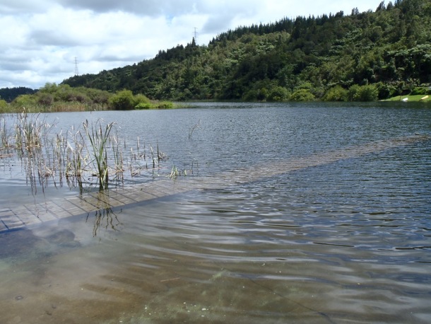
Lake level
Notes:
The lake level shows significant variability over decadal time scales, and due to its shallow depth, has demonstrated large fluctuations in water level in the past (Burns, McIntosh, & Scholes, 2009).
Lake levels have ranged over three metres from 1993 to 2012 (Figure 2.3). The low lake level in 1993 coincided with a decrease in water quality in the lake, and recent increases in lake level have potentially contributed to recent increase in nutrients driving productivity as seen by increases in chlorophyll-a concentrations.
Water residence time of 1.4-1.7 yr based on the period of 2003-2006 (Trolle et al., 2011).

Slide 11
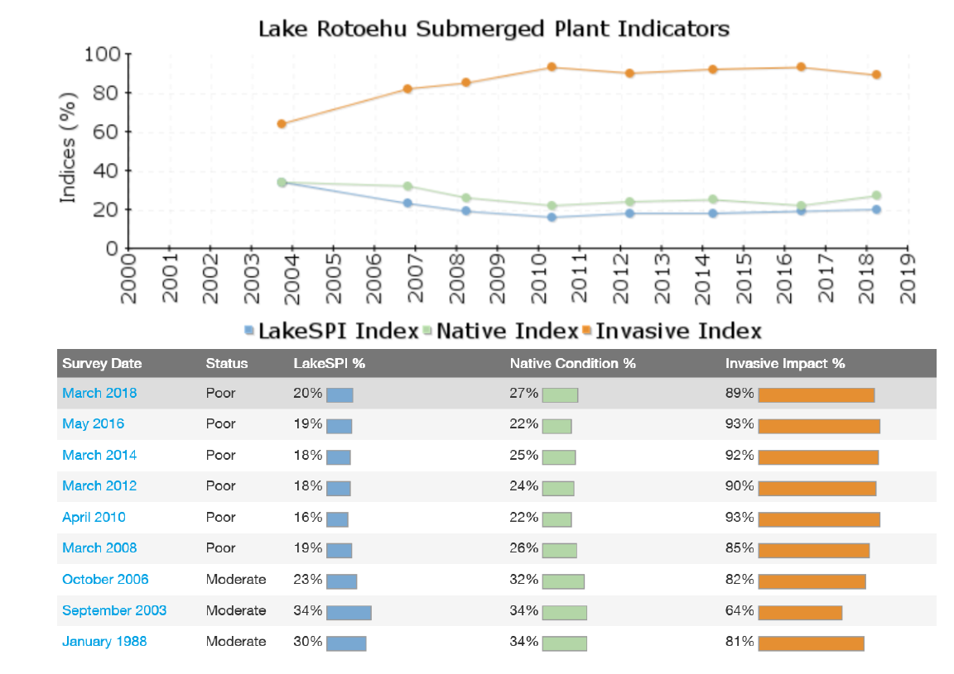
Macrophytes - LakeSPI
Notes:
NIWA has developed a Lake SPI (Submerged Plant Indicators) methodology to assess ecosystem health in lakes using aquatic macrophytes (e.g. Burton, 2016)
Lake SPI scores range from 0-100% where 0% is no plants in the lake, and >75% has excellent plant life.
Lake Rotoehu has remained in a poor, but stable condition (since 2010) as the full impact of hornwort invasion in the lake has taken place
highest Invasive Impact Indices (89%) of Rotorua Lakes
a thick cyanobacteria bloom was present on the lake affecting two of the five LakeSPI sites (Figure 33). This bloom (Figure 33) prevented a visual assessment of the vegetation at one of the five LakeSPI sites. Instead, previous data recorded for this site during the previous 2016 survey was verified using a grapnel and sonar equipment. Kākahi (Echyridella menziesii) recorded from most sites in 2016, were not observed in 2018

Slide 12
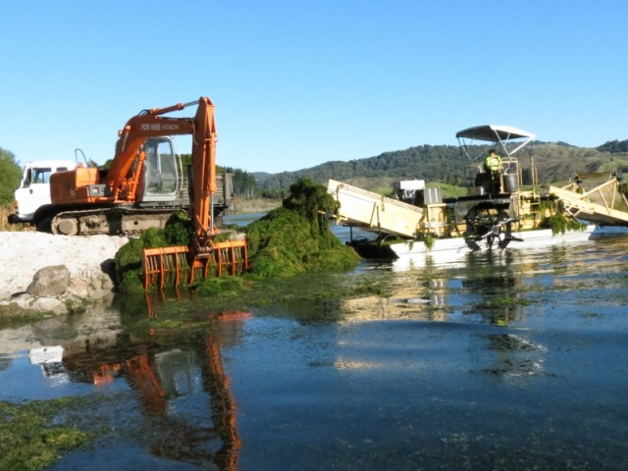
Weed Harvesting
Notes:
Hornwort (Ceratophyllum demersum) infestation of Lake Rotoehu likely occurred in the early 2000’s, manifesting into large dense surface reaching beds in the southern end of the lake by 2004
Using percent conversion figures attained from trial work carried out in 2006; the harvested wet hornwort consists of 4.0% dry matter with 3.0% of dry matter nitrogen and 0.4% phosphorus
Removal of Hornwort to vermiculture and landfill has almost achieved Rotoehu Action Plan water column nutrient targets for nitrogen and phosphorus for 2014 harvesting
. Cutting zone of the harvester is restricted to the top 2 metre of the water column.
Problems include: access, travel time, underwater obstacles, reach, winds and currents, variable growth rates (timing of harvest), sediment resuspension, relocation of harvested material- potential for infestation,

Slide 13
N & P contributions

Slide 14
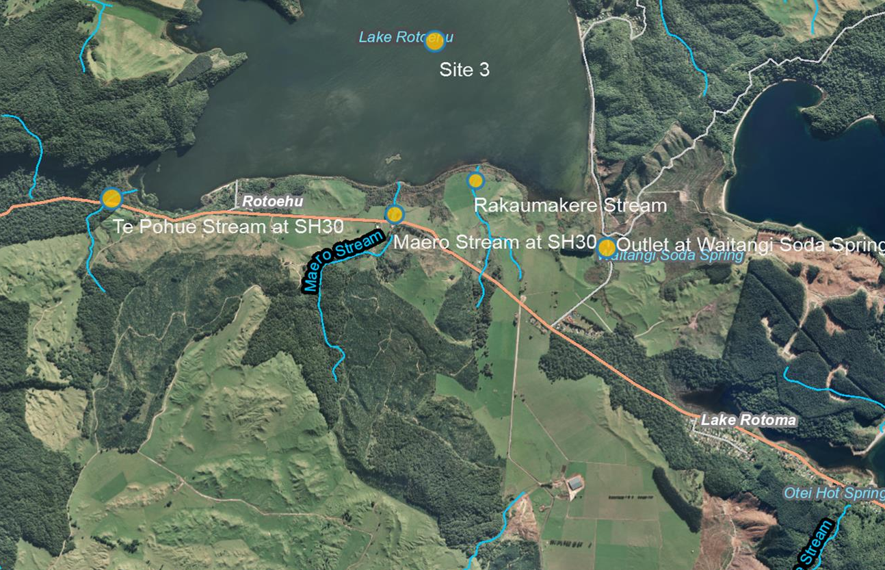
Rotoehu Inflows (2001-2012)

Slide 15
Rotoehu Inflows

Slide 16
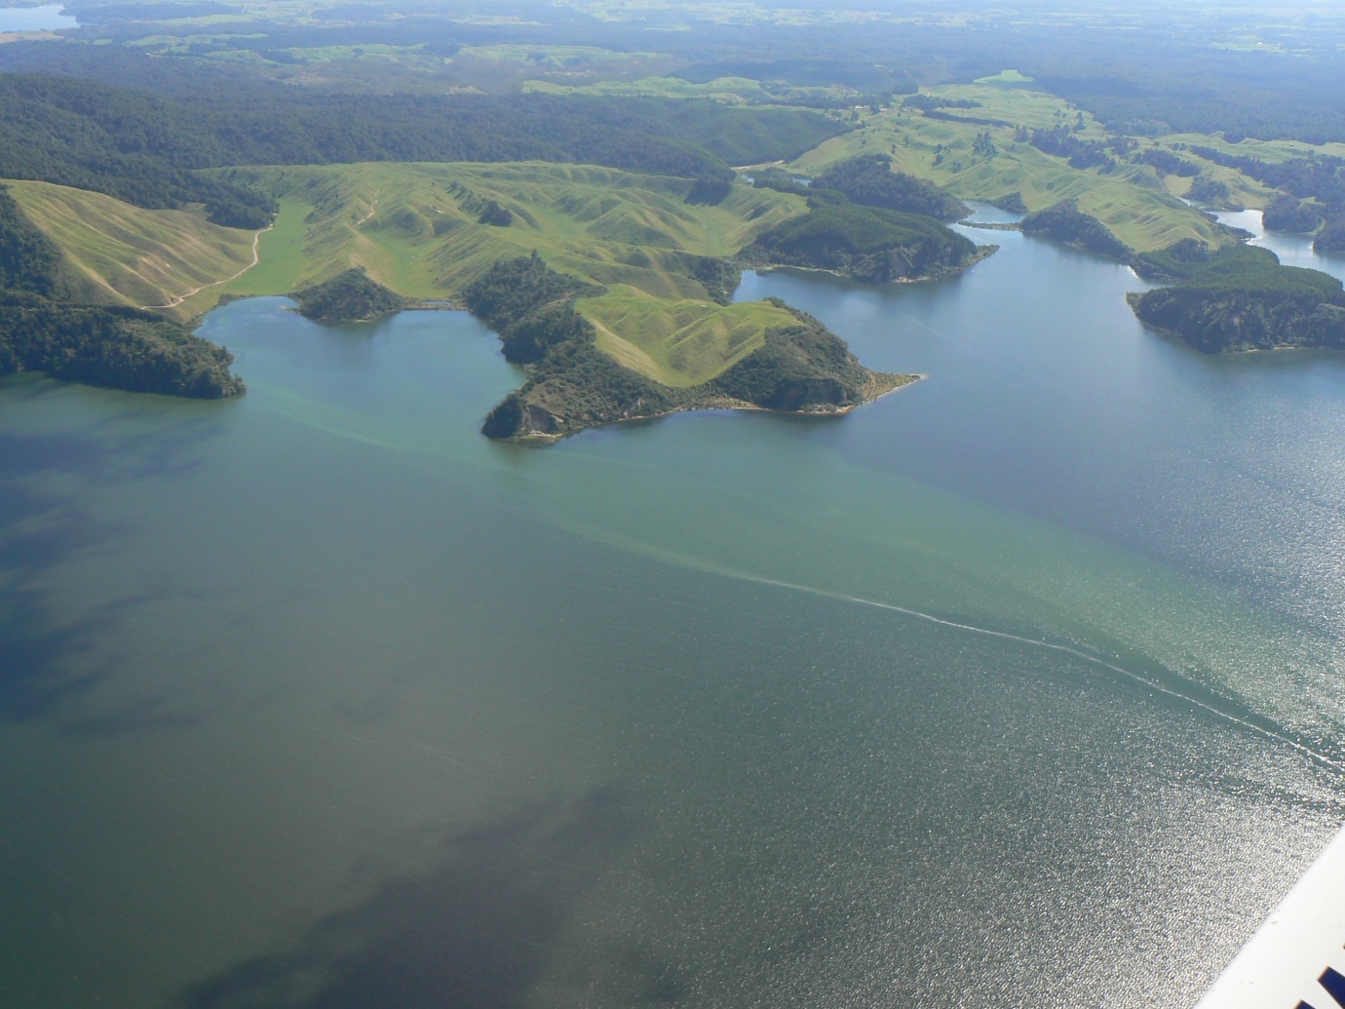
Discussion
Acknowledgements
James Dare
Andy Bruere
Chris McBride & University of Waikato

