Slide 1
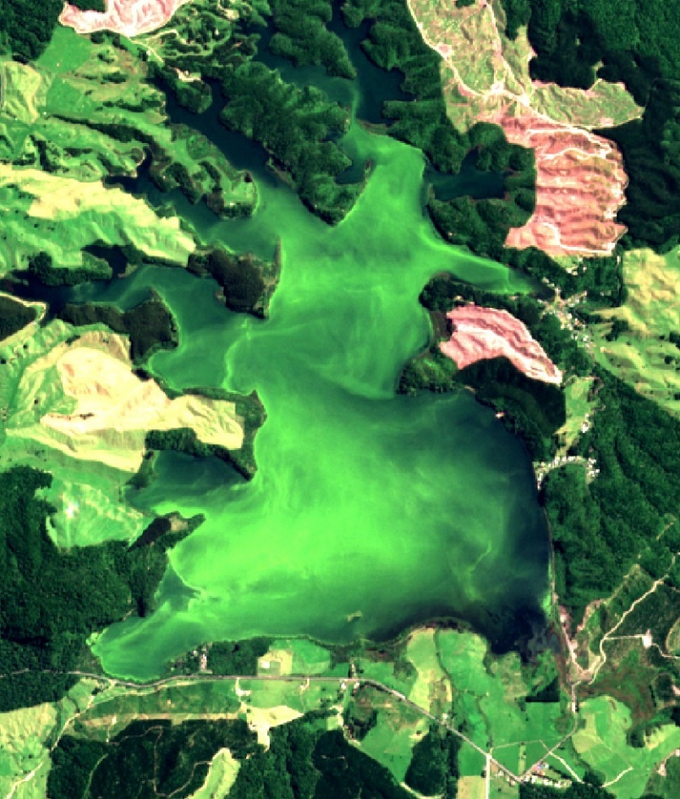


Rotoehu: water quality and nutrient targets
Chris McBride & Mat Allan

Slide 2
Overview
Drivers of lake water quality
  Bottom water oxygen.. Internal loading
  Land use change
  Hydrology
Remote sensing tools
  Water quality
  Land use change
Nutrient budgets
Opportunities for further understanding

Slide 3
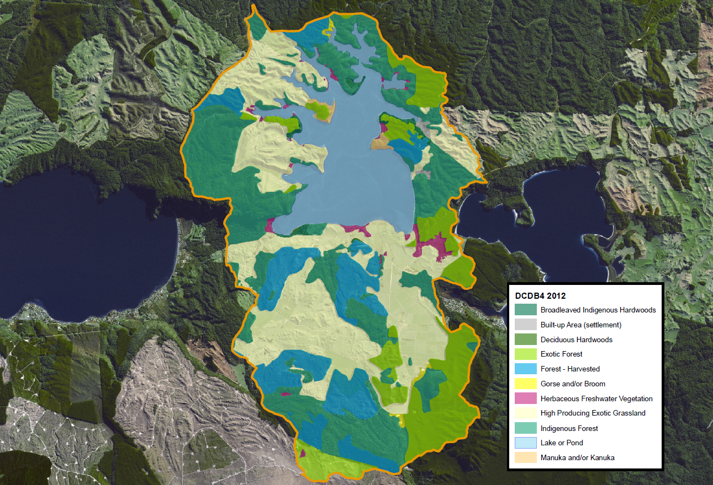
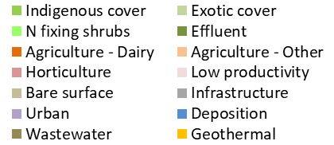
Catchment
BoPRC; data 2002-2003

Slide 4
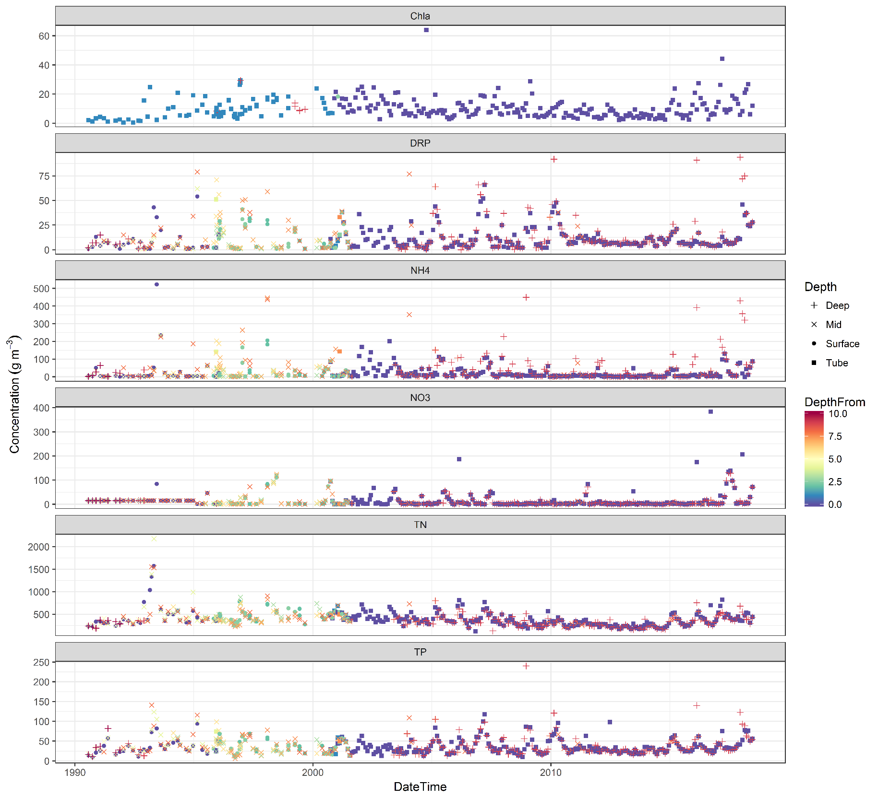
IN-LAKE WATER QUALITY

Slide 5
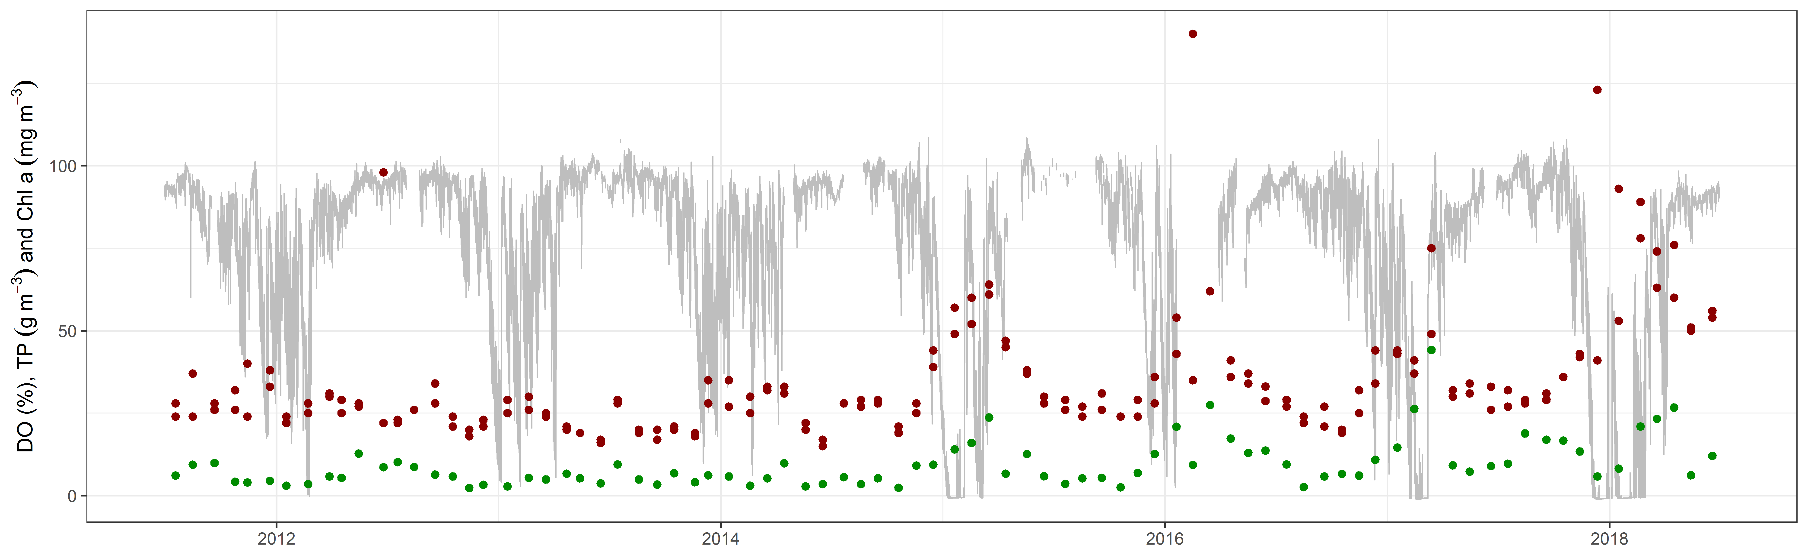
Lake TN and TP driven strongly by anoxia??
Dissolved oxygen (bottom waters)
TP
Chlorophyll-a

Slide 6
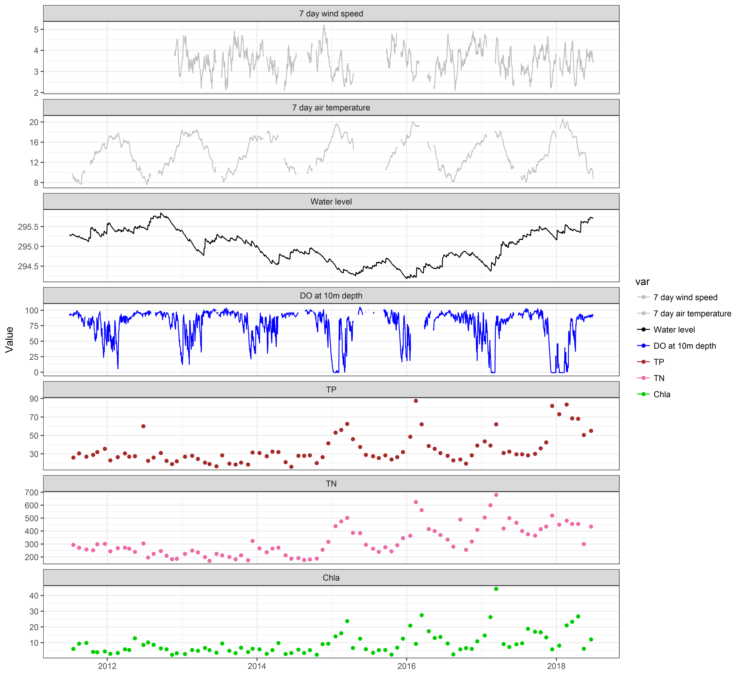

Slide 7
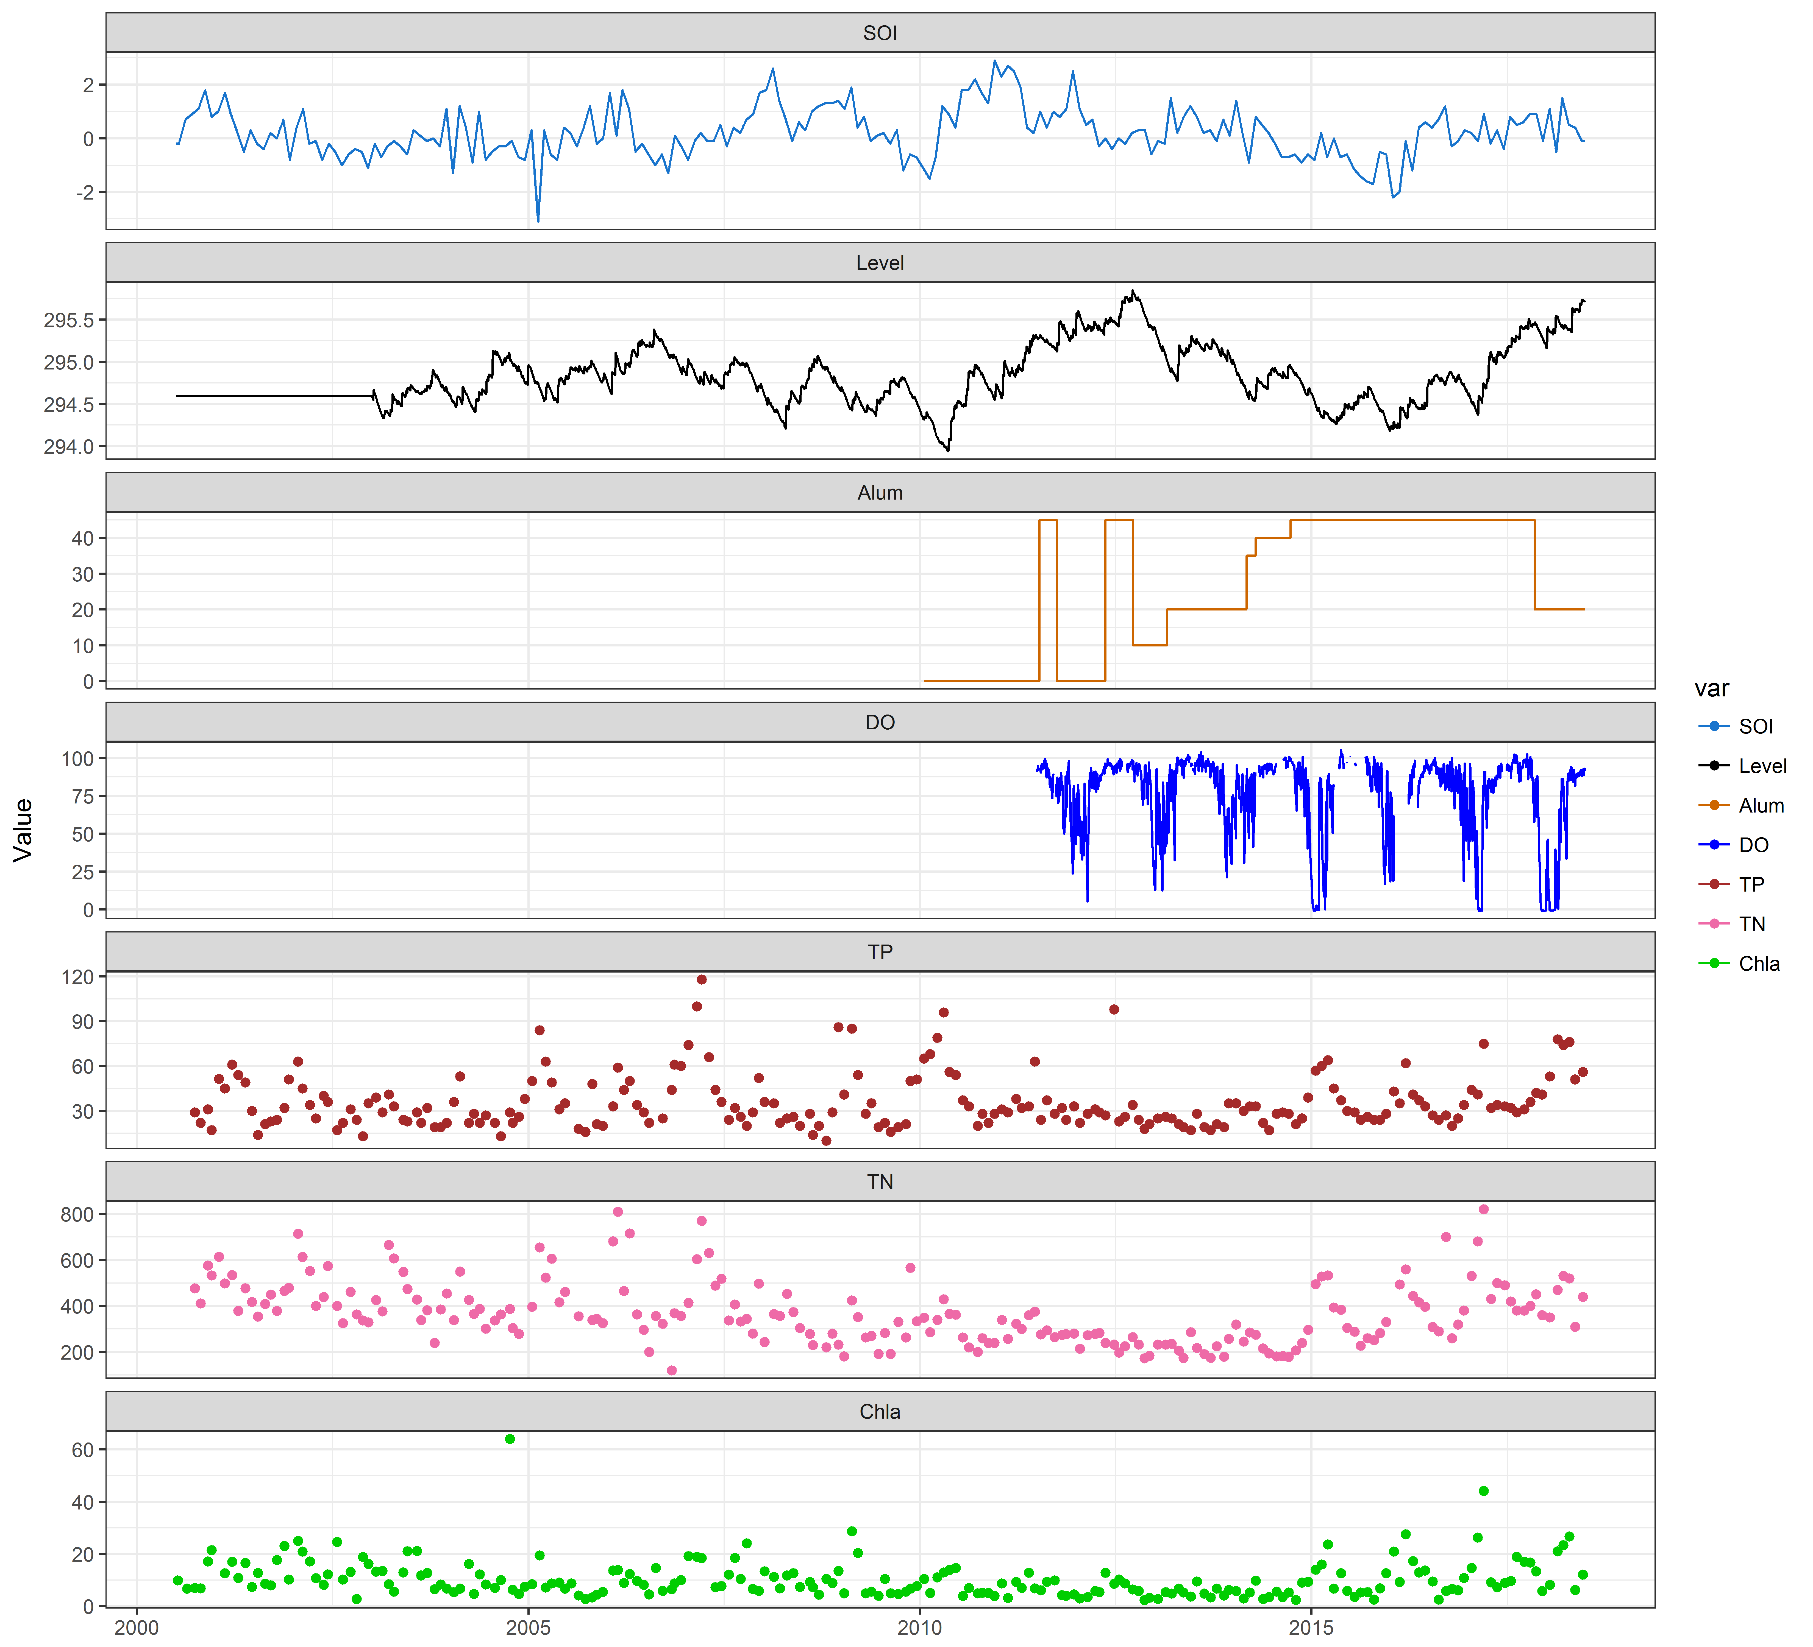
Southern oscillation Index
Rotoehu water level
Alum dose rate (l/hr)
Bottom water oxygen
Total P
Total N
Chlorophyll a

Slide 8
IN-LAKE WATER QUALITY

Slide 9
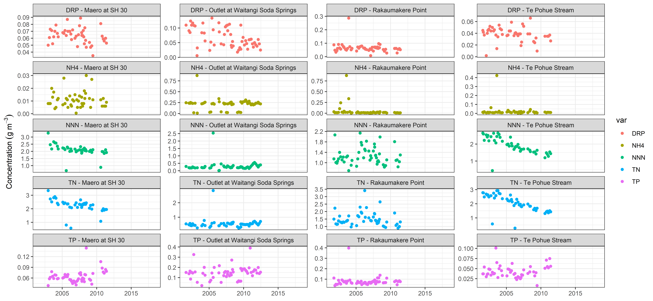
Inflow nutrient concentrations
Maero Waitangi Stream @ Rakaumakere Te Pohue Stream
?
?
?
?

Slide 10
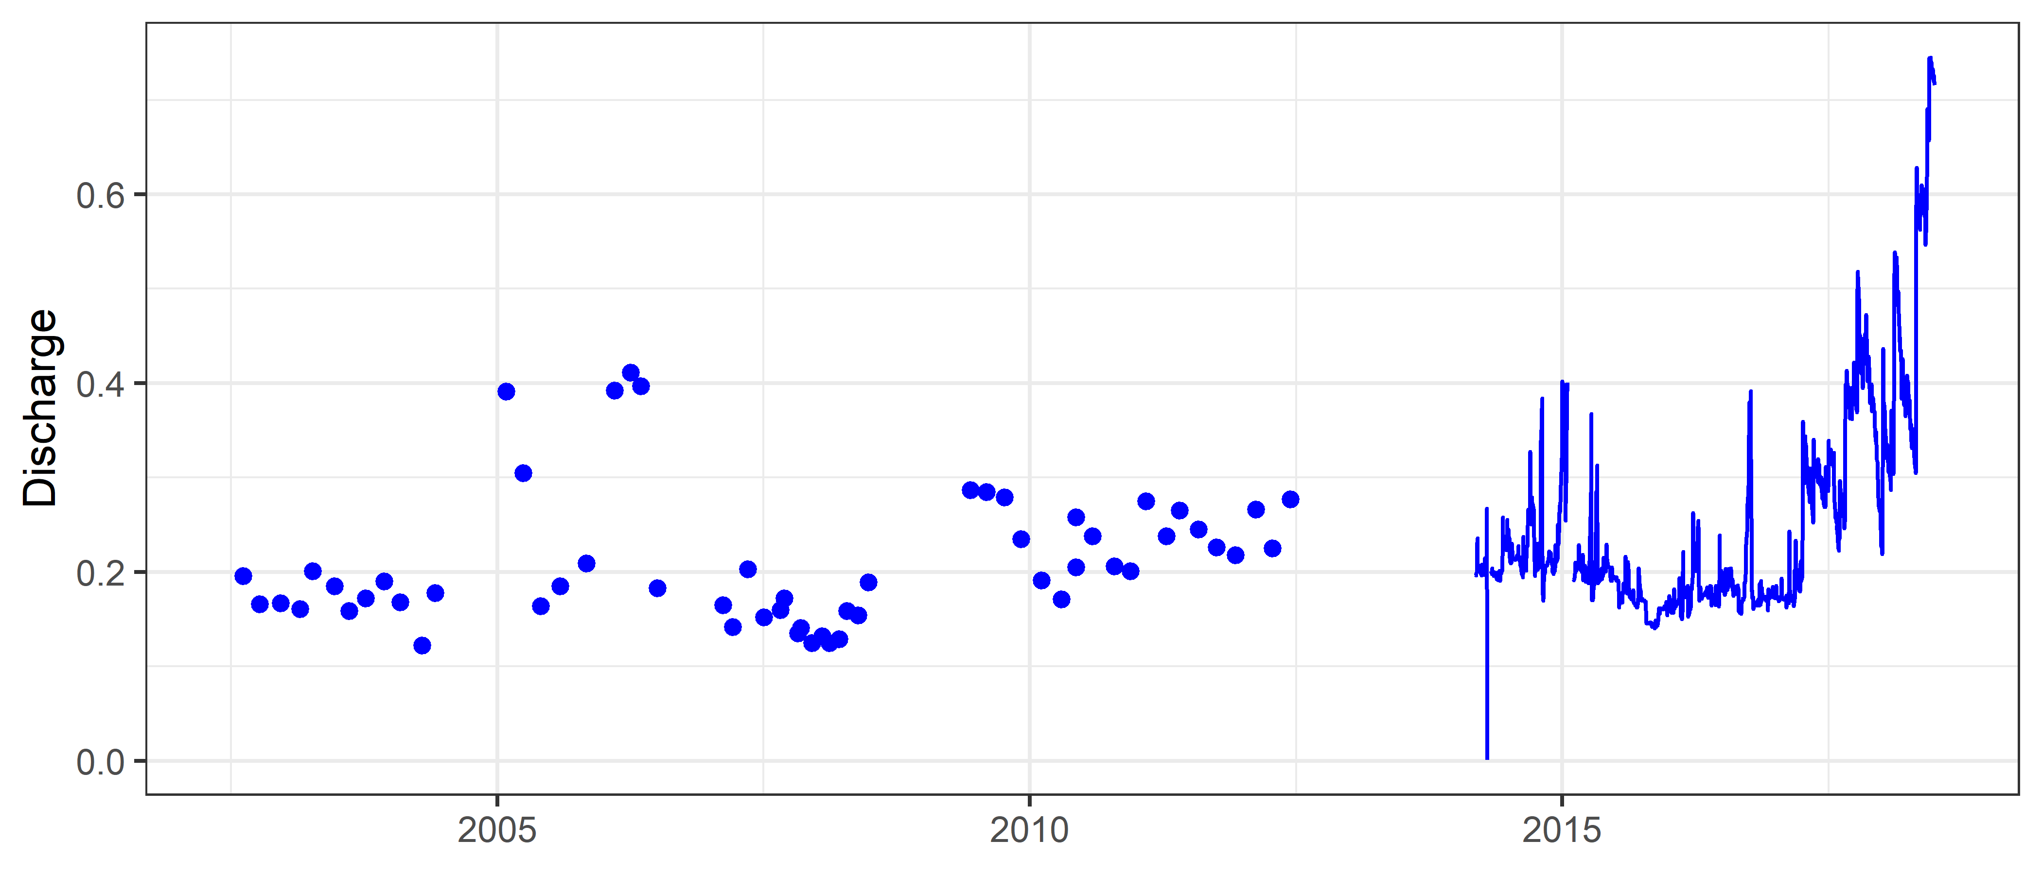
Waitangi stream discharge

Slide 11
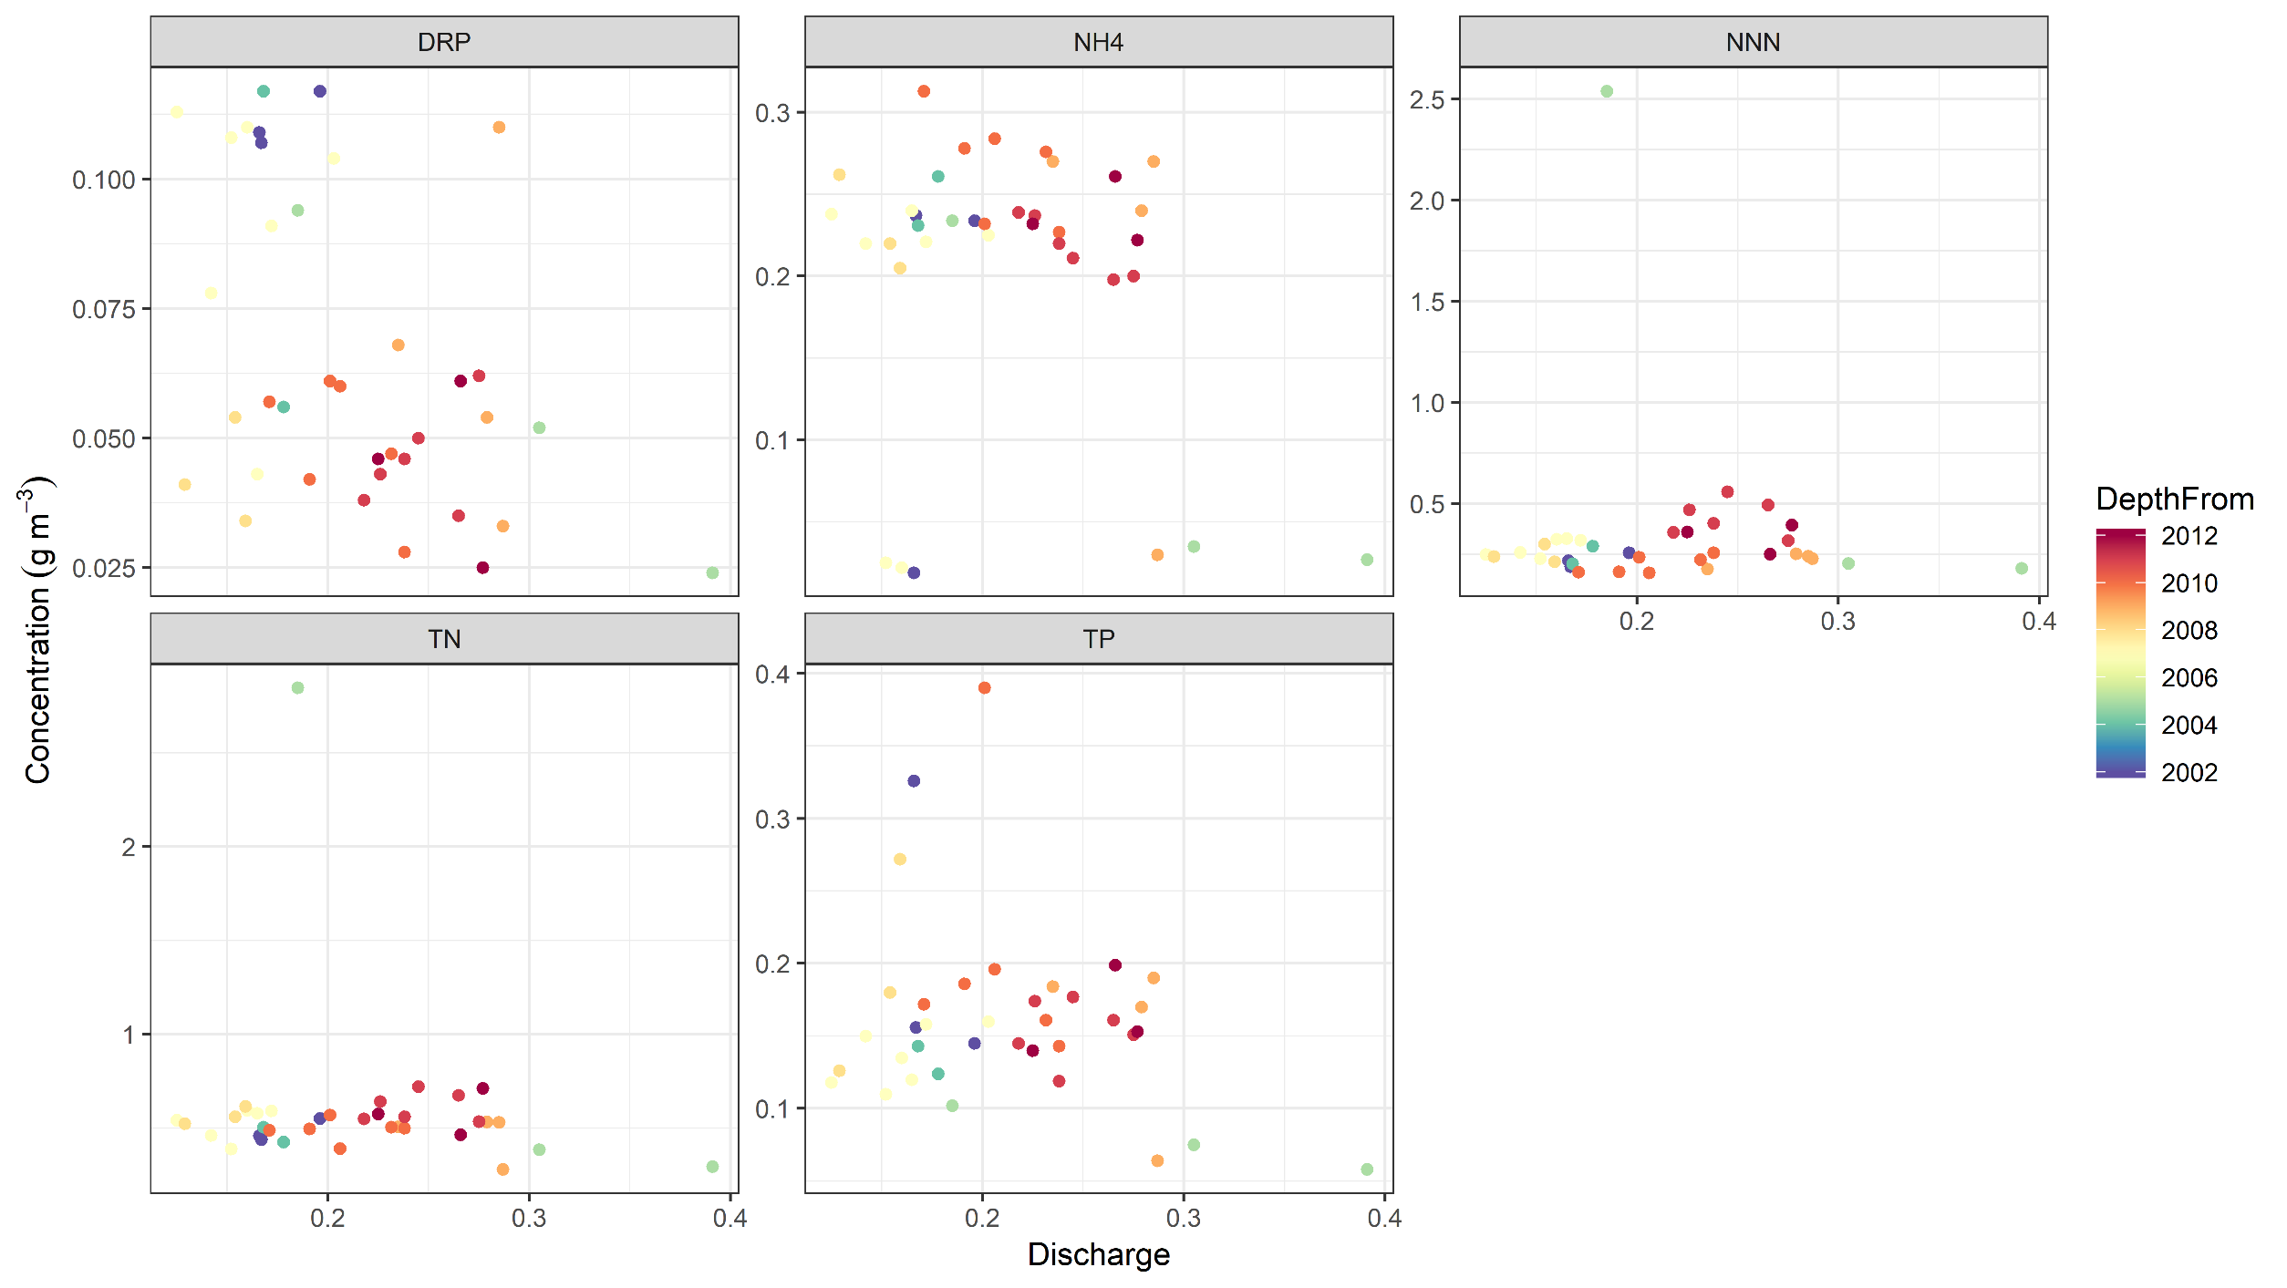
Discharge-concentration: Waitangi Stream

Slide 12
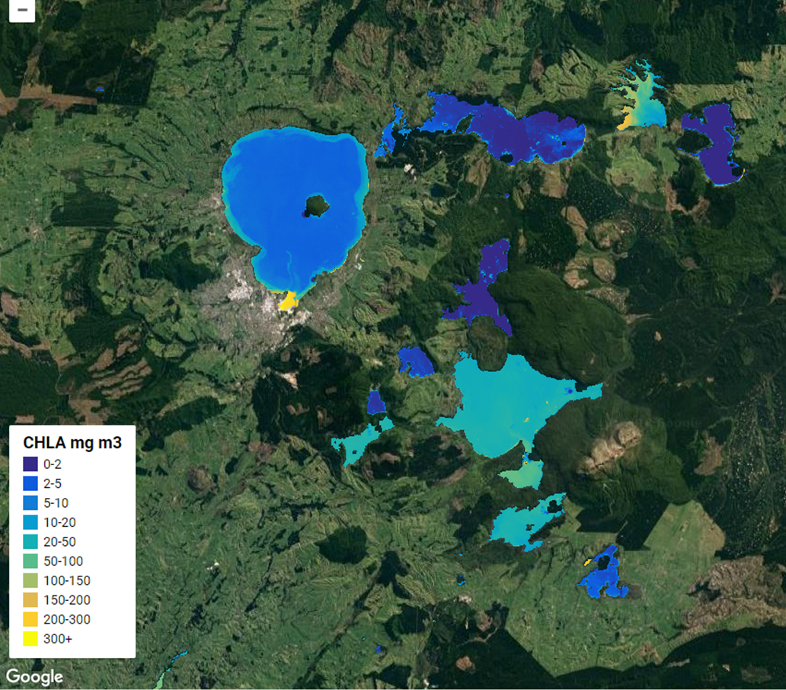
Landsat-8 (29/01/2018)
Remote sensing of phytoplankton blooms
Sentinel-2 (16-02-2018)
Google Earth Engine code implemented chl a from LS8

Slide 13
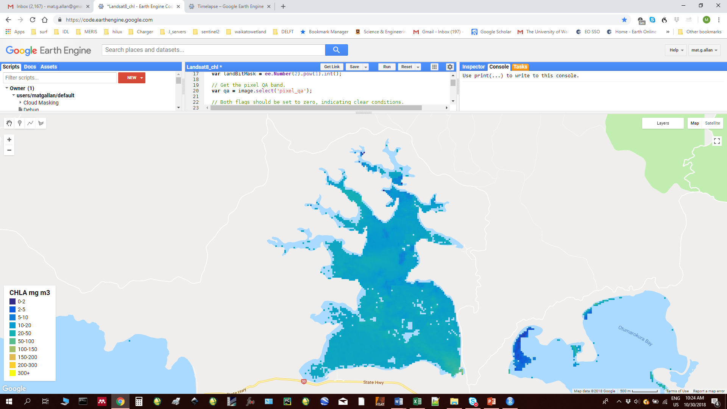

Slide 14
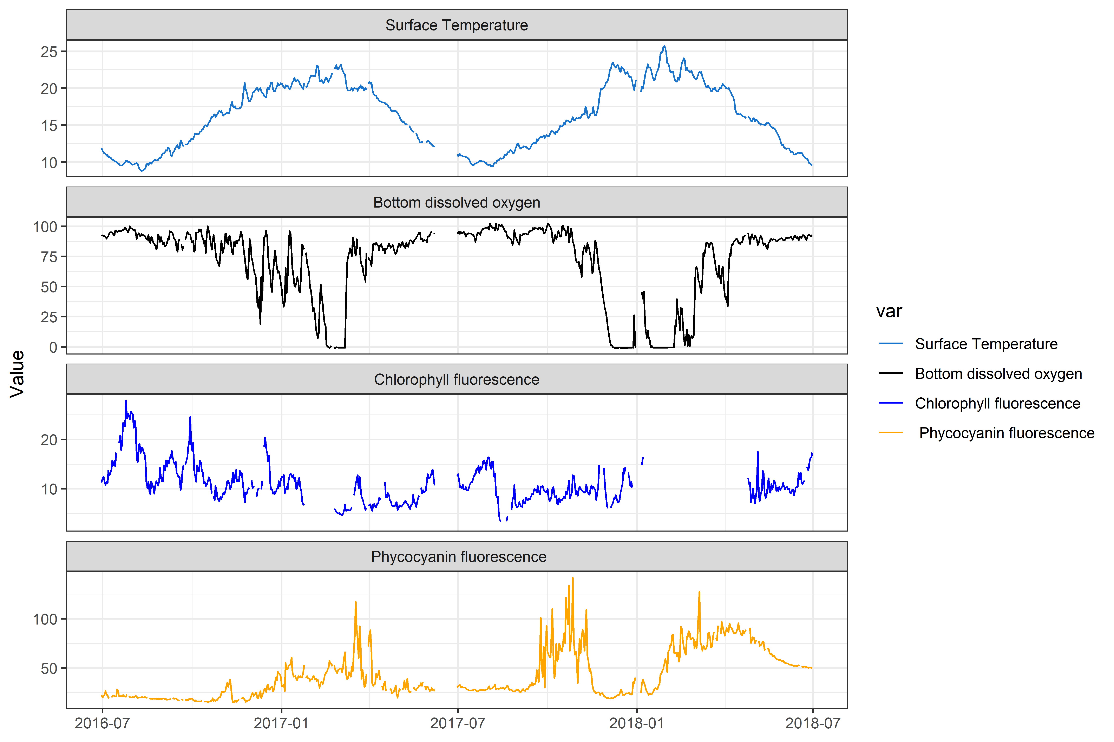
Buoy data
Phytoplankton dynamics

Slide 15
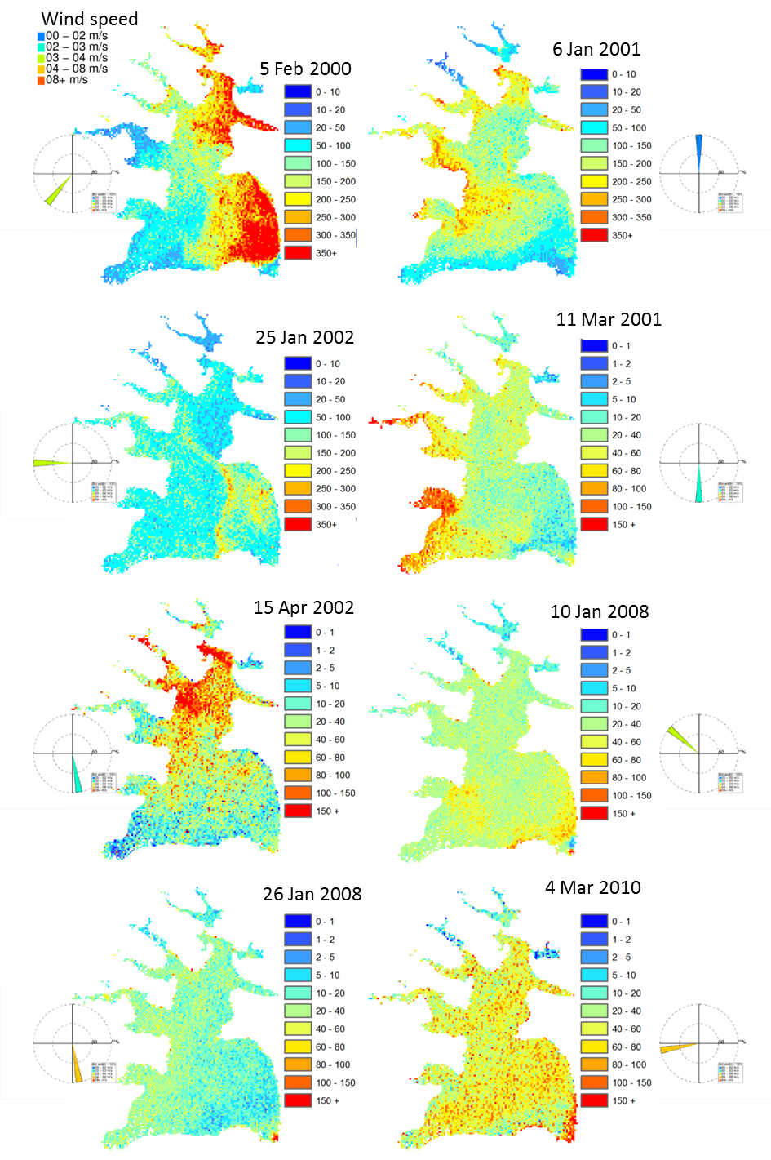
LANDSAT-7 chlorophyll a

Slide 16
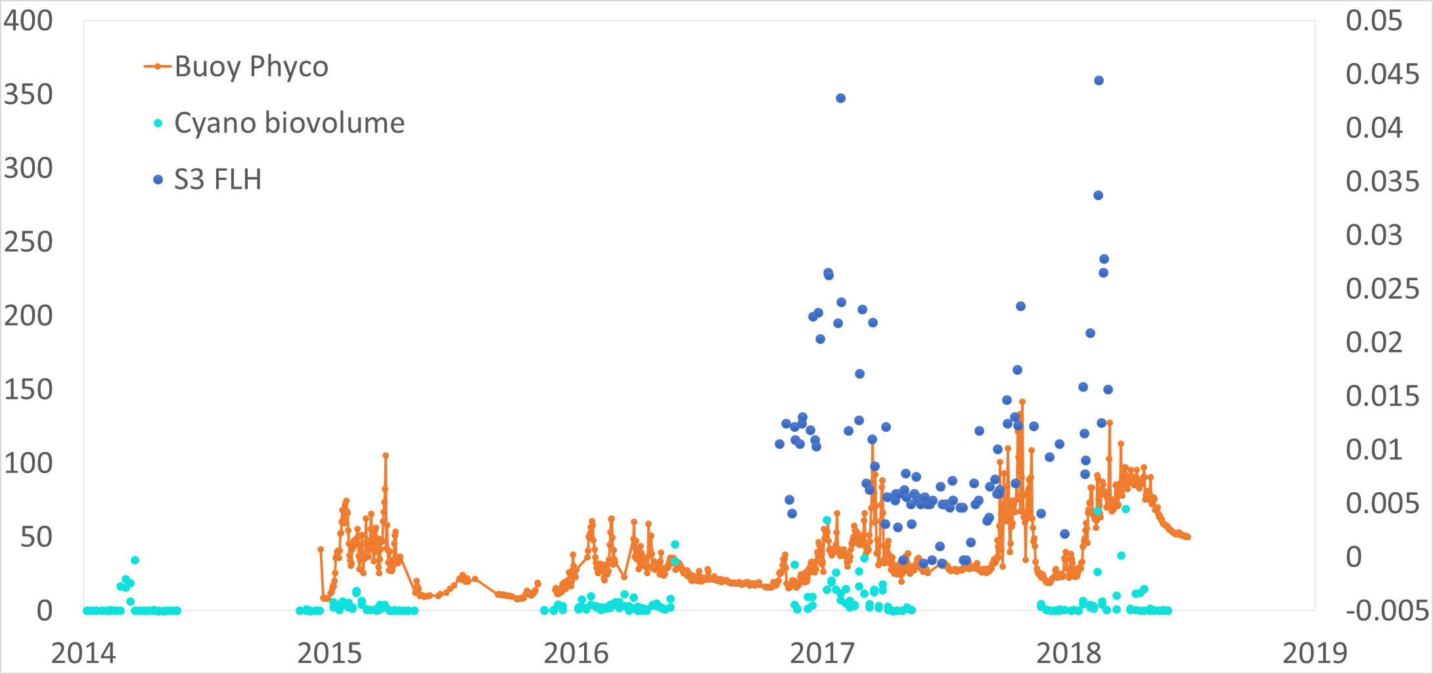
Buoy vs Satellite fluorescence

Slide 17
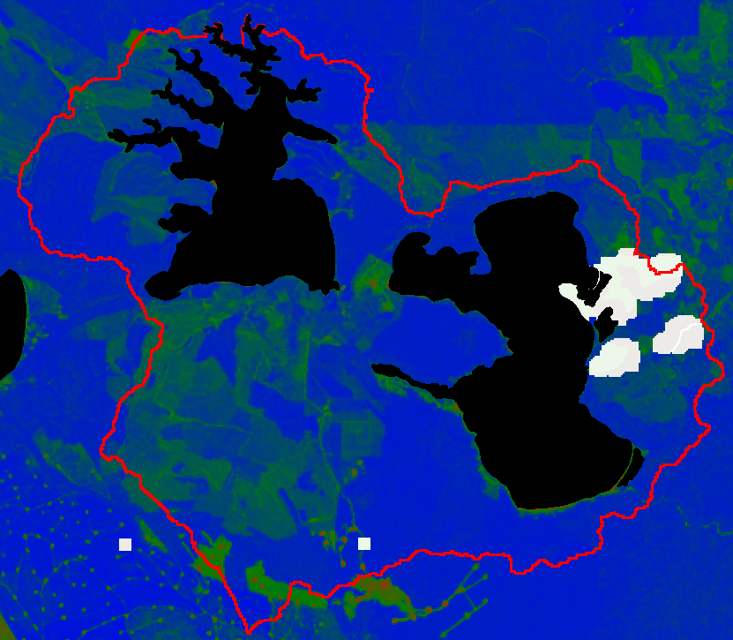
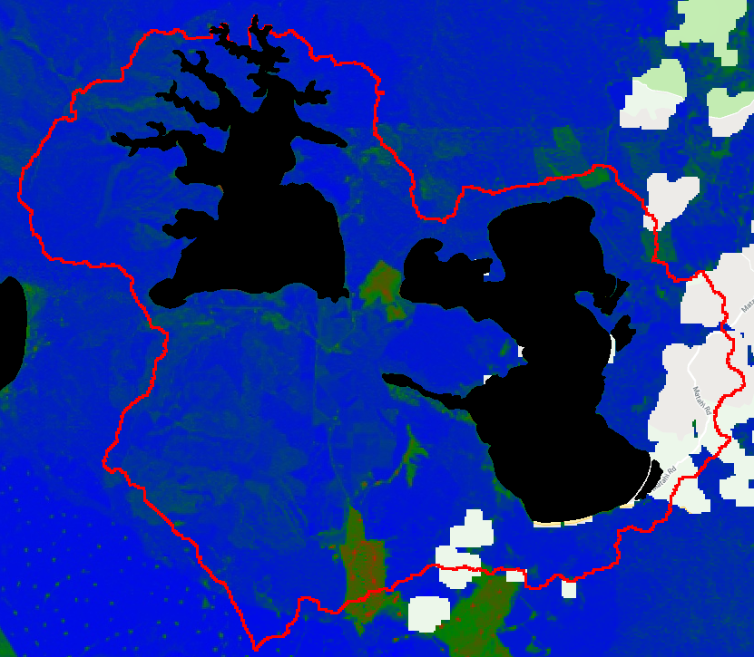
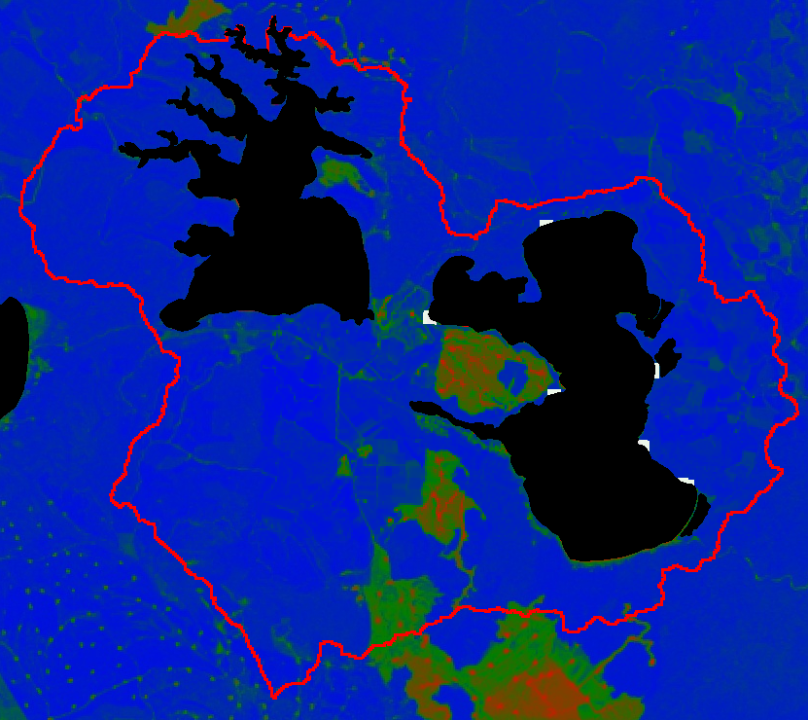
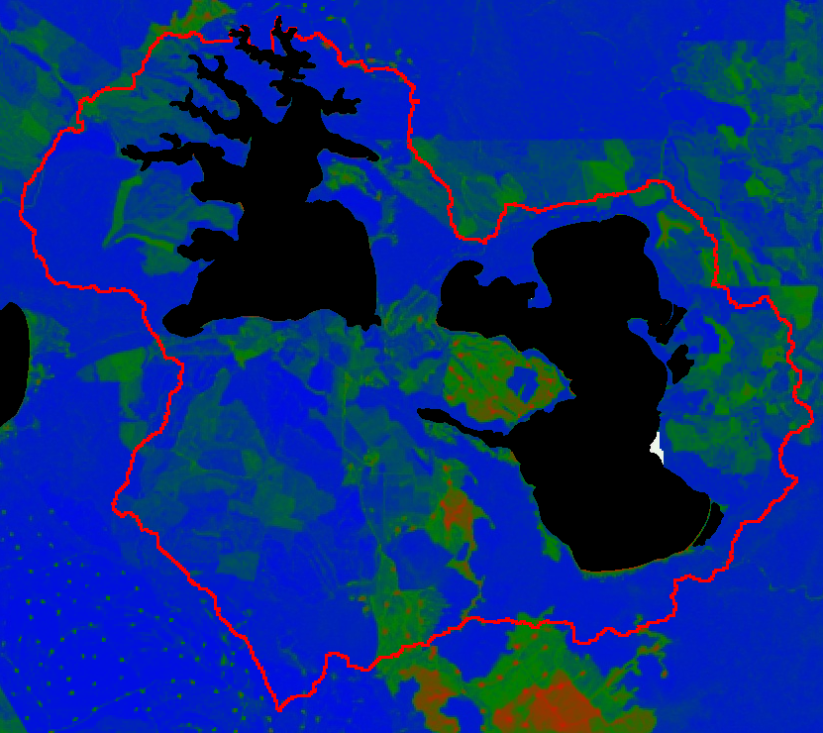
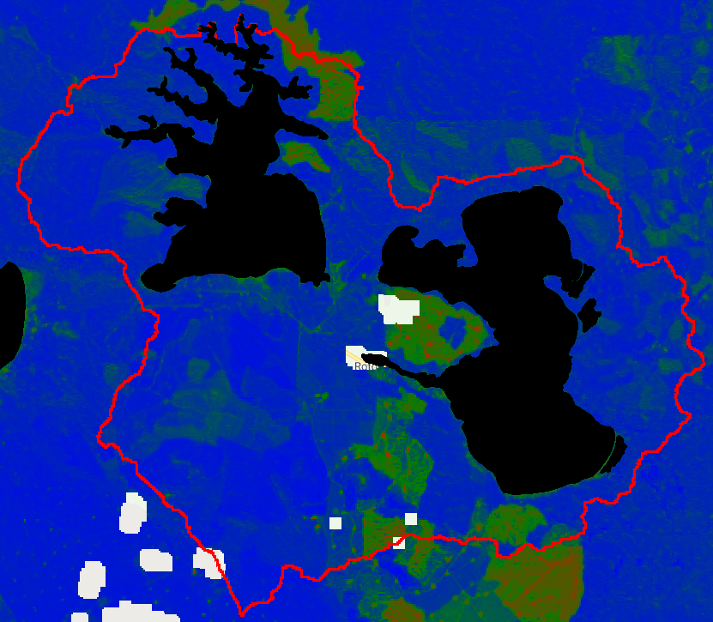
2014
2015
2016
NDVI – vegetation index for detection of forest harvesting
2017
2018

Slide 18
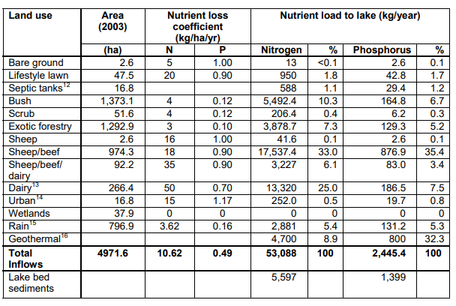
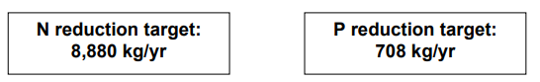
Areal nutrient budgets
Overseer v6.2.3: High attenuation (50%)
Action Plan
Overseer v6.2.3: Low attenuation (25%)
Trolle DYCD model TN 40,058 kg TP 2,780 kg
Notes:
Trolle DYCD model TP 2.78 TN 40.58 tonnes
Trolle DYCD model TP 2.78 TN 40.58 tonnes
Verburg internal – 11-12 TN, 1.2-1.7 TP

Slide 19
Summary
Monitoring buoy and sample data suggest that recent poor water quality is likely to be driven by internal loading during strong and sustained stratification ( -> bottom DO depletion)
Remote sensing suggest possible recent impacts from land use
  e.g., forest harvesting
Stream monitoring data show stable or improving nutrient concentrations, but data end c.a. 2012.
Consideration of temporal variation
  Hydrology (-> Waitangi flow?)
  Land use, e.g. forest clearance

Slide 20
Recommendations
Budgets based on Overseer suggest similar N load, higher P loads, BUT; load-to-lake is uncertain due to unanswered questions regarding attenuation.
Load calculation by subcatchment, and comparison with Overseer estimates to estimate actual attenuation
  Recommence stream monitoring?
More detailed analysis of likely geothermal load (and variability)
Detailed analysis of internal loading

