Slide 1
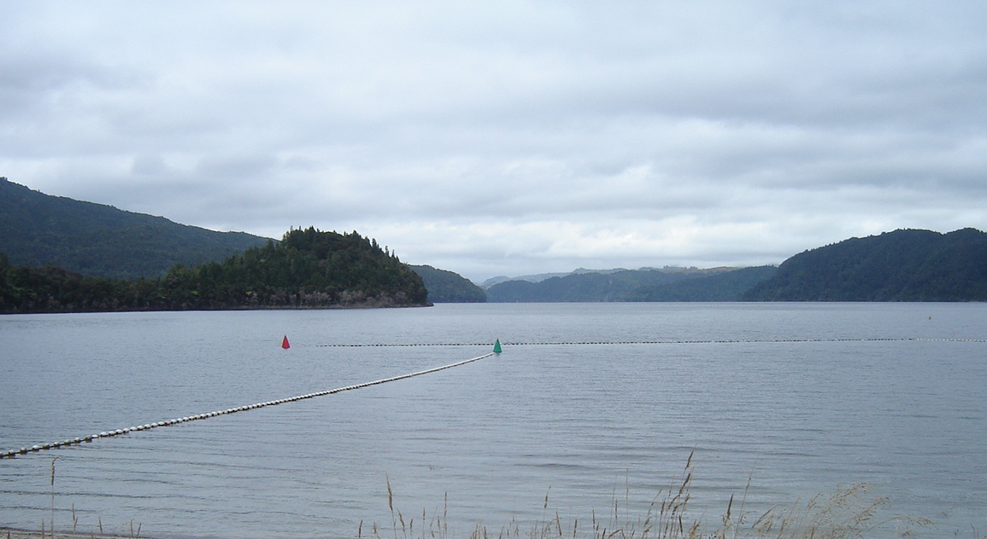
Managing New Zealand lakes:
Potential challenges
Theodore Alfred Kpodonu
Environmental Research Institute
School of Science
University of Waikato
08-09-2016 Science evening, Holiday Inn, Rotorua

Slide 2
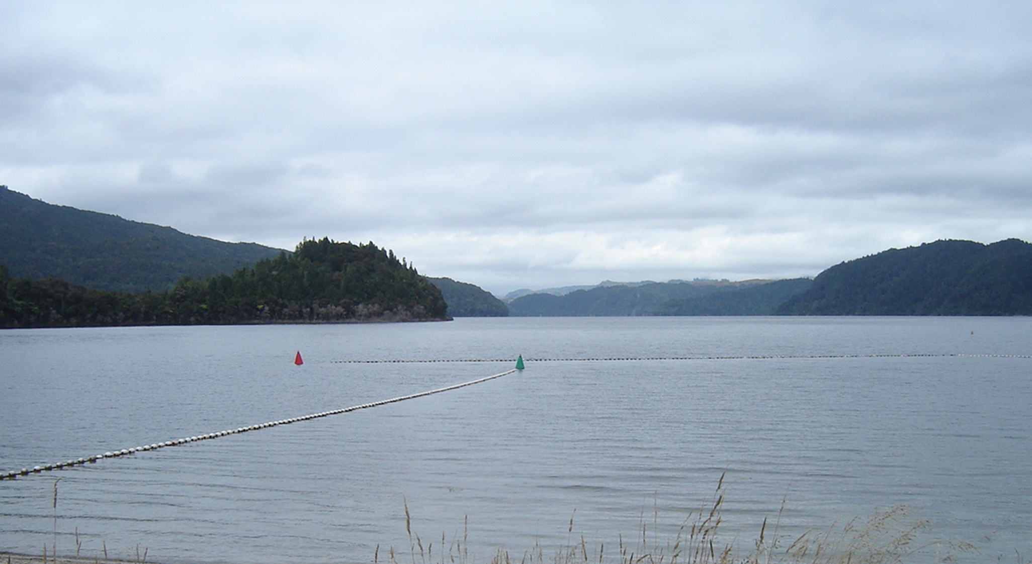


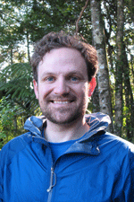


Acknowledgements
Lake Okataina Scenic Reserve Board
Prof David Hamilton
Dr Christopher Lusk
Dr Adam Hartland
Assoc Prof Daniel Laughlin

Slide 3
Blue Print for water quality management in New Zealand

Slide 4
Measure of success of lake water quality management
Trophic lake Index (TLI)
Components of TLI:
Concentrations of
TP (National bottom line 50 mg/m³ )
TN (National bottom line 800 mg/m³ )
Chl a (National bottom line 10 mg/m³ )
also, secchi disc depth

Slide 5
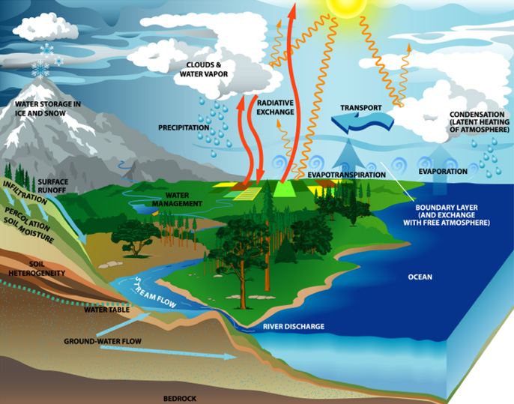
Sources of natural variability in components of the TLI
lake
gilmourbiology.wikispaces.com

Slide 6
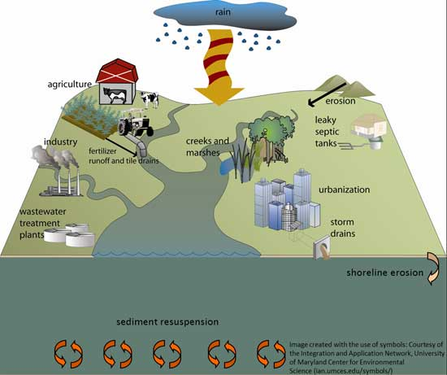
Anthropogenic sources of variability
Source: https://trca.ca/

Slide 7
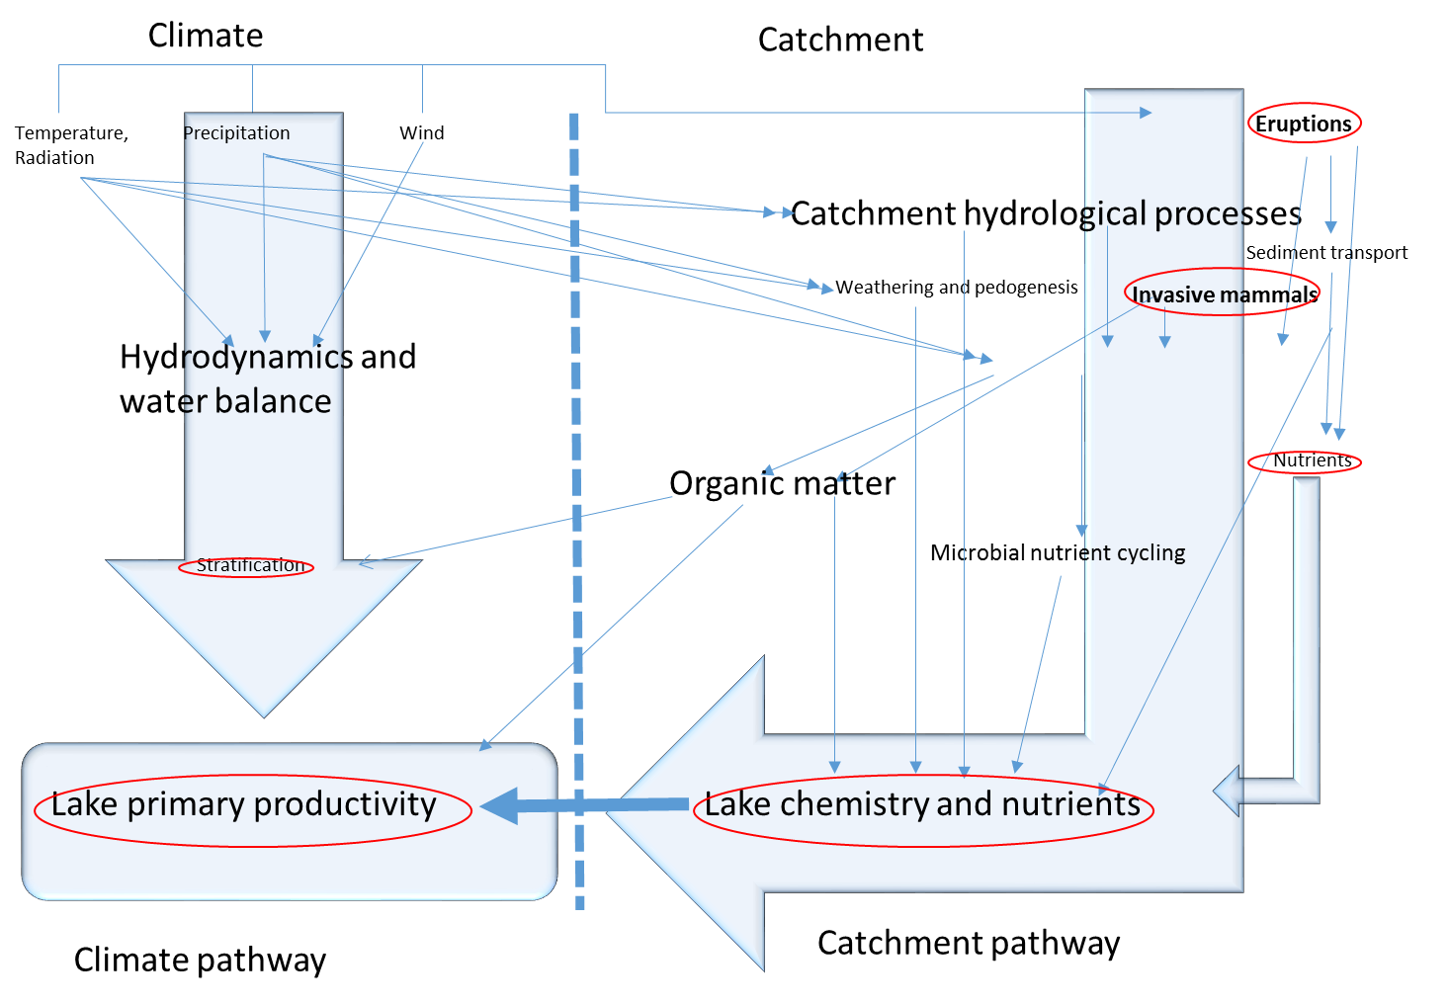
Interplay between catchment and climate processes

Slide 8
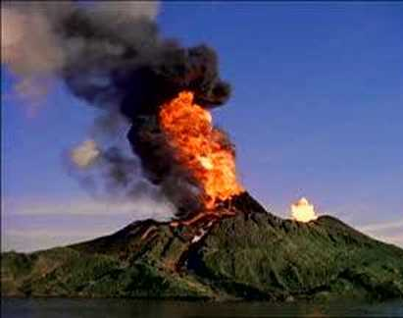
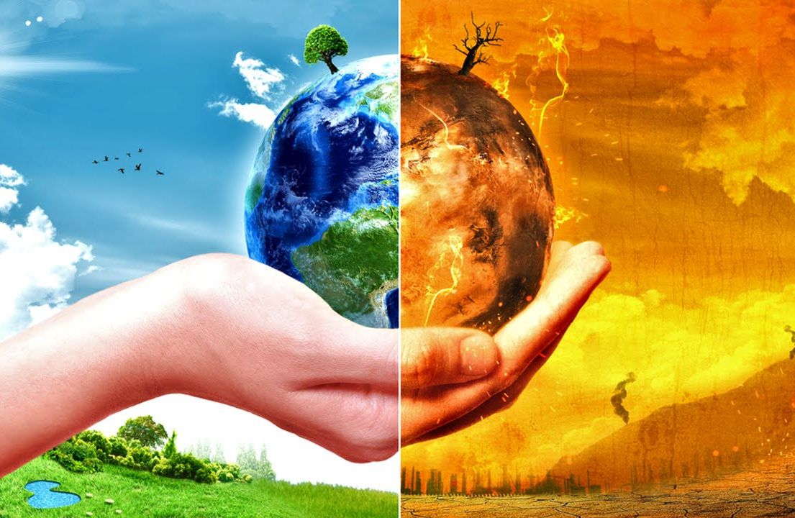
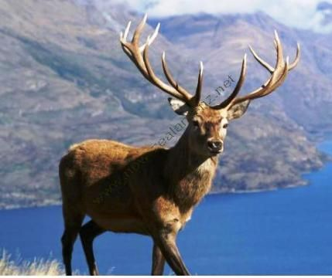
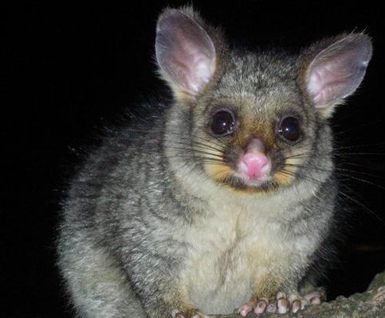
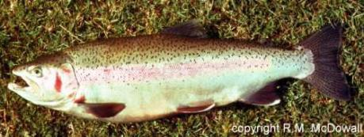
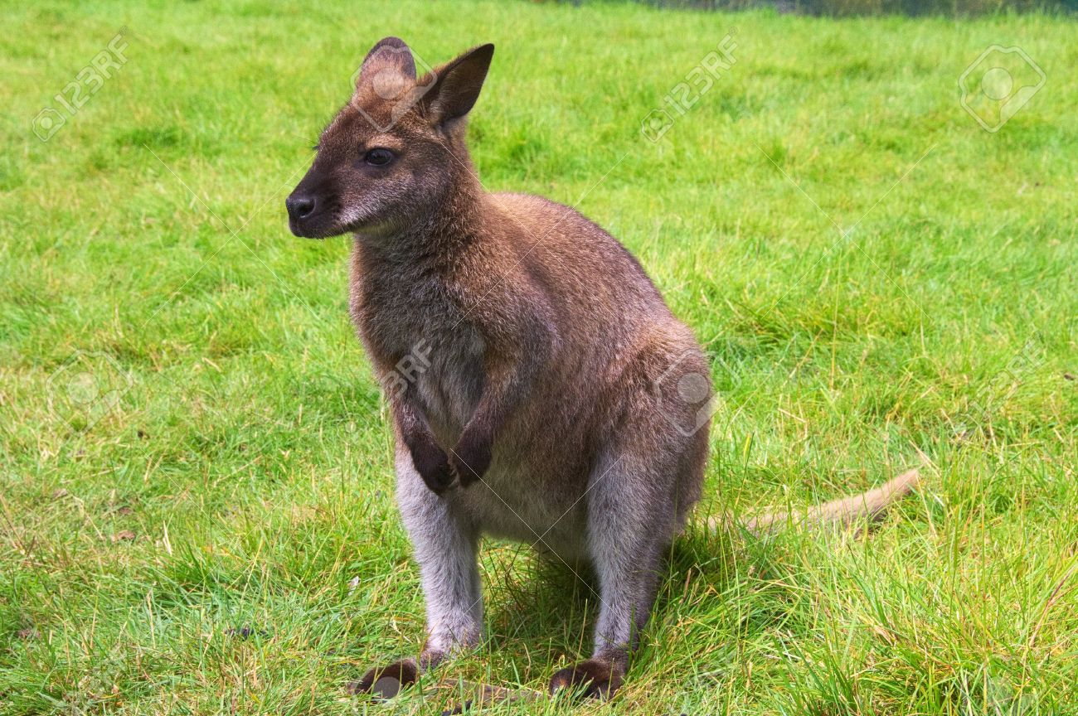
Focus of the study

Slide 9
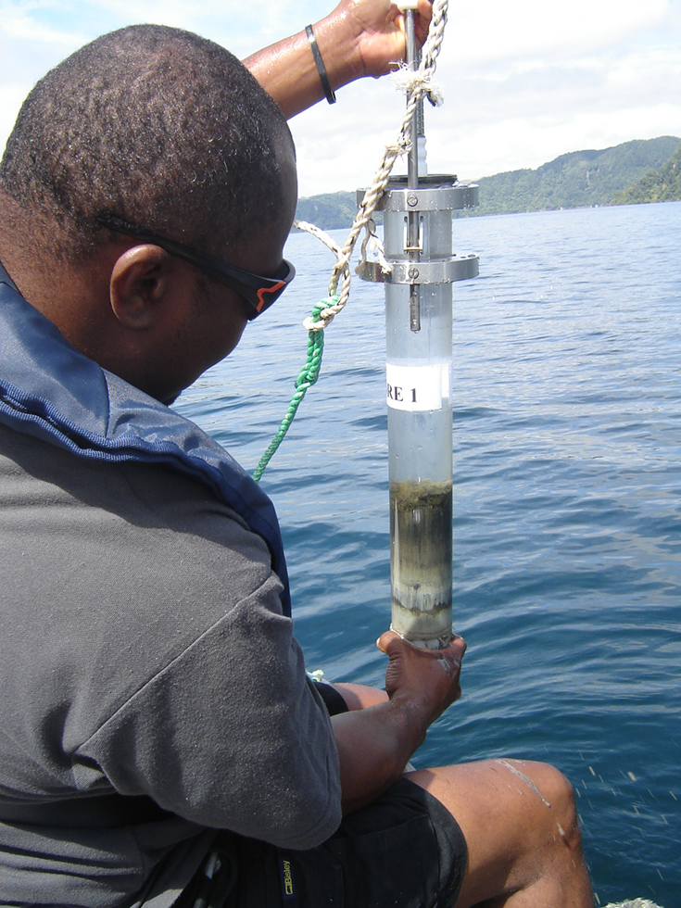

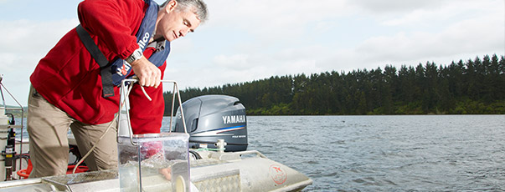
Lake Okataina-The field laboratory
Paleolimnology
Long-term monitoring

Slide 10
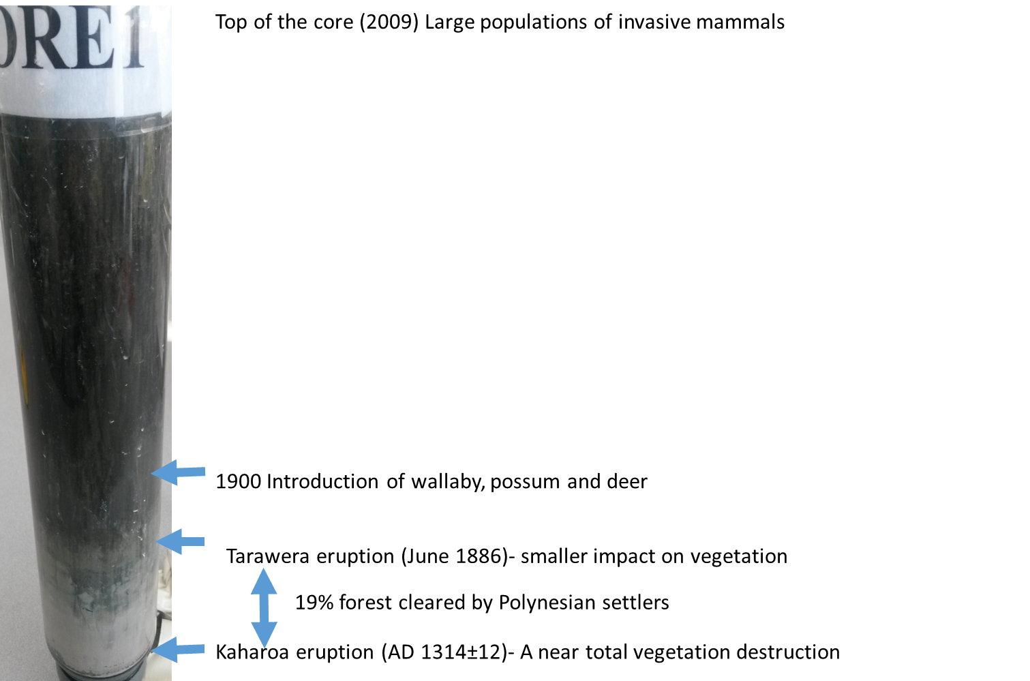
Lake Okataina-Watershed history
Organic and inorganic sedimentary geochemical proxies were analysed

Slide 11
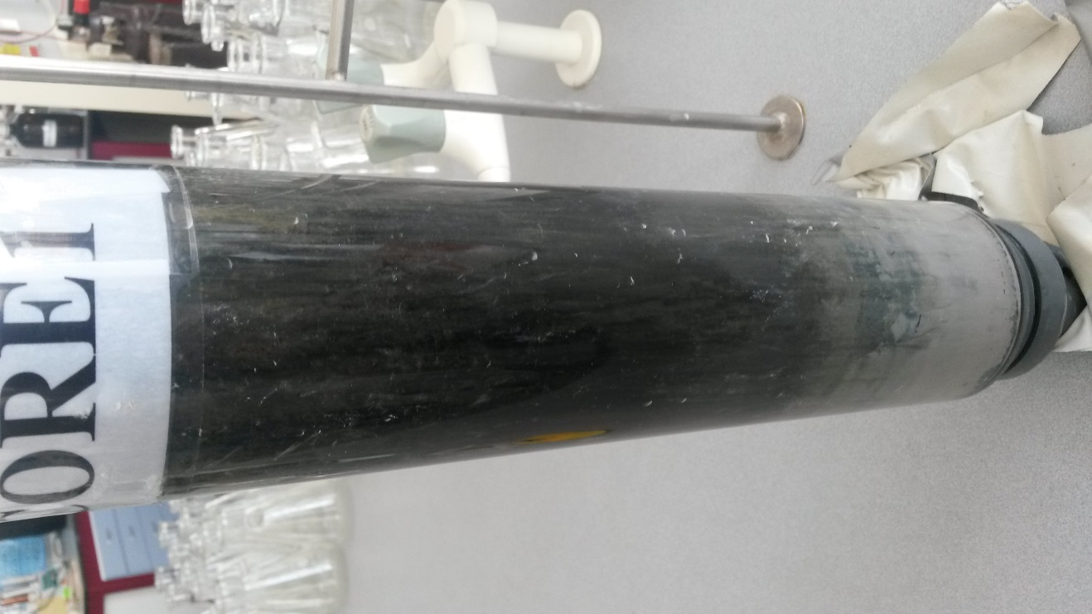
  Extracting Sedimentary archive
Core dating ( tephrochronology and ²¹⁰Pb dating)
Phosphorus was sequentially extracted from core slices
P fractions were calculated as percentage of the total extractable pool
Algal pigments were extracted and calculated as a percentage of chlorophyll a

Slide 12
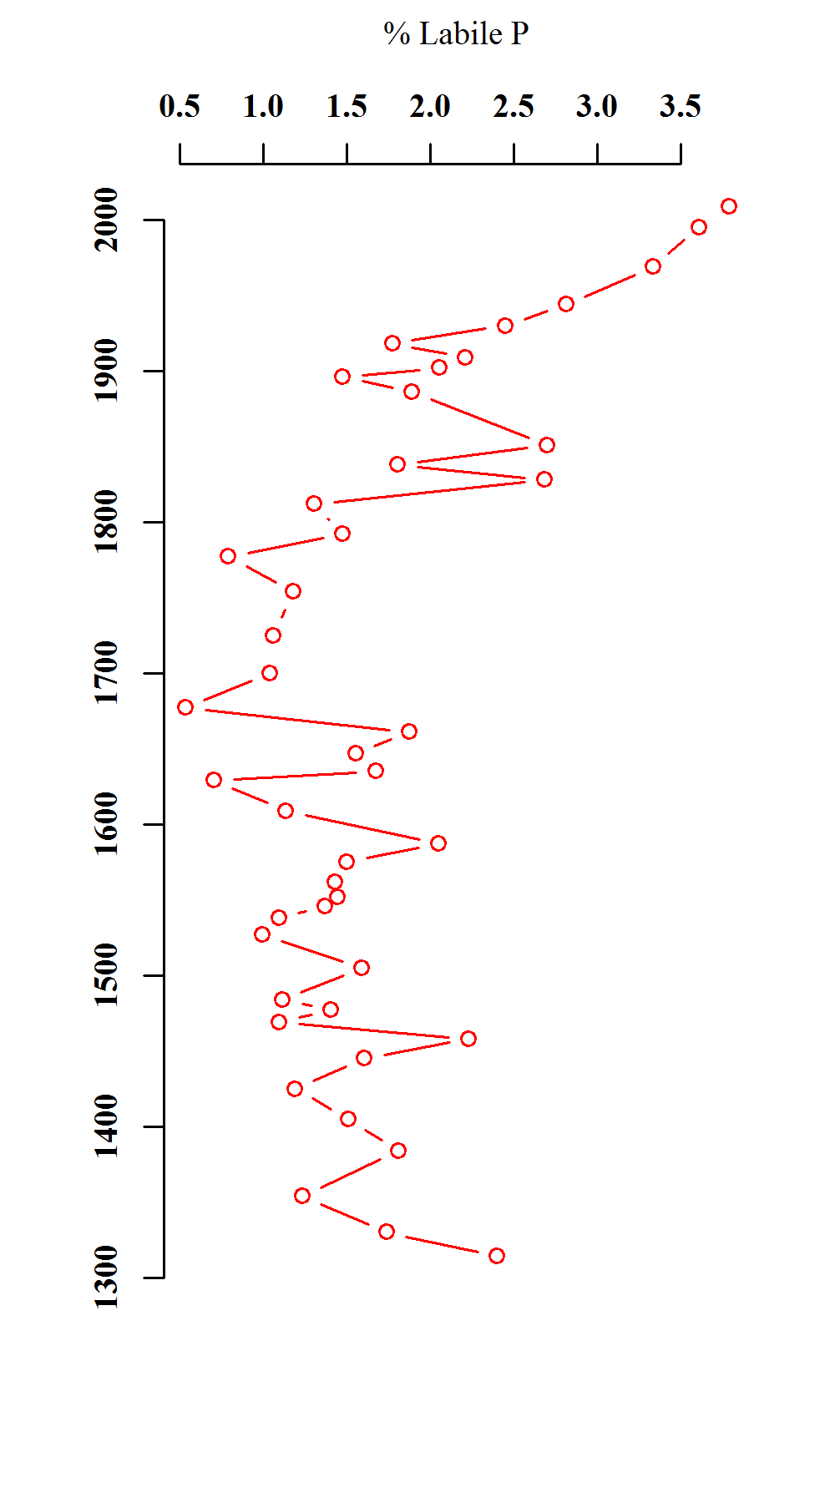
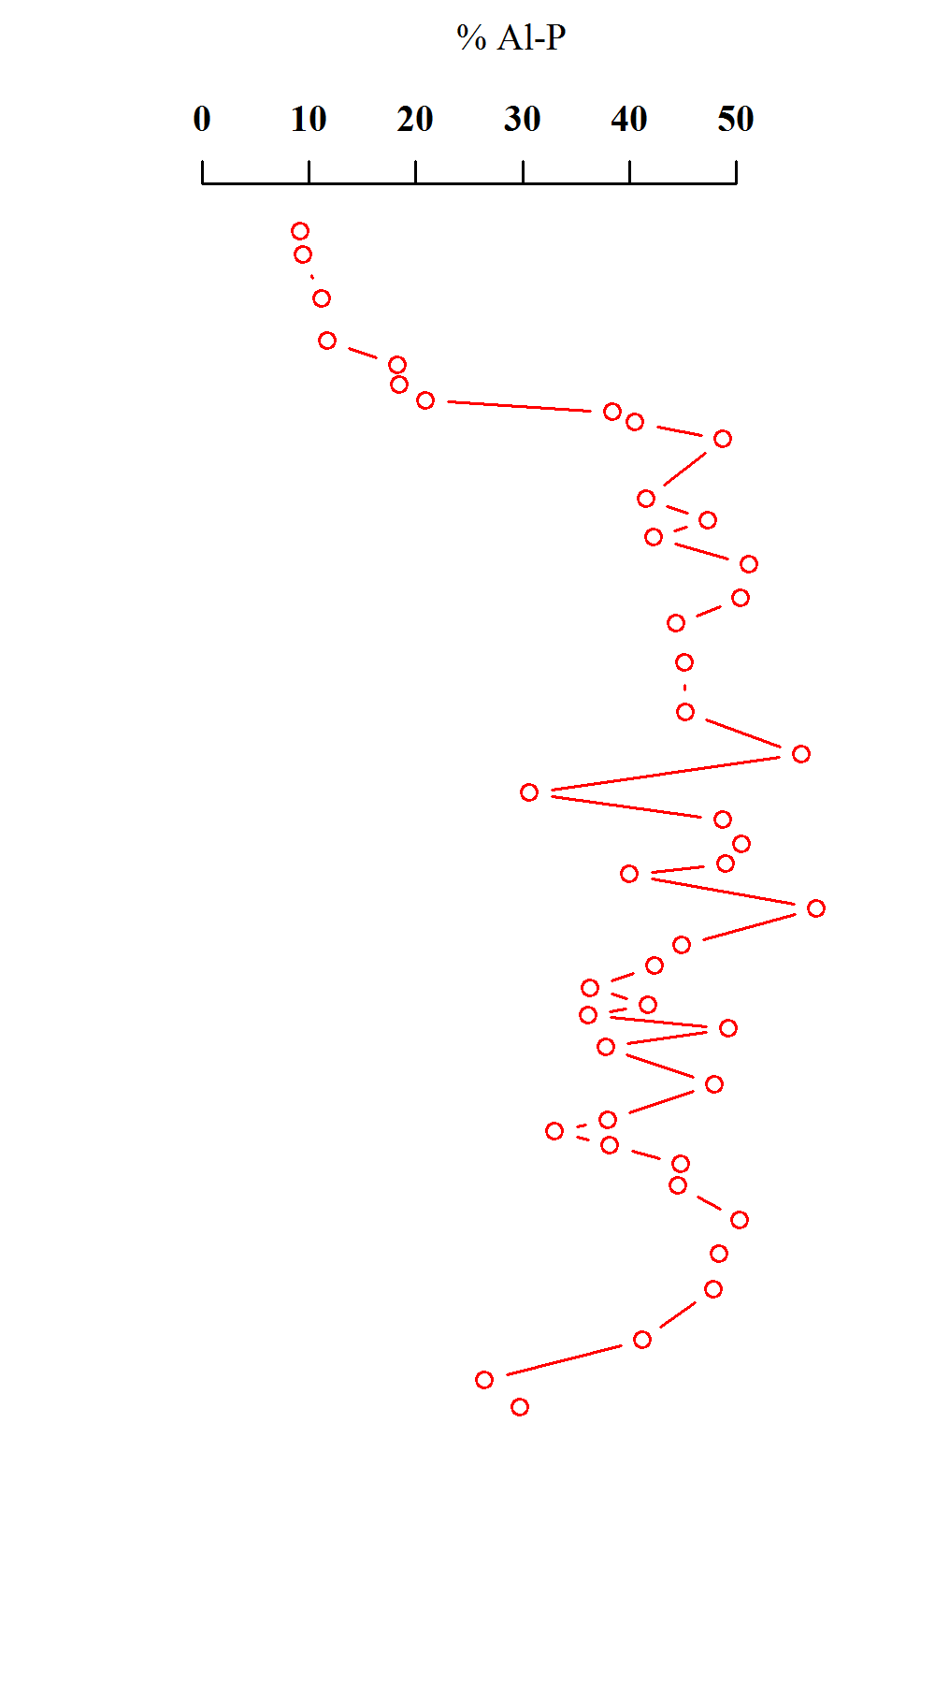
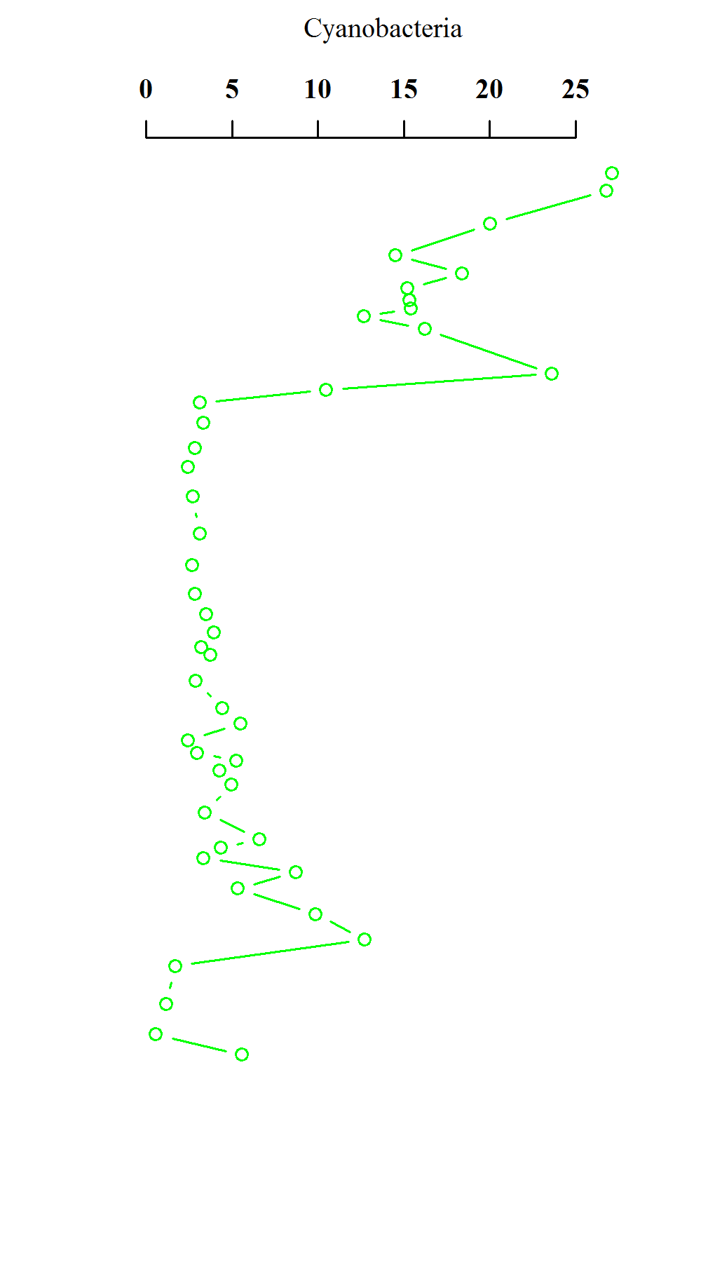
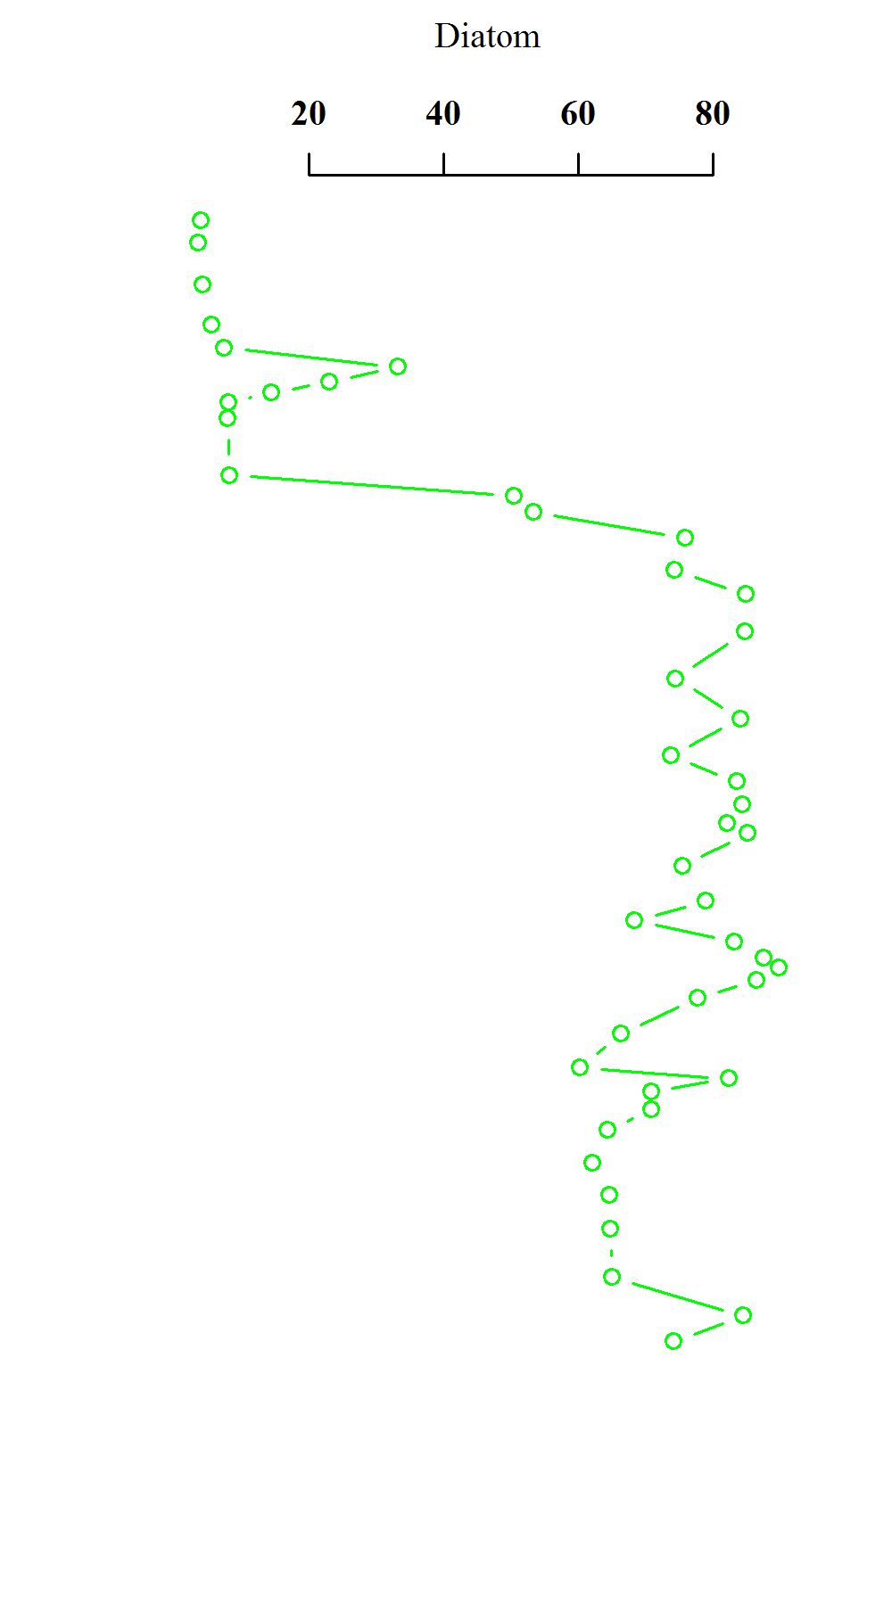
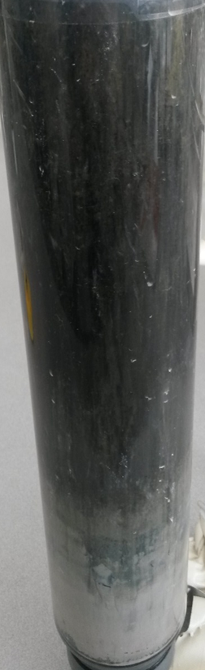
  Dynamics in Phosphorus speciation in sediment core

Slide 13
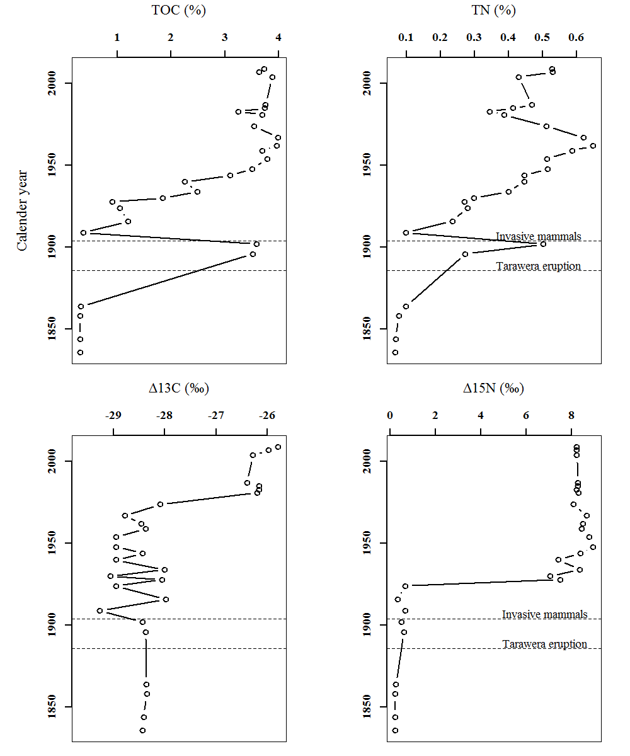
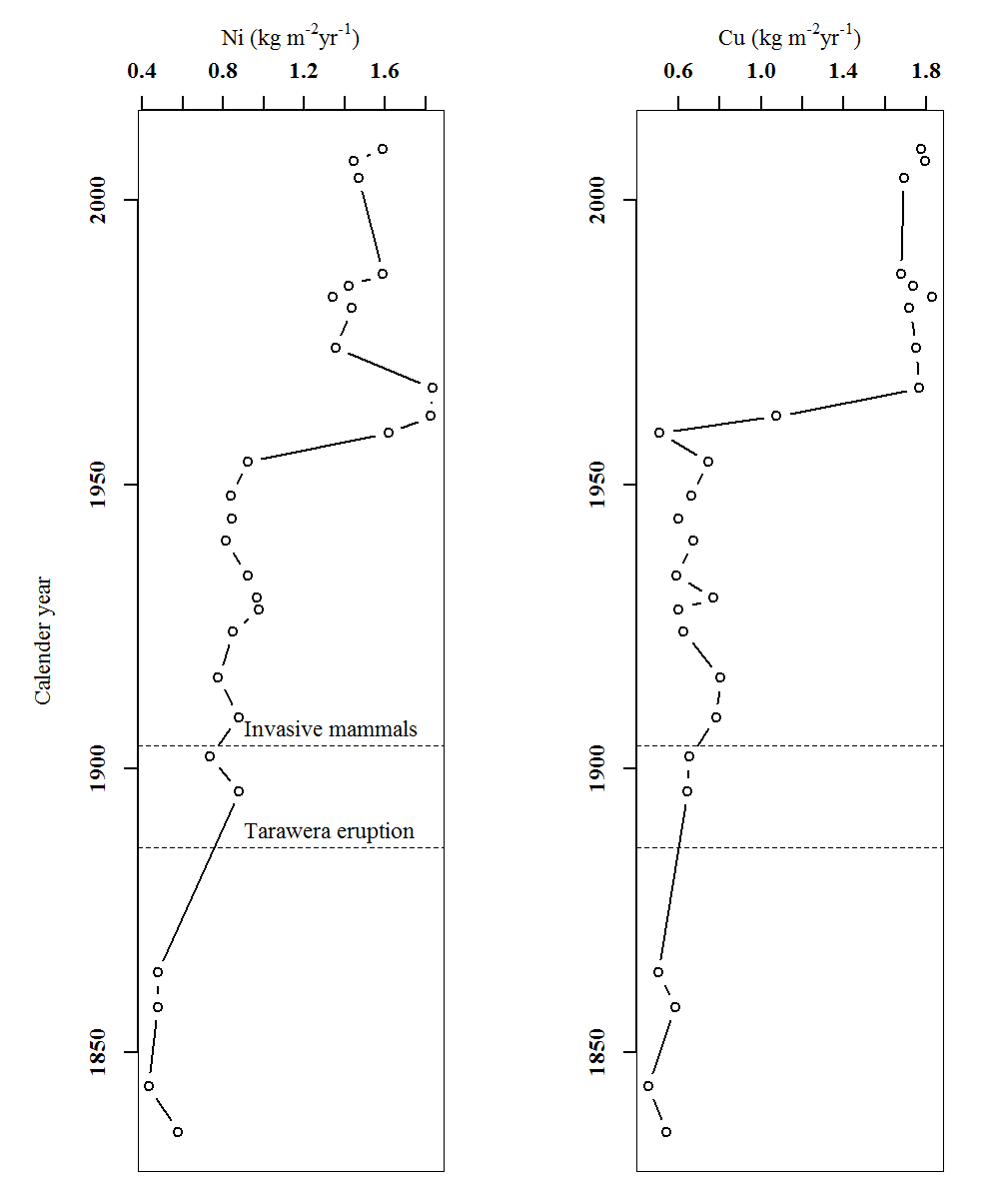
Organic matter loading after Tarawera eruption

Slide 14
Putting this in perspective
Eruptions/invasive mammals/climate
Erosion
Nutrients in lakes

Slide 15
Implications and conclusion
Invasive mammals have become the “new normal” in New Zealand catchments
dominance by westerly and south-westerly winds and less precipitation in the Central North Island of New Zealand
Projected temperature increase for the Rotorua region by 2100 is 2.5° C

Slide 16
As a consequence…………
We might see more of this

Slide 17
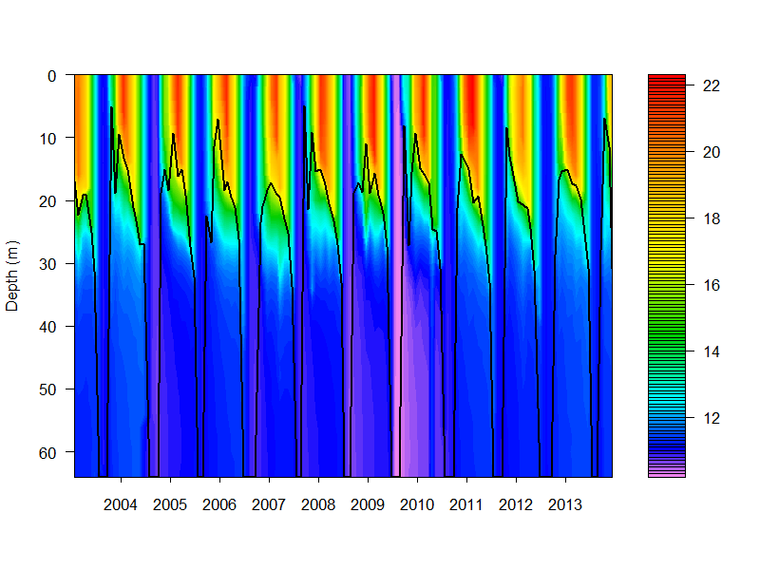
As a consequence…………
If the net effect between the westerly winds and temperature increase equal increased stratification,

Slide 18
Thank you

